Slide 1
Responsive Reading:
Exodus 26:1-9
Notes:
<number>
<number>
<number>

Slide 2
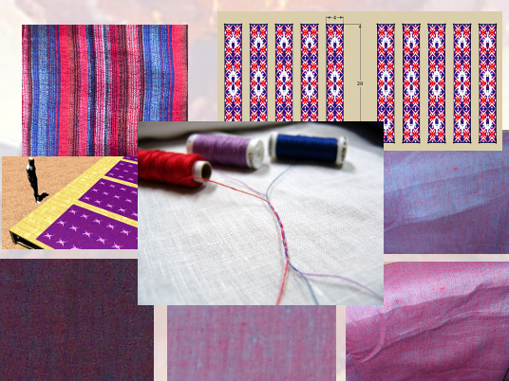
Moreover thou shalt make the tabernacle with ten curtains of ﬁne twined linen,

Slide 3
and blue, and purple, and scarlet:

Slide 4
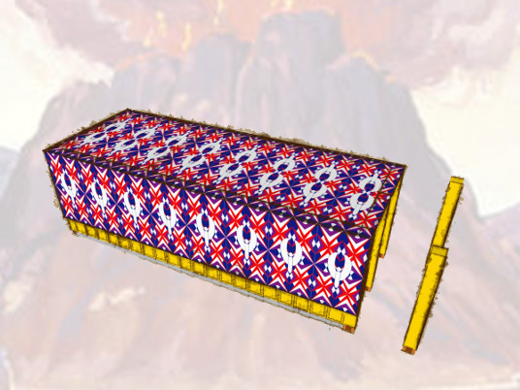
with cherubims of cunning work shalt thou make them.

Slide 5
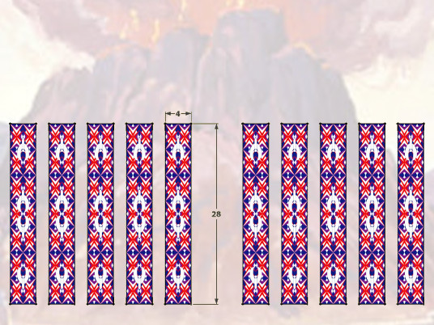
The length of one curtain shall be eight and twenty cubits,

Slide 6
and the breadth of one curtain four cubits:

Slide 7
and every one of the curtains shall have one measure

Slide 8
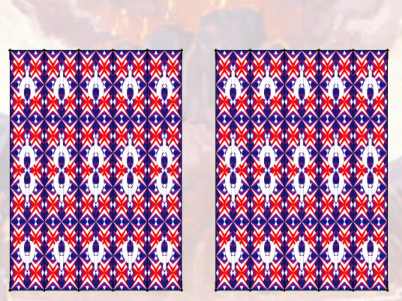
The ﬁve curtains shall be coupled together one to another;

Slide 9
and other ﬁve curtains shall be coupled one to another.

Slide 10
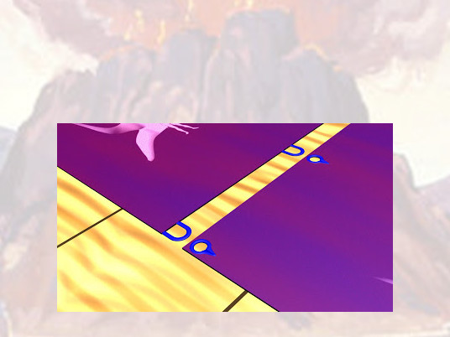
And thou shalt make loops of blue upon the edge of the one curtain

Slide 11
from the selvedge in the coupling;

Slide 12
and likewise shalt thou make in the uttermost edge of another curtain,

Slide 13
in the coupling of the second.

Slide 14
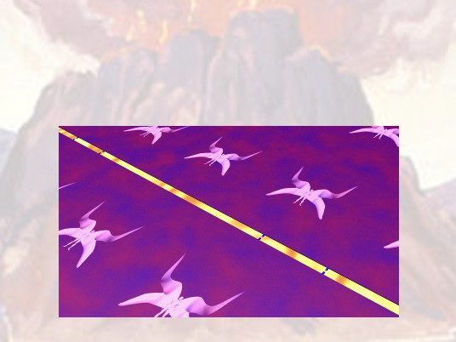
Fifty loops shalt thou make in the one curtain,

Slide 15
and ﬁfty loops shalt thou make in the edge of the curtain that is in the coupling of the second;

Slide 16
that the loops may take hold one of another.

Slide 17
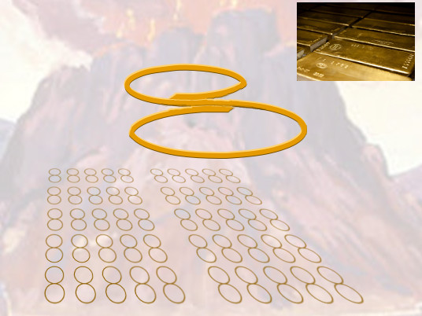
And thou shalt make ﬁfty taches of gold, and couple the curtains together with the taches:

Slide 18
and it shall be one tabernacle.

Slide 19
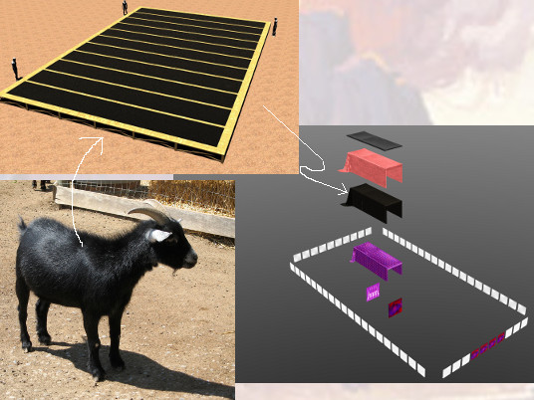
And thou shalt make curtains of goats hair to be a covering upon the tabernacle:

Slide 20
eleven curtains shalt thou make.

Slide 21
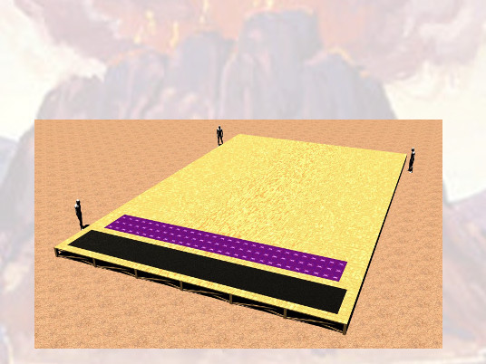
The length of one curtain shall be thirty cubits, and the breadth of one curtain four cubits:

Slide 22
and the eleven curtains shall be all of one measure.

Slide 23
Responsive Reading:
Exodus 26:10 – 26:17
Notes:
<number>
<number>
<number>

Slide 24
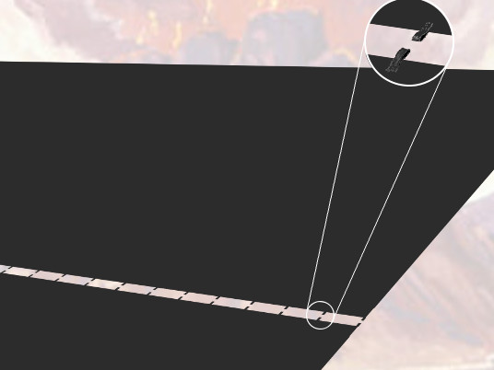
And thou shalt make ﬁfty loops on the edge of the one curtain that is outmost

Slide 25
in the coupling, and ﬁfty loops in the edge of the curtain which coupleth the second

Slide 26
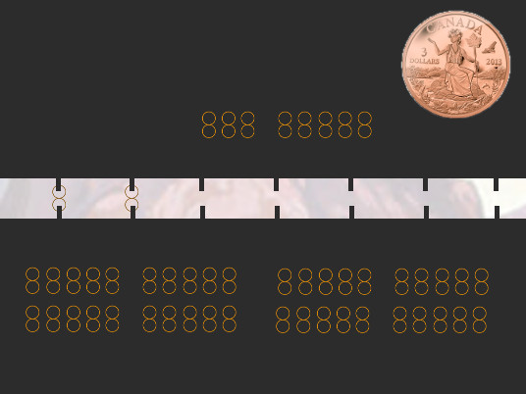
And thou shalt make ﬁfty taches of brass, and put the taches into the loops,

Slide 27
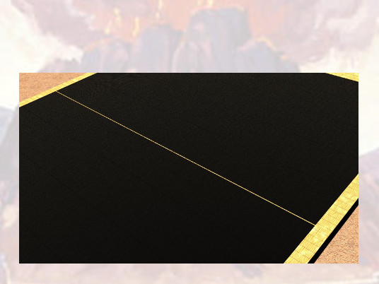
and couple the tent together, that it may be one

Slide 28
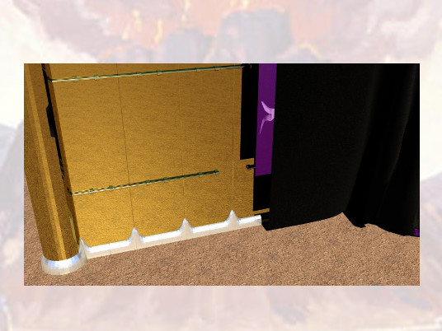
And the remnant that remaineth of the curtains of the tent, the half curtain that remaineth,

Slide 29
shall hang over the backside of the tabernacle.

Slide 30
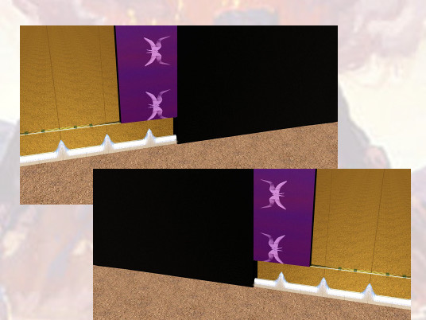
And a cubit on the one side,

Slide 31
and a cubit on the other side of that which remaineth in the length of the curtains of the tent,

Slide 32
it shall hang over the sides of the tabernacle on this side and on that side, to cover it.

Slide 33
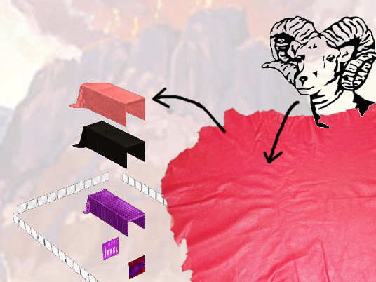
And thou shalt make a covering for the tent of rams skins dyed red,

Slide 34
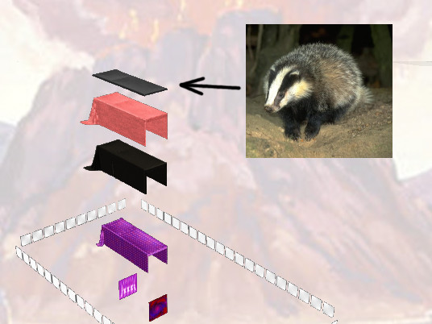
and a covering above of badgers skins.

Slide 35
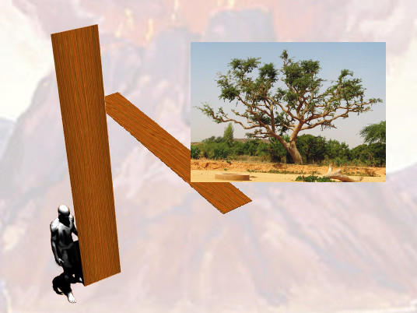
And thou shalt make boards for the tabernacle of shittim wood standing up.

Slide 36
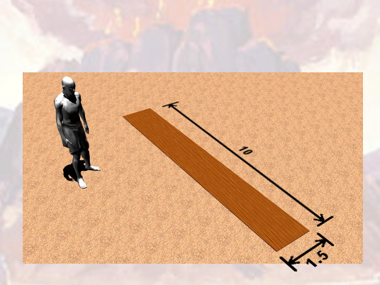
Ten cubits shall be the length of a board,

Slide 37
and a cubit and a half shall be the breadth of one board.

Slide 38
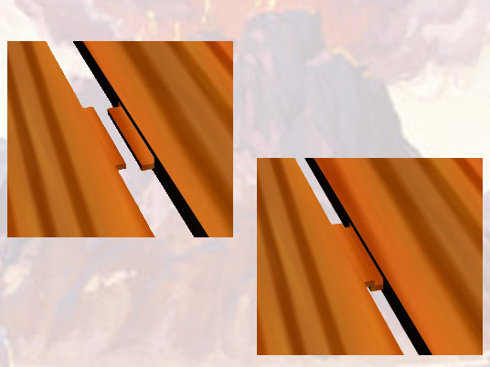
Two tenons shall there be in one board, set in order one against another:

Slide 39
thus shalt thou make for all the boards of the tabernacle.

Slide 40
Responsive Reading:
Exodus 26:18 – 26:25
Notes:
<number>
<number>
<number>

Slide 41
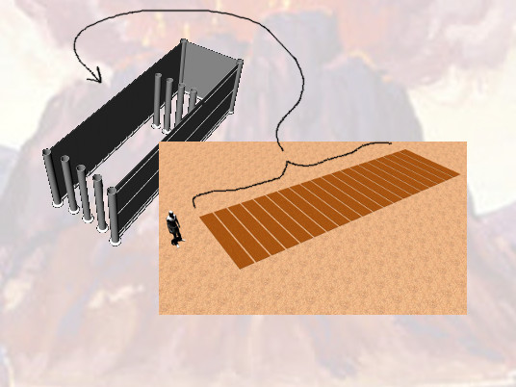
And thou shalt make the boards for the tabernacle,

Slide 42
twenty boards on the south side southward.

Slide 43
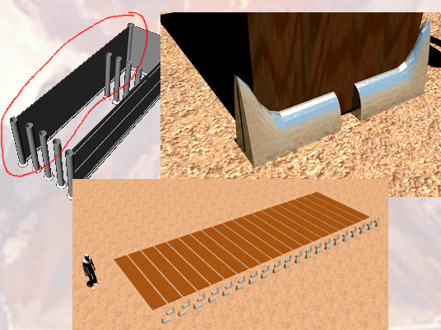
And thou shalt make forty sockets of silver under the twenty boards;

Slide 44
two sockets under one board for his two tenons,

Slide 45
and two sockets under another board for his two tenons.

Slide 46
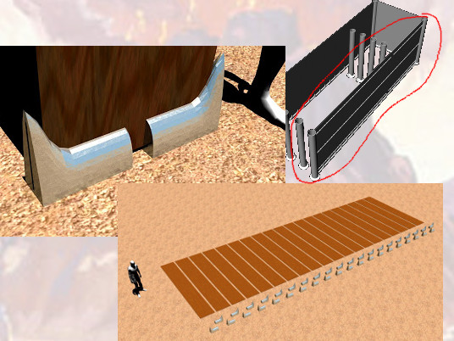
And for the second side of the tabernacle on the north side there shall be twenty boards:

Slide 47
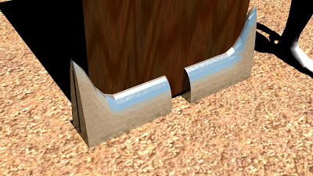
And their forty sockets of silver; two sockets under one board,

Slide 48
and two sockets under another board.

Slide 49
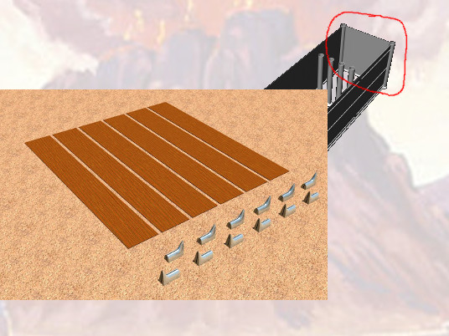
And for the sides of the tabernacle westward thou shalt make six boards.

Slide 50
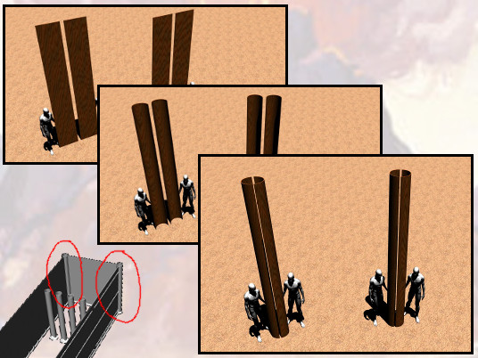
And two boards shalt thou make for the corners of the tabernacle in the two sides.

Slide 51
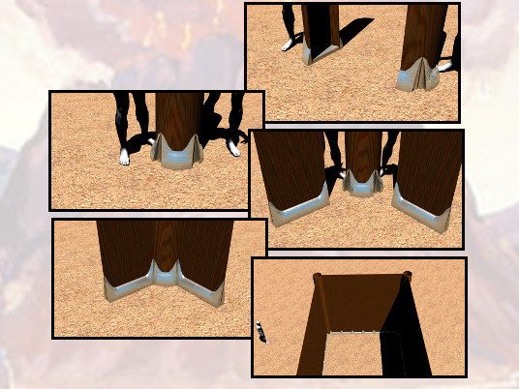
And they shall be coupled together beneath,

Slide 52
and they shall be coupled together above the head of it unto one ring:

Slide 53
thus shall it be for them both; they shall be for the two corners.

Slide 54
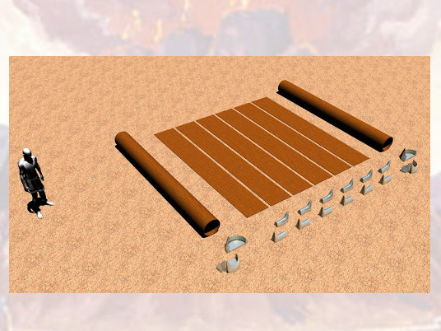
And they shall be eight boards, and their sockets of silver, sixteen sockets;

Slide 55
two sockets under one board, and two sockets under another board.

Slide 56
Responsive Reading:
Exodus 26:26 – 26:33
Notes:
<number>
<number>
<number>

Slide 57
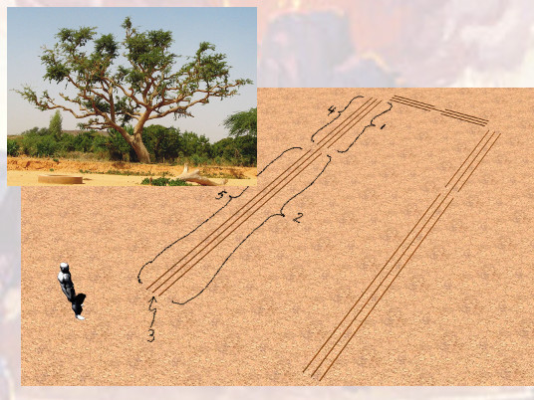
And thou shalt make bars of shittim wood; ﬁve for the boards of the one side of the tabernacle,

Slide 58
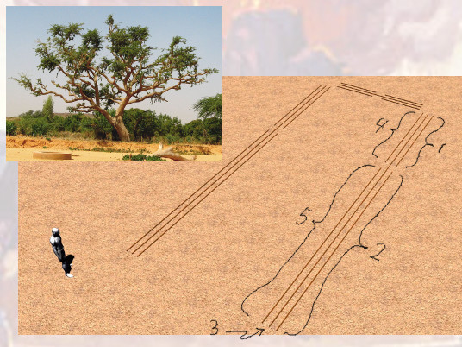
And ﬁve bars for the boards of the other side of the tabernacle,

Slide 59
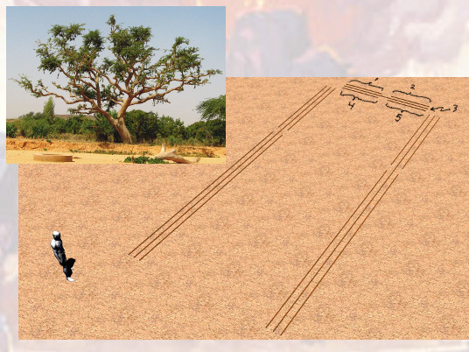
and ﬁve bars for the boards of the side of the tabernacle, for the two sides westward.

Slide 60
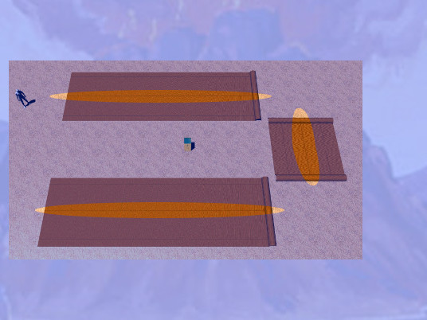
And the middle bar in the midst of the boards shall reach from end to end.

Slide 61
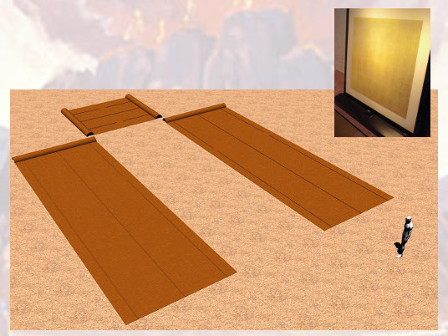
And thou shalt overlay the boards with gold,

Slide 62
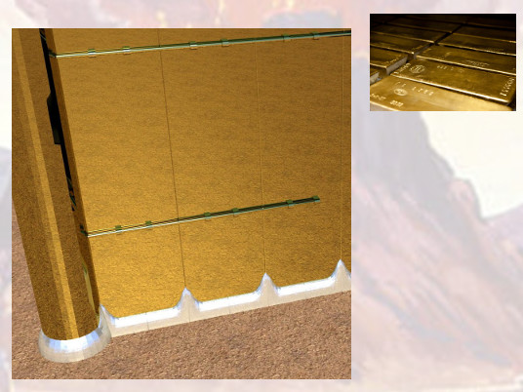
and make their rings of gold for places for the bars:

Slide 63
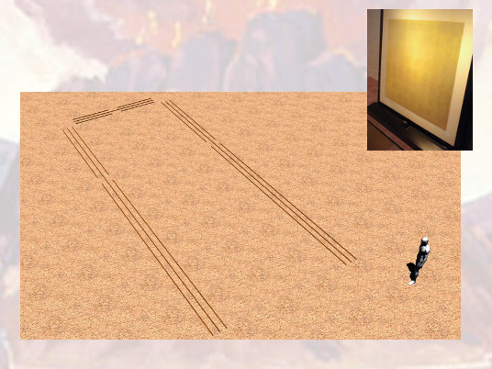
and thou shalt overlay the bars with gold.

Slide 64
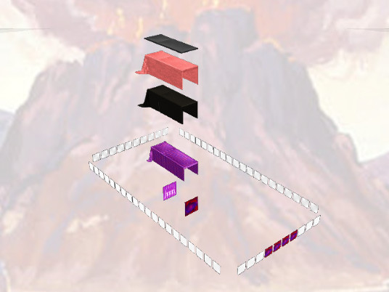
And thou shalt rear up the tabernacle

Slide 65
according to the fashion thereof which was shewed thee in the mount.

Slide 66
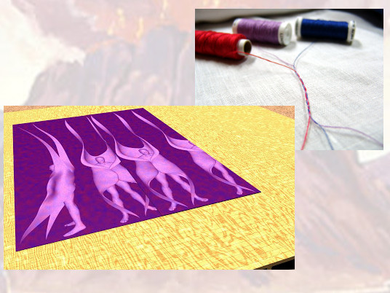
And thou shalt make a vail of blue, and purple, and scarlet,

Slide 67
and ﬁne twined linen of cunning work: with cherubims shall it be made

Slide 68
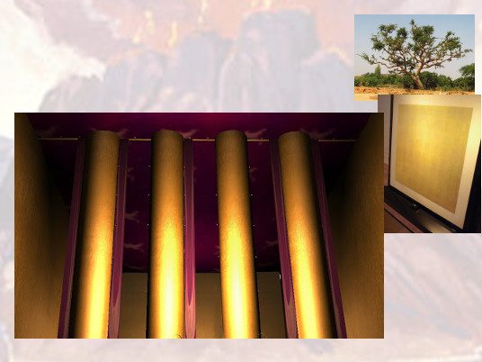
And thou shalt hang it upon four pillars of shittim wood overlaid with gold:

Slide 69
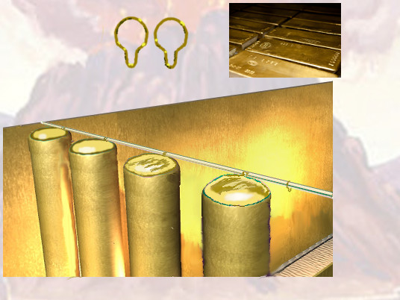
their hooks shall be of gold,

Slide 70
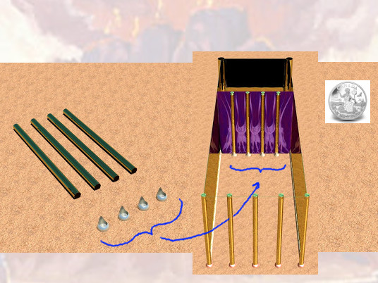
upon the four sockets of silver.

Slide 71
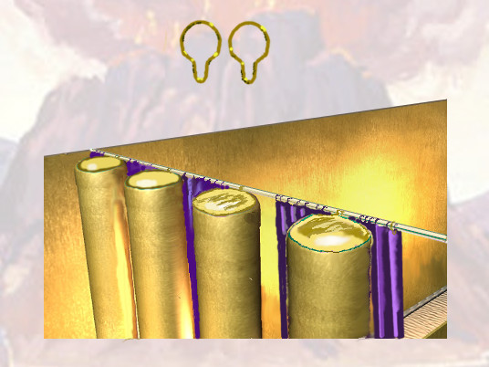
And thou shalt hang up the vail under the taches,

Slide 72
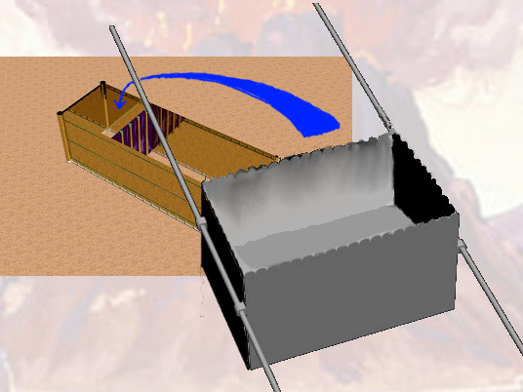
that thou mayest bring in thither within the vail the ark of the testimony:

Slide 73
and the vail shall divide unto you between the holy place and the most holy

Slide 74
Responsive Reading:
Exodus 26:34 – 26:37
Notes:
<number>
<number>
<number>

Slide 75
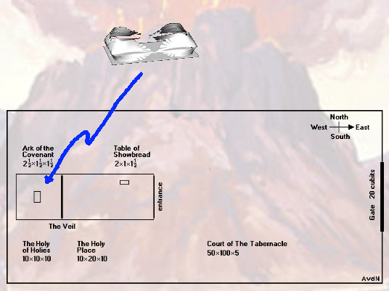
And thou shalt put the mercy seat upon the ark of the testimony in the most holy place.

Slide 76
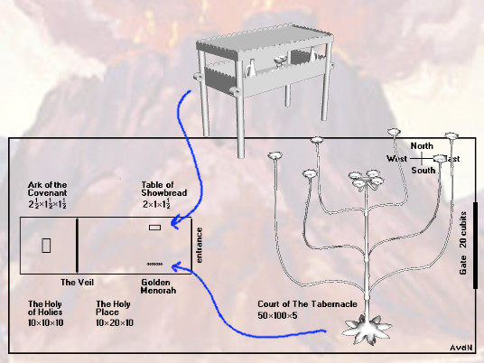
And thou shalt set the table without the vail, and the

Slide 77
candlestick over against the table on the side of the tabernacle toward the south:

Slide 78
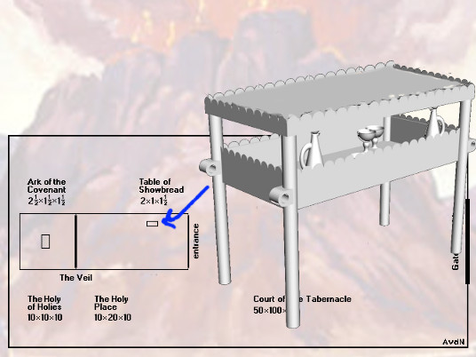
and thou shalt put the table on the north side.

Slide 79
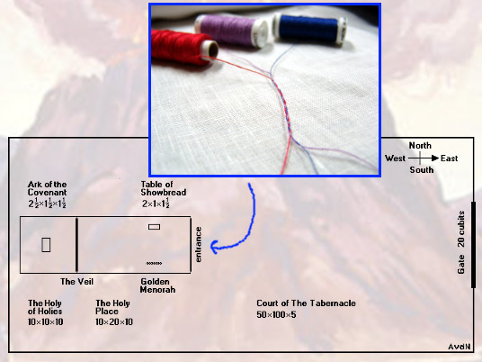
And thou shalt make an hanging for the door of the tent,

Slide 80
of blue, and purple, and scarlet, and ﬁne twined linen, wrought with needlework.

Slide 81
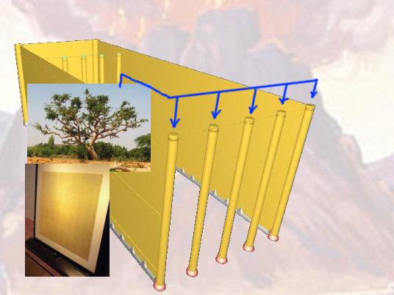
And thou shalt make for the hanging ﬁve pillars of shittim wood,

Slide 82
and overlay them with gold,

Slide 83
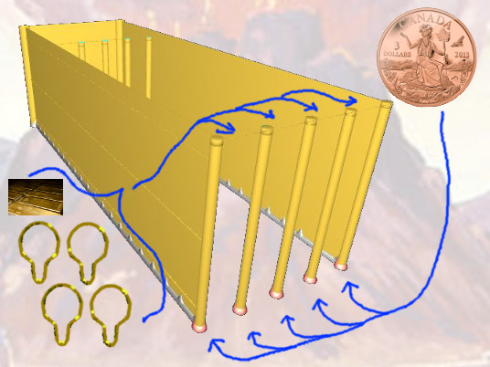
and their hooks shall be of gold: and thou shalt cast ﬁve sockets of brass for them.

