Slide 1
Responsive Reading:
Read white verses
Platform Elder
Exodus 28:1 – 28:7
Notes:
<number>
<number>
<number>

Slide 2
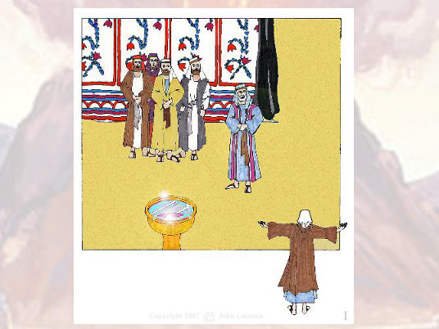
And take thou unto thee Aaron thy brother, and his sons with him,

Slide 3
from among the children of Israel, that he may minister unto me in the priests oﬃce,

Slide 4
even Aaron, Nadab and Abihu, Eleazar and Ithamar, Aarons sons.

Slide 5
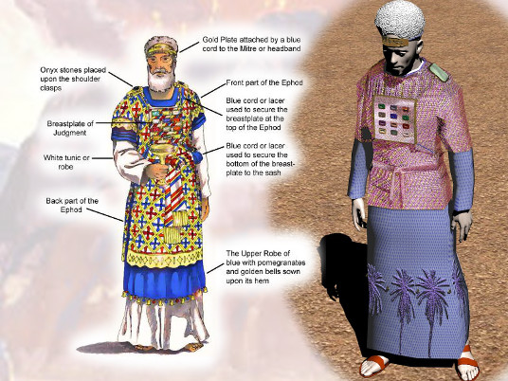
And thou shalt make holy garments for Aaron thy brother for glory and for beauty.

Slide 6
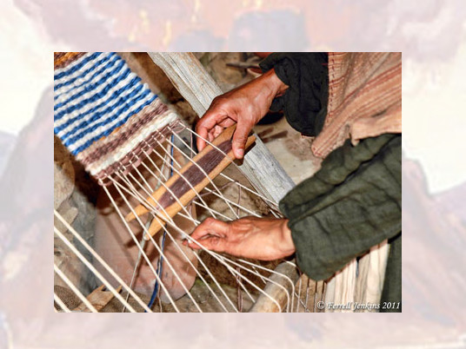
And thou shalt speak unto all that are wise hearted, whom I have ﬁlled with the spirit of wisdom,

Slide 7
that they may make Aarons garments to consecrate him,

Slide 8
that he may minister unto me in the priests oﬃce.

Slide 9
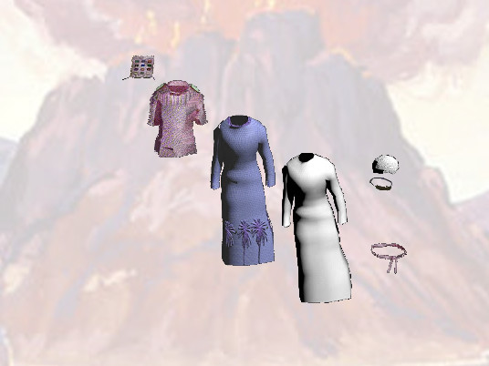
And these are the garments which they shall make;

Slide 10
breastplate, and an ephod, and a robe, and a broidered coat, a mitre, and a girdle:

Slide 11
and they shall make holy garments for Aaron thy brother, and his sons,

Slide 12
that he may minister unto me in the priests oﬃce.

Slide 13
And they shall take gold, and blue, and purple, and scarlet, and ﬁne linen

Slide 14
And they shall make the ephod of gold, of blue, and of purple, of scarlet,

Slide 15
and ﬁne twined linen, with cunning work.

Slide 16
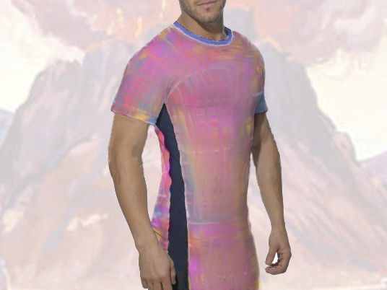
It shall have the two shoulderpiecs thereof joined at the two edges thereof;

Slide 17
and so it shall be joined together.

Slide 18
Responsive Reading:
Exodus 28:8 – 28:15
Notes:
<number>
<number>
<number>

Slide 19
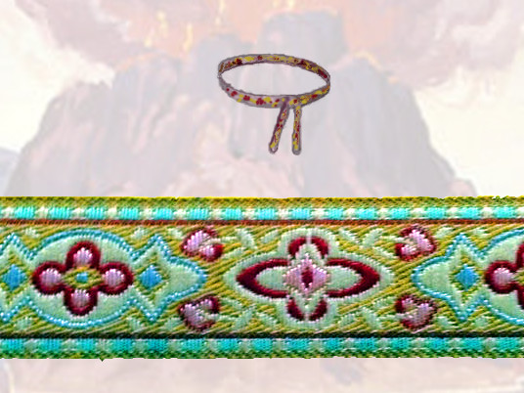
And the curious girdle of the ephod, which is upon it, shall be of the same,

Slide 20
according to the work thereof;

Slide 21
even of gold, of blue, and purple, and scarlet, and ﬁne twined linen

Slide 22
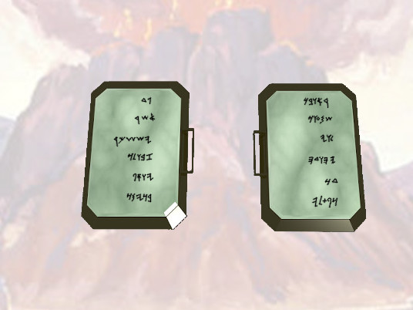
And thou shalt take two onyx stones, and grave on them the names of the children of Israel

Slide 23
Six of their names on one stone,

Slide 24
and the other six names of the rest on the other stone, according to their birth.

Slide 25
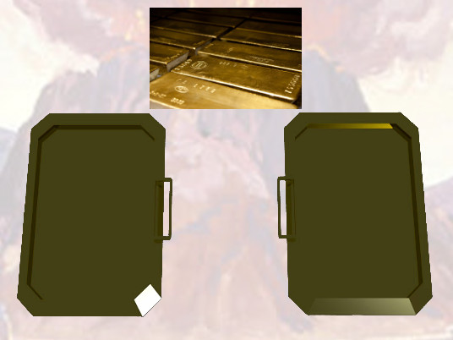
With the work of an engraver in stone, like the engravings of a signet,

Slide 26
shalt thou engrave the two stones with the names of the children of Israel:

Slide 27
thou shalt make them to be set in ouches of gold.

Slide 28
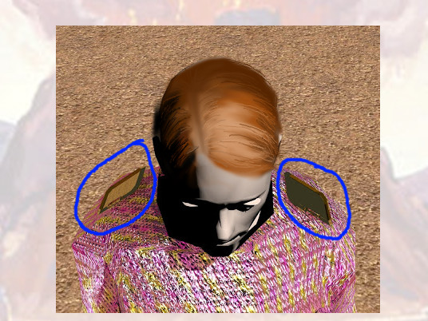
And thou shalt put the two stones upon the shoulders of the ephod

Slide 29
for stones of memorial unto the children of Israel:

Slide 30
and Aaron shall bear their names before the LORD upon his two shoulders for a memorial.

Slide 31
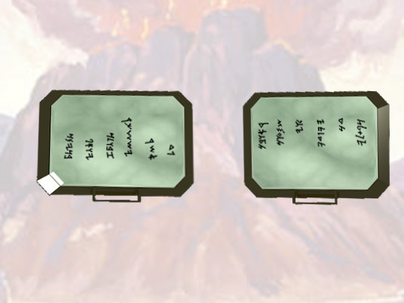
And thou shalt make ouches of gold;

Slide 32
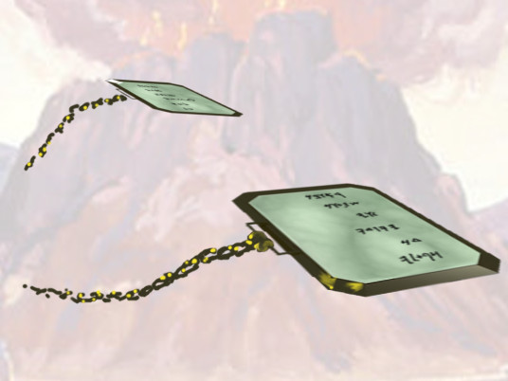
And two chains of pure gold at the ends;

Slide 33
of wreathen work shalt thou make them,

Slide 34
and fasten the wreathen chains to the ouches.

Slide 35
And thou shalt make the breastplate of judgment with cunning work;

Slide 36
after the work of the ephod thou shalt make it;

Slide 37
of gold, of blue, and of purple, and of scarlet, and of ﬁne twined linen, shalt thou make it.

Slide 38
Responsive Reading:
Exodus 27:16 – 28:23
Notes:
<number>
<number>
<number>

Slide 39
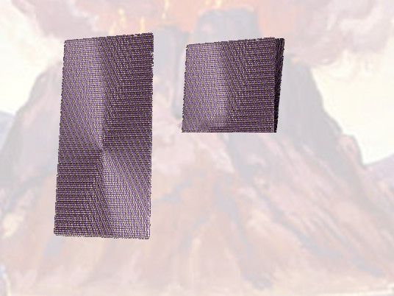
Foursquare it shall be being doubled;

Slide 40
a span shall be the length thereof, and a span shall be the breadth thereof.

Slide 41
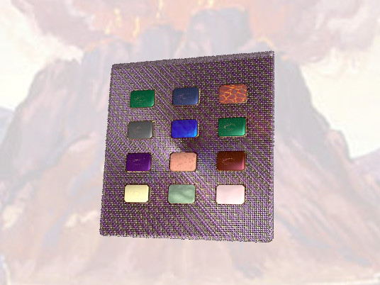
And thou shalt set in it settings of stones, even four rows of stones:

Slide 42
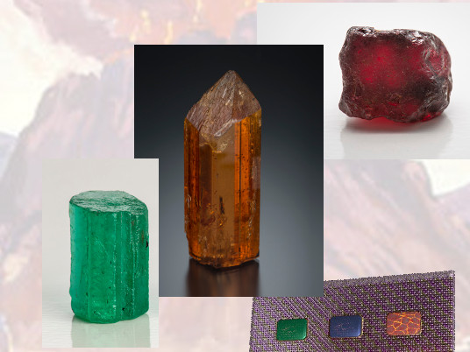
the ﬁrst row shall be a sardius, a topaz, and a carbuncle: this shall be the ﬁrst row.

Slide 43
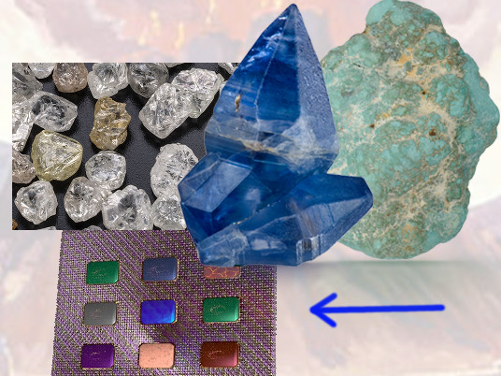
And the second row shall be an emerald, a sapphire, and a diamond.

Slide 44
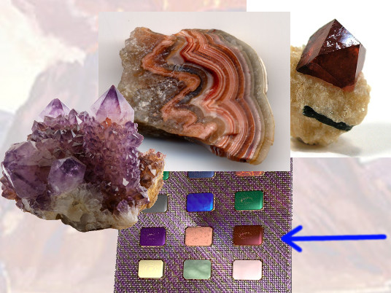
And the third row a ligure, an agate, and an amethyst.

Slide 45
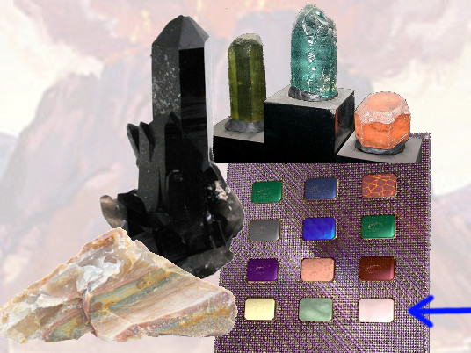
And the fourth row a beryl, and an onyx, and a jasper:

Slide 46
they shall be set in gold in their inclosings.

Slide 47
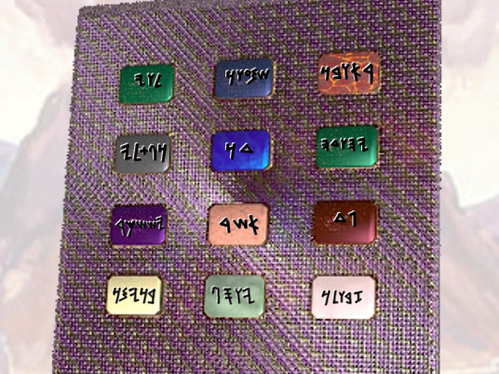
And the stones shall be with the names of the children of Israel, twelve,

Slide 48
according to their names, like the engravings of a signet;

Slide 49
every one with his name shall they be according to the twelve tribes.

Slide 50
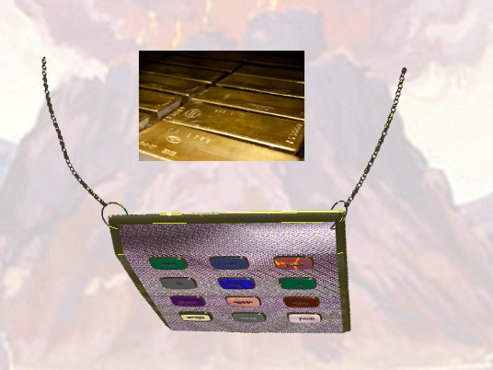
And thou shalt make upon the breastplate chains at the ends of wreathen work of pure gold.

Slide 51
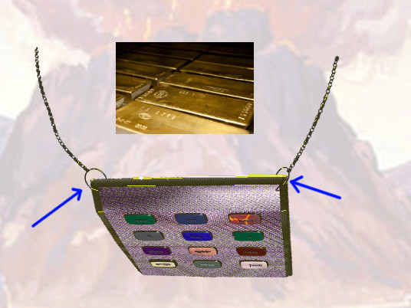
And thou shalt make upon the breastplate two rings of gold,

Slide 52
and shalt put the two rings on the two ends of the breastplate.

Slide 53
Responsive Reading:
Exodus 28:24 – 28:31
Notes:
<number>
<number>
<number>

Slide 54
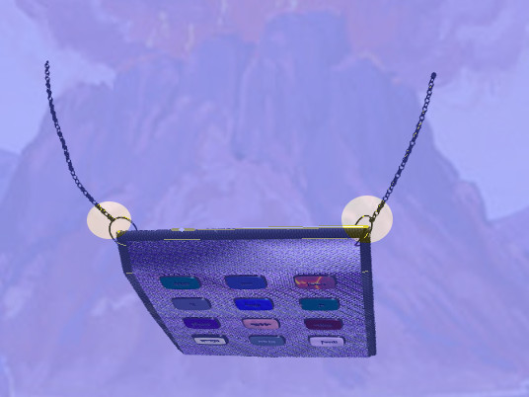
And thou shalt put the two wreathen chains of gold in the two rings

Slide 55
which are on the ends of the breastplate.

Slide 56
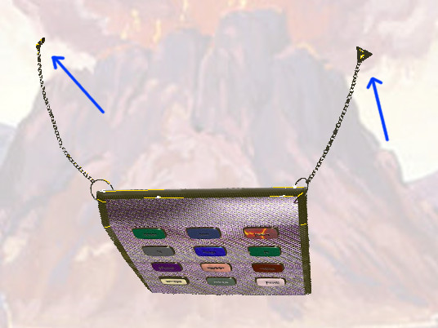
And the other two ends of the two wreathen chains thou shalt fasten in the two ouches,

Slide 57
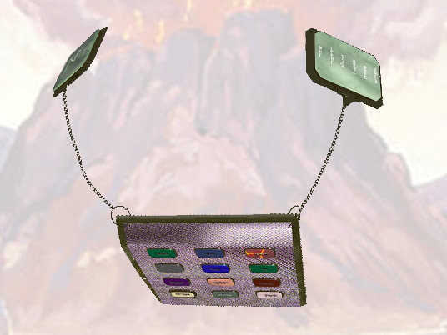
and put them on the shoulderpieces of the ephod before it.

Slide 58
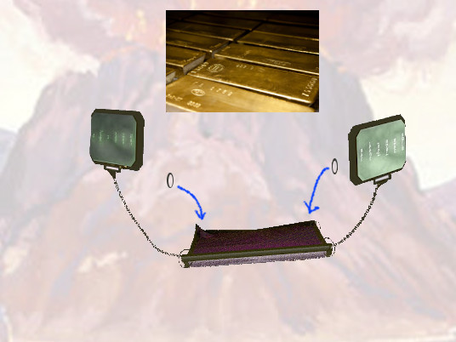
And thou shalt make two rings of gold, and thou shalt put them upon the two ends of the breastplate

Slide 59
in the border thereof, which is in the side of the ephod inward.

Slide 60
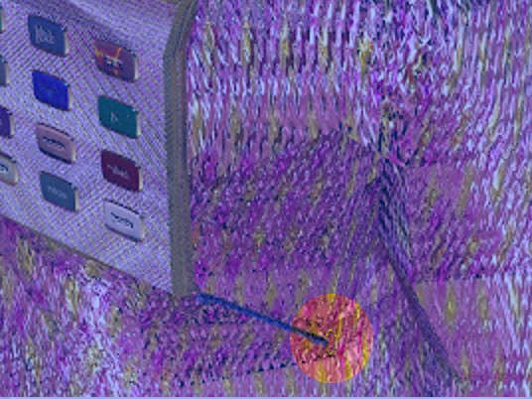
And two other rings of gold thou shalt make,

Slide 61
and shalt put them on the two sides of the ephod underneath,

Slide 62
toward the forepart thereof, over against the other coupling thereof,

Slide 63
above the curious girdle of the ephod.

Slide 64
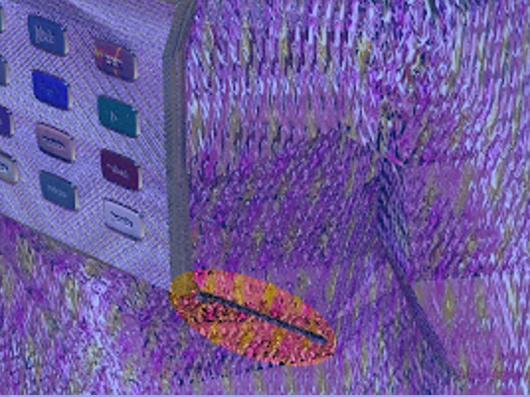
And they shall bind the breastplate by the rings thereof unto the rings of the ephod

Slide 65
with a lace of blue, that it may be above the curious girdle of the ephod,

Slide 66
and that the breastplate be not loosed from the ephod

Slide 67
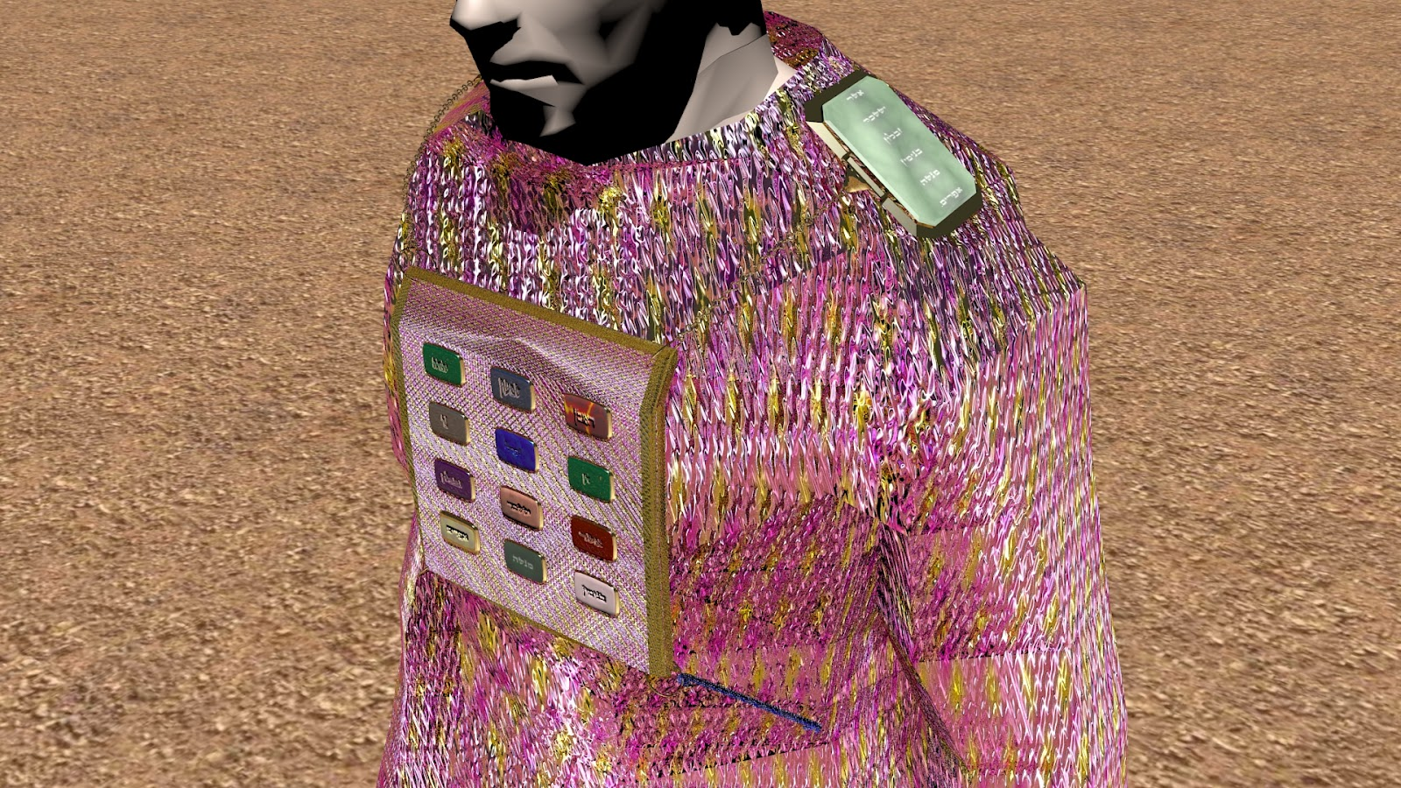
And Aaron shall bear the names of the children of Israel in the breastplate of judgment upon his heart,

Slide 68
when he goeth in unto the holy place, for a memorial before the LORD continually.

Slide 69
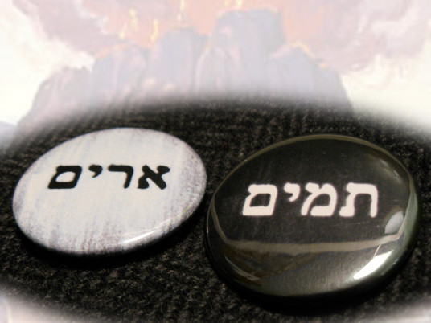
And thou shalt put in the breastplate of judgment the Urim and the Thummim;

Slide 70
and they shall be upon Aarons heart, when he goeth in before the LORD:

Slide 71
and Aaron shall bear the judgment of the children of Israel upon his heart

Slide 72
before the LORD continually.

Slide 73
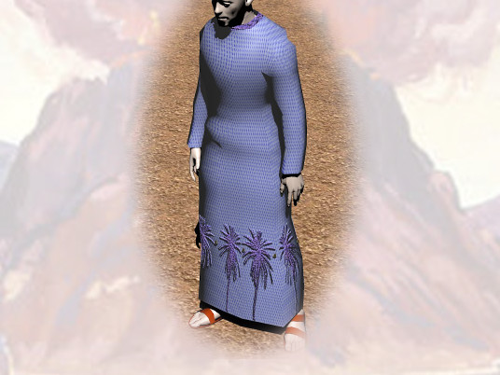
And thou shalt make the robe of the ephod all of blue.

Slide 74
Responsive Reading:
Exodus 28:32 – 28:39
Notes:
<number>
<number>
<number>

Slide 75
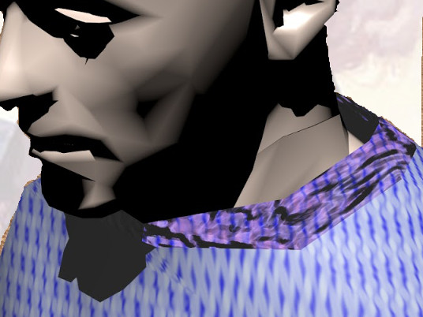
And there shall be an hole in the top of it, in the midst thereof:

Slide 76
it shall have a binding of woven work round about the hole of it,

Slide 77
as it were the hole of an habergeon, that it be not rent.

Slide 78
And beneath upon the hem of it thou shalt make pomegranates

Slide 79
of blue, and of purple, and of scarlet, round about the hem thereof;

Slide 80
and bells of gold between them round about:

Slide 81
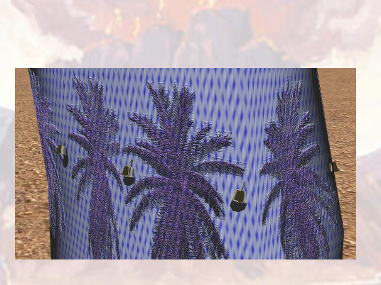
A golden bell and a pomegranate, a golden bell and a pomegranate,

Slide 82
upon the hem of the robe round about

Slide 83
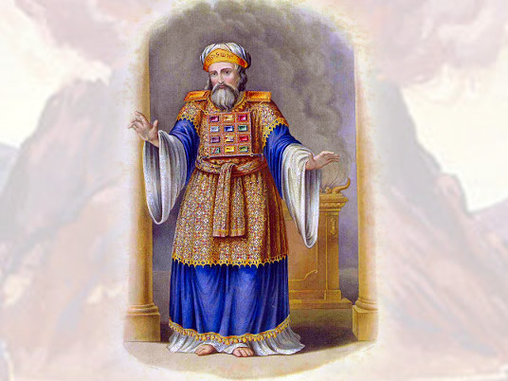
And it shall be upon Aaron to minister:

Slide 84
and his sound shall be heard when he goeth in unto the holy place before the LORD,

Slide 85
and when he cometh out, that he die not.

Slide 86
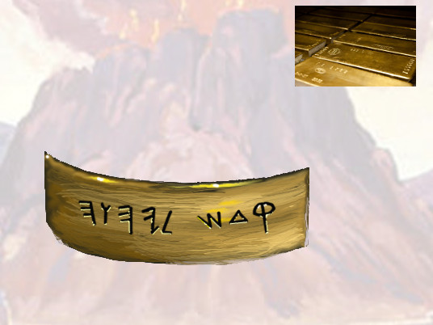
And thou shalt make a plate of pure gold,

Slide 87
and grave upon it, like the engravings of a signet, HOLINESS TO THE LORD.

Slide 88
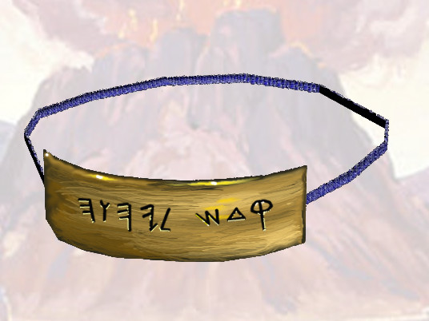
And thou shalt put it on a blue lace, that it may be upon the mitre;

Slide 89
upon the forefront of the mitre it shall be.

Slide 90
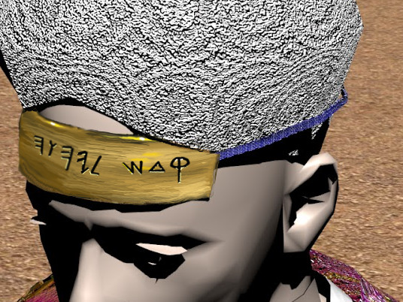
And it shall be upon Aarons forehead, that Aaron may bear the iniquity of the holy things,

Slide 91
which the children of Israel shall hallow in all their holy gifts; .

Slide 92
and it shall be always upon his forehead, that they may be accepted before the LORD.

Slide 93
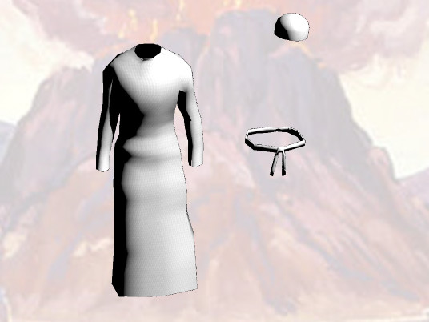
And thou shalt embroider the coat of ﬁne linen, and thou shalt make the mitre of ﬁne linen,

Slide 94
and thou shalt make the girdle of needlework.

Slide 95
Responsive Reading:
Read white verses
Platform Elder
Exodus 28:40 – 29:4
Notes:
<number>
<number>
<number>

Slide 96
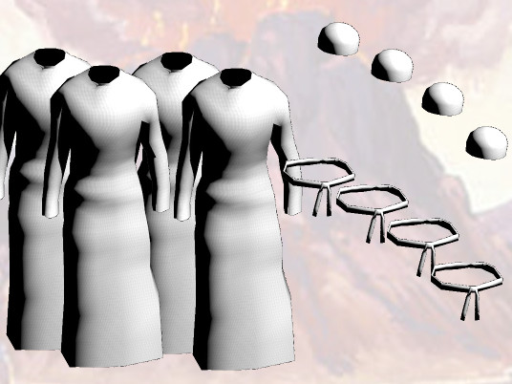
And for Aarons sons thou shalt make coats, and thou shalt make for them girdles,

Slide 97
and bonnets shalt thou make for them, for glory and for beauty.

Slide 98
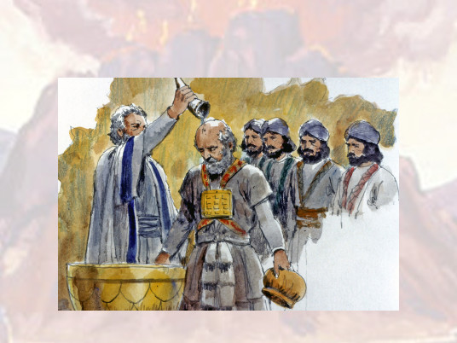
And thou shalt put them upon Aaron thy brother, and his sons with him;

Slide 99
and shalt anoint them, and consecrate them, and sanctify them,

Slide 100
that they may minister unto me in the priests oﬃce.

Slide 101
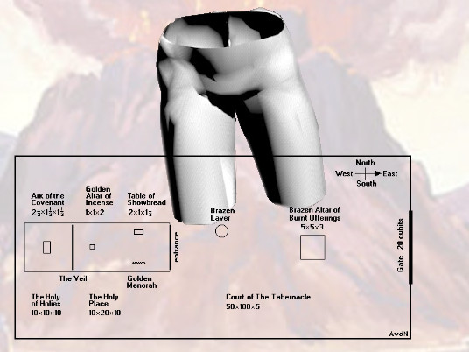
And thou shalt make them linen breeches to cover their nakedness;

Slide 102
from the loins even unto the thighs they shall reach:

Slide 103
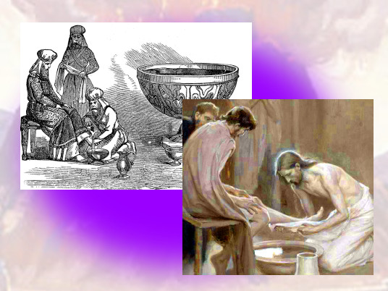
And they shall be upon Aaron, and upon his sons,

Slide 104
when they come in unto the tabernacle of the congregation,

Slide 105
or when they come near unto the altar to minister in the holy place;

Slide 106
that they bear not iniquity, and die: it shall be a statute for ever unto him and his seed after him.

