Slide 1
Responsive Reading:
Exodus 30:1 – 30:6
Notes:
<number>
<number>
<number>

Slide 2
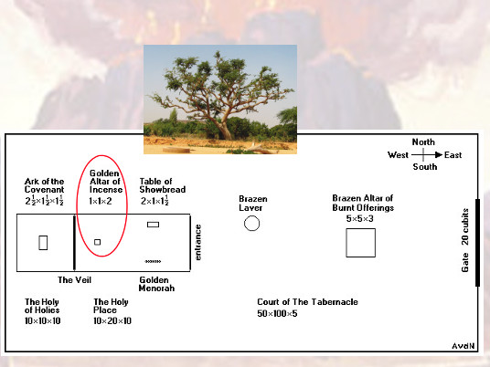
¹And thou shalt make an altar to burn incense upon: of shittim wood shalt thou make it.

Slide 3
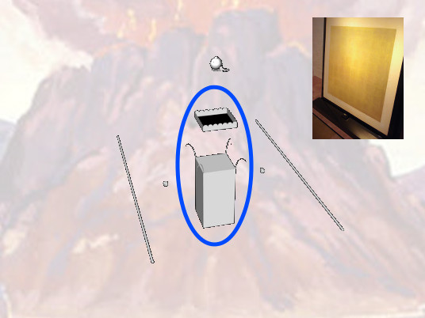
²A cubit shall be the length thereof, and a cubit the breadth thereof;

Slide 4
foursquare shall it be: and two cubits shall be the height thereof:

Slide 5
the horns thereof shall be of the same.

Slide 6
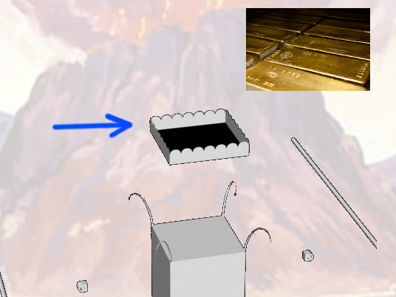
³And thou shalt overlay it with pure gold, the top thereof, and the sides thereof round about,

Slide 7
and the horns thereof; and thou shalt make unto it a crown of gold round about.

Slide 8
⁴And two golden rings shalt thou make to it under the crown of it,

Slide 9
by the two corners thereof, upon the two sides of it shalt thou make it;

Slide 10
and they shall be for places for the staves to bear it withal

Slide 11
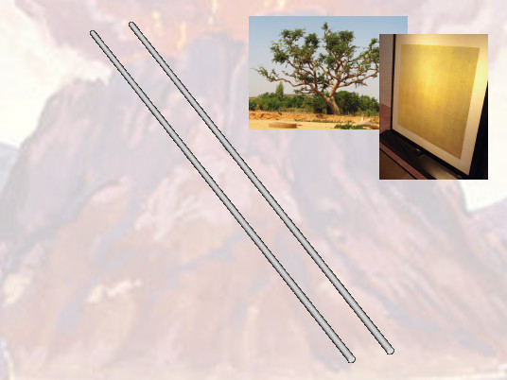
⁵And thou shalt make the staves of shittim wood, and overlay them with gold.

Slide 12
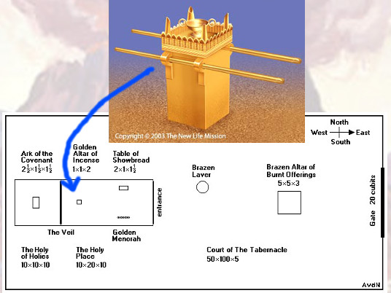
⁶And thou shalt put it before the vail that is by the ark of the testimony,

Slide 13
before the mercy seat that is over the testimony, where I will meet with thee.

Slide 14
Responsive Reading:
Exodus 30:7 – 30:14
Notes:
<number>
<number>
<number>

Slide 15
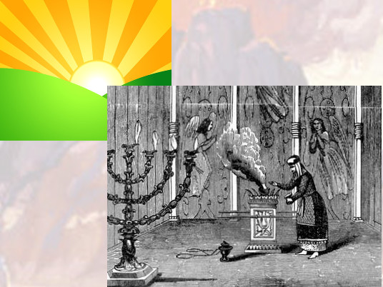
And Aaron shall burn thereon sweet incense every morning:

Slide 16
when he dresseth the lamps, he shall burn incense upon it.

Slide 17
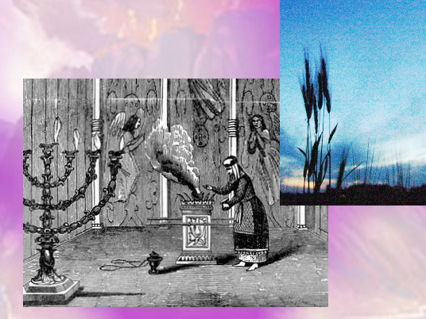
And when Aaron lighteth the lamps at even, he shall burn incense upon it,

Slide 18
a perpetual incense before the LORD throughout your generations.

Slide 19
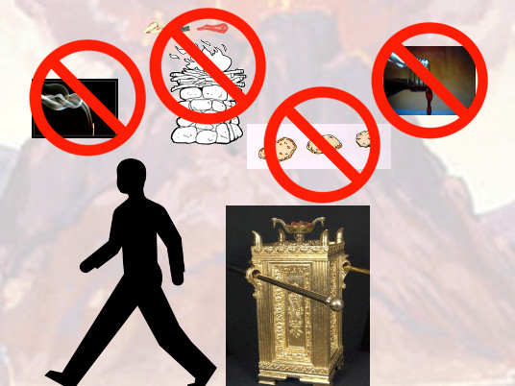
Ye shall oﬀer no strange incense thereon, nor burnt sacriﬁce, nor meat oﬀering;

Slide 20
neither shall ye pour drink oﬀering thereon.

Slide 21
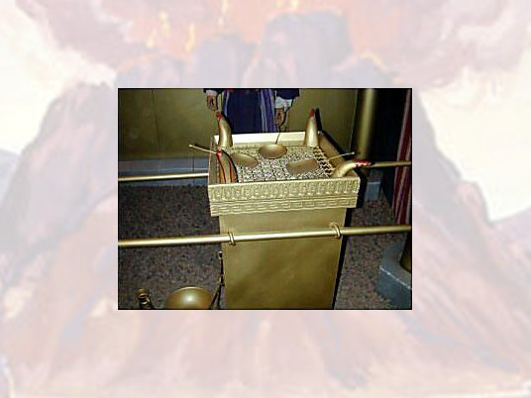
And Aaron shall make an atonement upon the horns of it once in a year

Slide 22
with the blood of the sin oﬀering of atonements:

Slide 23
once in the year shall he make atonement upon it throughout your generations:

Slide 24
it is most holy unto the LORD.

Slide 25
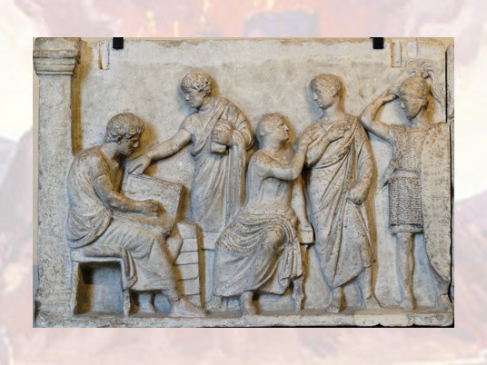
11And the LORD spake unto Moses, saying,

Slide 26
When thou takest the sum of the children of Israel after their number,

Slide 27
then shall they give every man a ransom for his soul unto the LORD,

Slide 28
when thou numberest them;

Slide 29
that there be no plague among them, when thou numberest them.

Slide 30
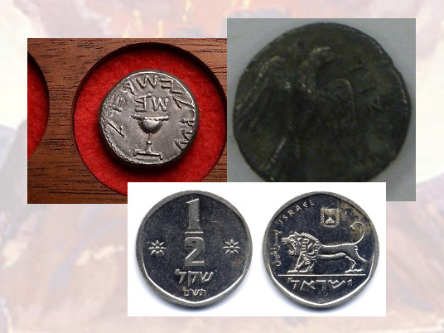
This they shall give, every one that passeth among them that are numbered,

Slide 31
half a shekel after the shekel of the sanctuary: (a shekel is twenty gerahs:)

Slide 32
an half shekel shall be the oﬀering of the LORD

Slide 33
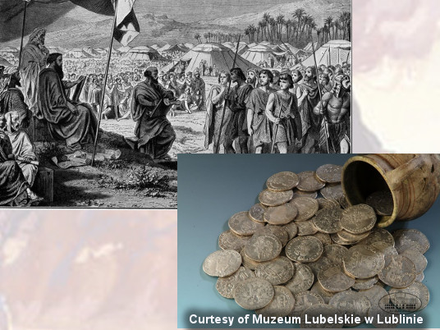
Every one that passeth among them that are numbered,

Slide 34
from twenty years old and above, shall give an oﬀering unto the LORD.

Slide 35
Responsive Reading:
Exodus 30:15 – 30:22
Notes:
<number>
<number>
<number>

Slide 36
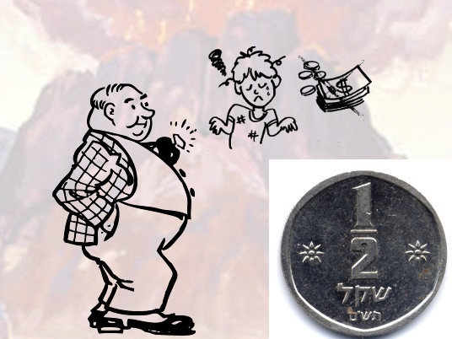
The rich shall not give more, and the poor shall not give less than half a shekel,

Slide 37
when they give an oﬀering unto the LORD, to make an atonement for your souls.

Slide 38
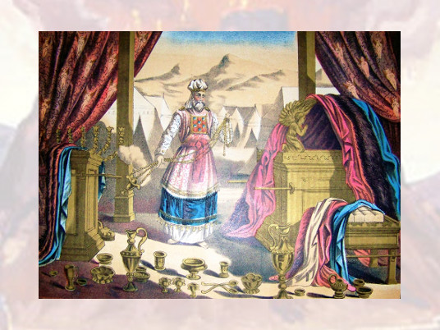
And thou shalt take the atonement money of the children of Israel,

Slide 39
and shalt appoint it for the service of the tabernacle of the congregation;

Slide 40
that it may be a memorial unto the children of Israel before the LORD,

Slide 41
to make an atonement for your souls.

Slide 42
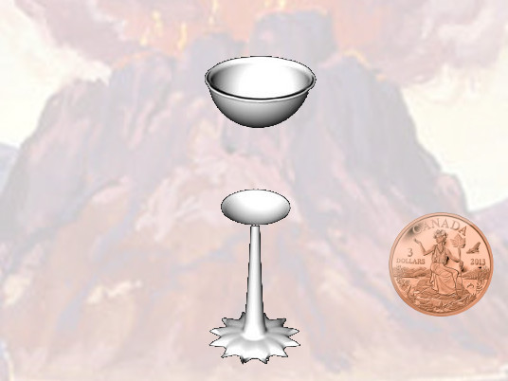
And the LORD spake unto Moses, saying

Slide 43
Thou shalt also make a laver of brass, and his foot also of brass, to wash withal:

Slide 44
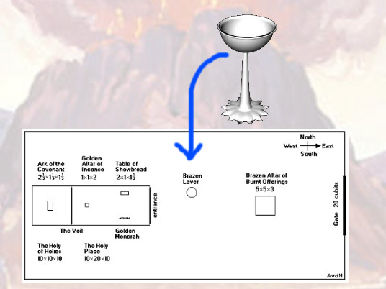
and thou shalt put it between the tabernacle of the congregation and the altar,

Slide 45
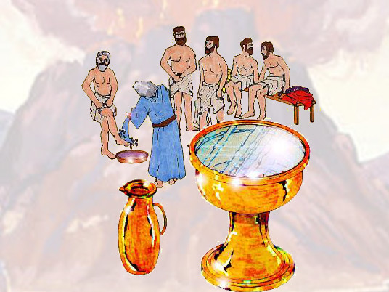
and thou shalt put water therein.

Slide 46
For Aaron and his sons shall wash their hands and their feet thereat:

Slide 47
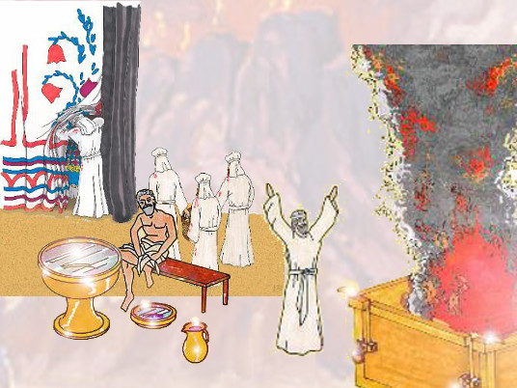
When they go into the tabernacle of the congregation,

Slide 48
they shall wash with water, that they die not;

Slide 49
or when they come near to the altar to minister,

Slide 50
to burn oﬀering made by ﬁre unto the LORD:

Slide 51
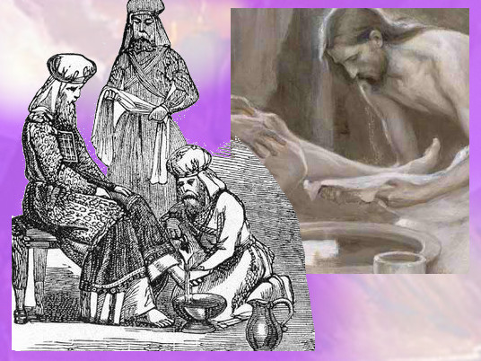
So they shall wash their hands and their feet, that they die not:

Slide 52
and it shall be a statute for ever to them,

Slide 53
even to him and to his seed throughout their generations.

Slide 54
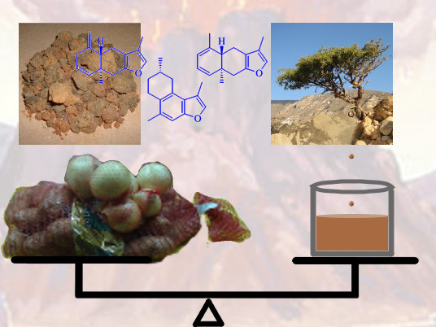
Moreover the LORD spake unto Moses, saying,

Slide 55
Responsive Reading:
Exodus 30:23 – 30:30
Notes:
<number>
<number>
<number>

Slide 56
Take thou also unto thee principal spices, of pure myrrh ﬁve hundred shekels,

Slide 57
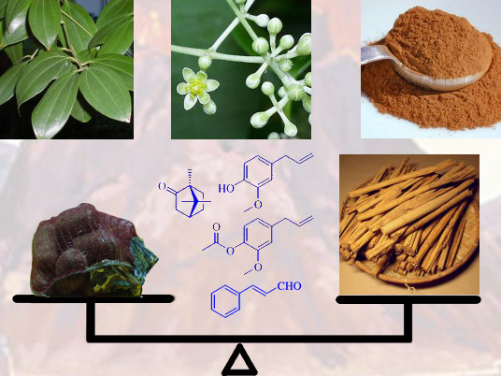
and of sweet cinnamon half so much, even two hundred and ﬁfty shekels,

Slide 58
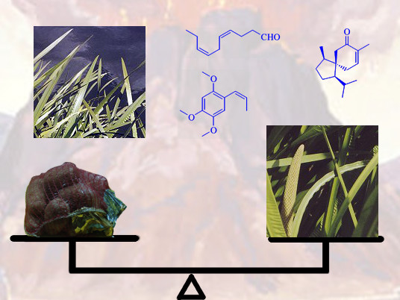
and of sweet calamus two hundred and ﬁfty shekels,

Slide 59
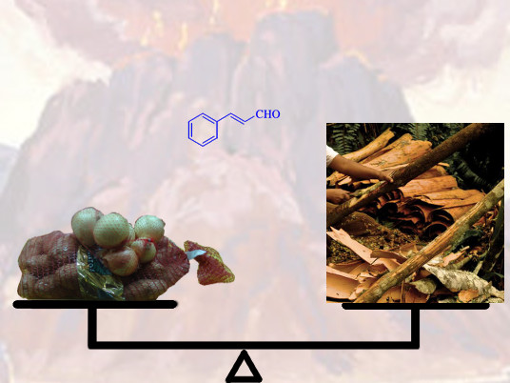
And of cassia ﬁve hundred shekels, after the shekel of the sanctuary,

Slide 60
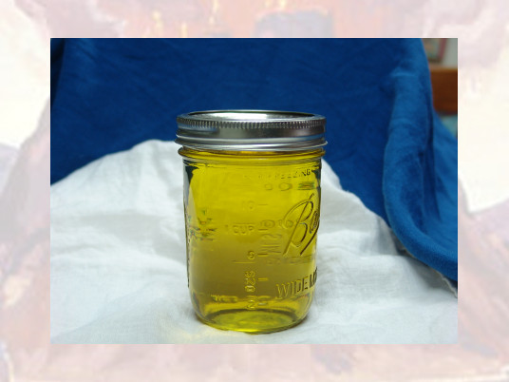
and of oil olive an hin:

Slide 61
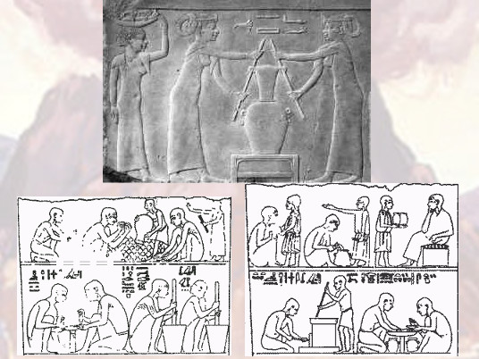
And thou shalt make it an oil of holy ointment,

Slide 62
an ointment compound after the art of the apothecary:

Slide 63
it shall be an holy anointing oil

Slide 64
And thou shalt anoint the tabernacle of the congregation therewith,

Slide 65
and the ark of the testimony,

Slide 66
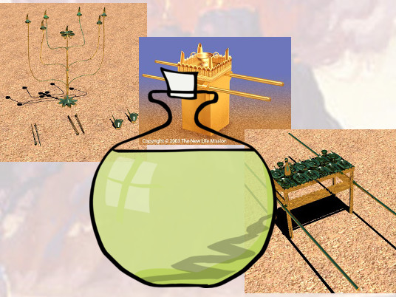
And the table and all his vessels, and the candlestick and his vessels,

Slide 67
and the altar of incense,

Slide 68
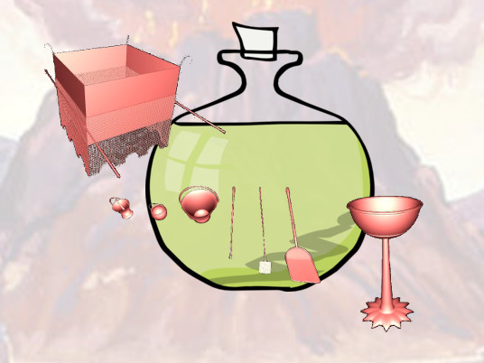
And the altar of burnt oﬀering with all his vessels, and the laver and his foot.

Slide 69
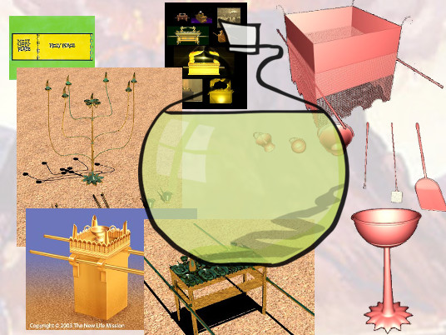
And thou shalt sanctify them, that they may be most holy: whatsoever toucheth them shall be holy.

Slide 70
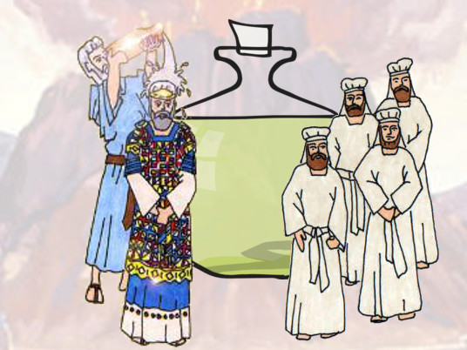
And thou shalt anoint Aaron and his sons, and consecrate them,

Slide 71
that they may minister unto me in the priests oﬃce

Slide 72
Responsive Reading:
Exodus 30:31 – 30:38
Notes:
<number>
<number>
<number>

Slide 73
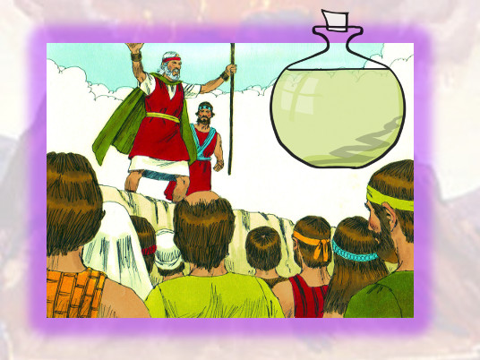
And thou shalt speak unto the children of Israel, saying,

Slide 74
This shall be an holy anointing oil unto me throughout your generations.

Slide 75
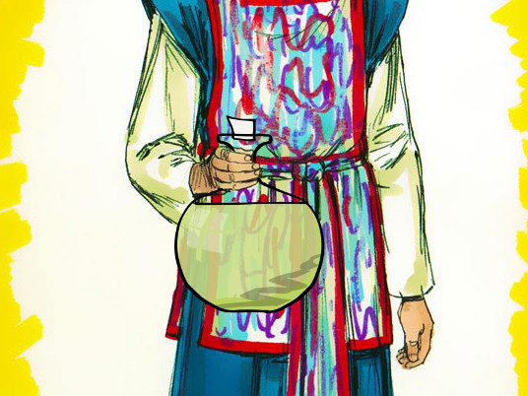
Upon mans ﬂesh shall it not be poured, neither shall ye make any other like it,

Slide 76
after the composition of it: it is holy, and it shall be holy unto you.

Slide 77
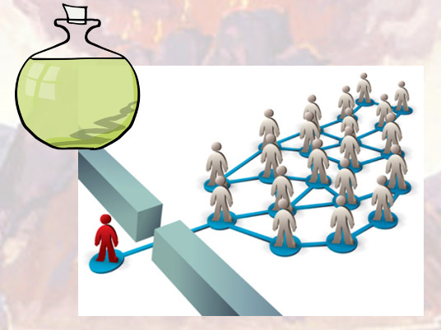
Whosoever compoundeth any like it, or whosoever putteth any of it upon a stranger,

Slide 78
shall even be cut oﬀ from his people.

Slide 79
And the LORD said unto Moses, Take unto thee sweet spices,

Slide 80
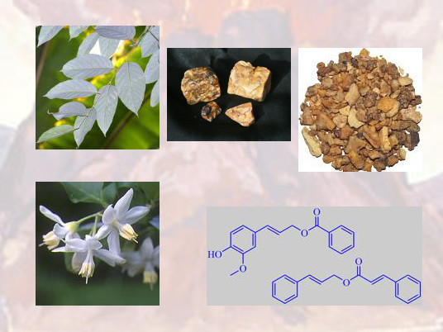
stacte,

Slide 81
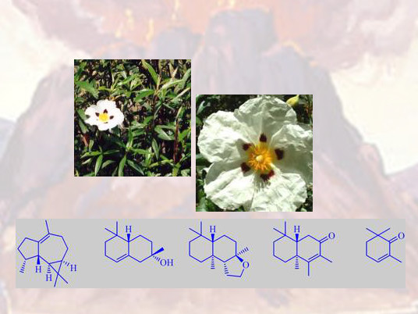
and onycha,

Slide 82
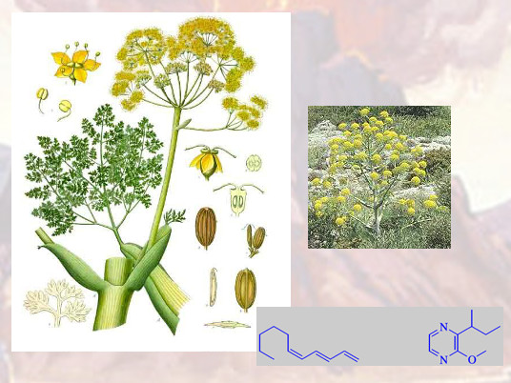
and galbanum;

Slide 83
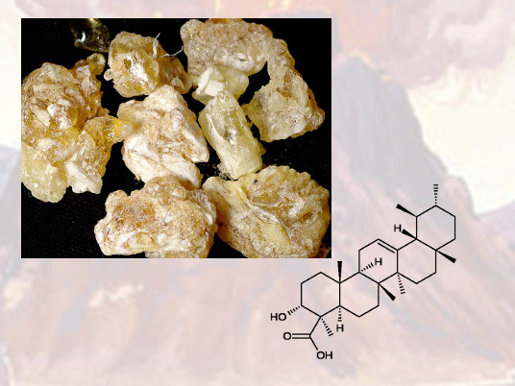
these sweet spices with pure frankincense: of each shall there be a like weight:

Slide 84
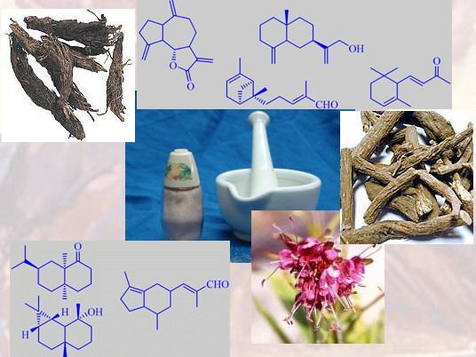
And thou shalt make it a perfume, a confection after the art of the apothecary,

Slide 85
tempered together, pure and holy

Slide 86
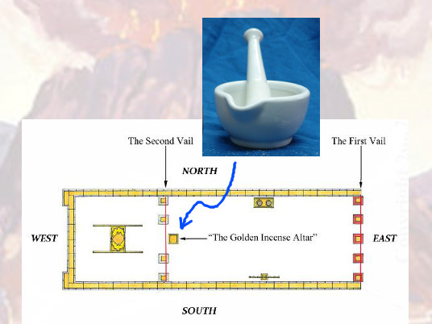
And thou shalt beat some of it very small,

Slide 87
and put of it before the testimony in the tabernacle of the congregation,

Slide 88
where I will meet with thee: it shall be unto you most holy

Slide 89
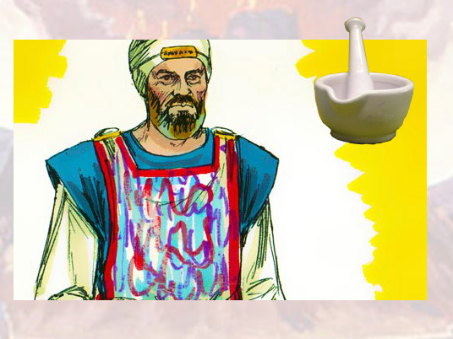
And as for the perfume which thou shalt make,

Slide 90
ye shall not make to yourselves according to the composition thereof:

Slide 91
it shall be unto thee holy for the LORD.

Slide 92
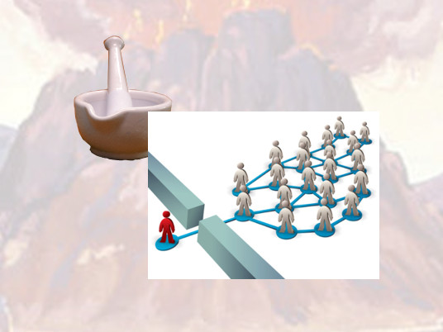
Whosoever shall make like unto that, to smell thereto, shall even be cut oﬀ from his people

