Slide 1
Responsive Reading:
Exodus 31:1 – 31:8
Notes:
<number>
<number>
<number>

Slide 2
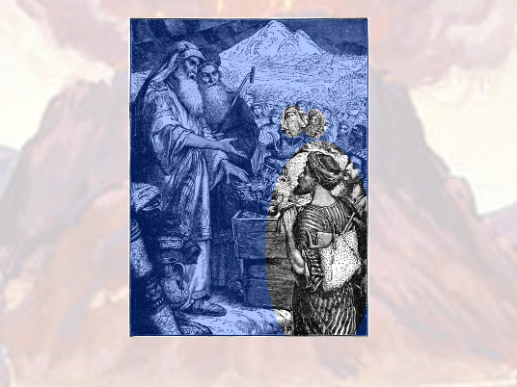
And the LORD spake unto Moses, saying,

Slide 3
See, I have called by name Bezaleel the son of Uri, the son of Hur, of the tribe of Judah:

Slide 4
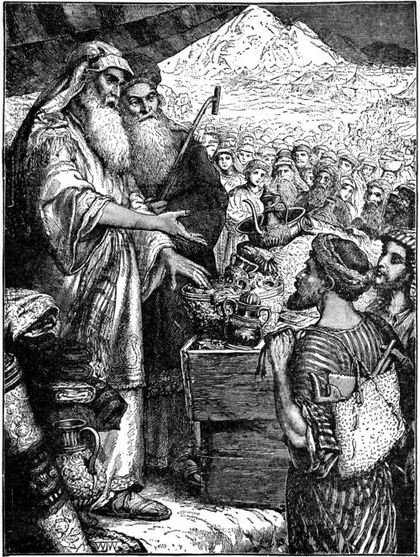
And I have ﬁlled him with the spirit of God, in wisdom, and in understanding, and in knowledge, and in all manner of workmanship,

Slide 5
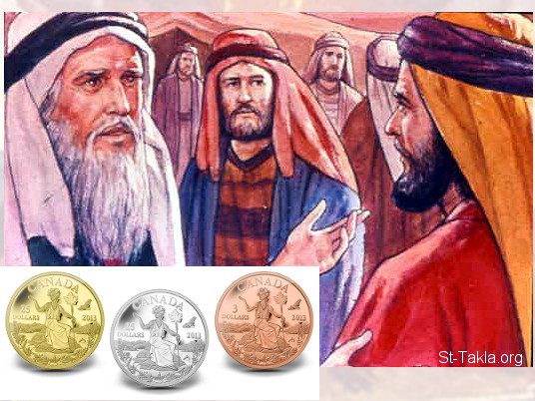
To devise cunning works, to work in gold, and in silver, and in brass,

Slide 6
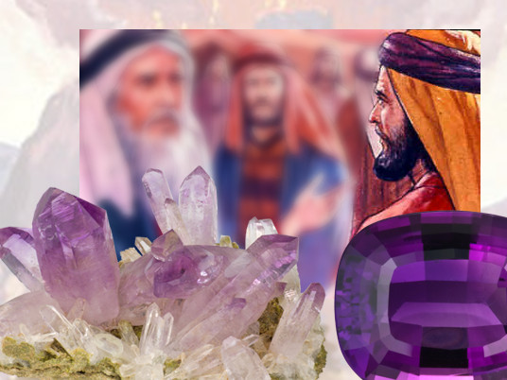
And in cutting of stones, to set them, and in carving of timber,

Slide 7
to work in all manner of workmanship.

Slide 8
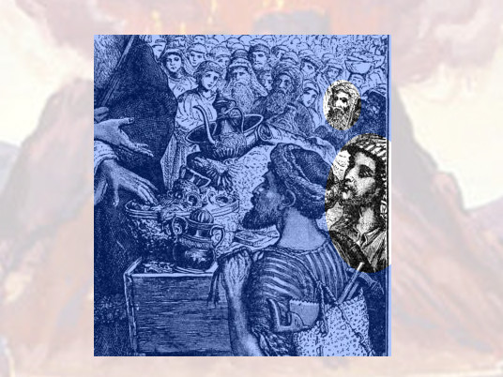
And I, behold, I have given with him Aholiab, the son of Ahisamach,

Slide 9
of the tribe of Dan: and in the hearts of all that are wise hearted I have put wisdom,

Slide 10
that they may make all that I have commanded thee;

Slide 11
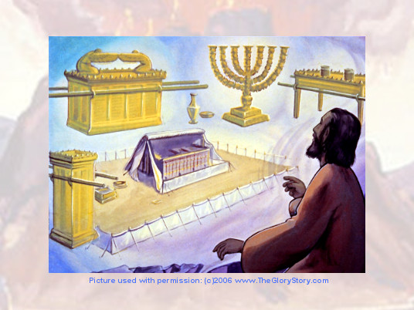
The tabernacle of the congregation, and the ark of the testimony,

Slide 12
and the mercy seat that is thereupon, and all the furniture of the tabernacle

Slide 13
And the table and his furniture, and the pure candlestick with all his furniture,

Slide 14
and the altar of incense,

Slide 15
Responsive Reading:
Exodus 31:9 – 31:16
Notes:
<number>
<number>
<number>

Slide 16
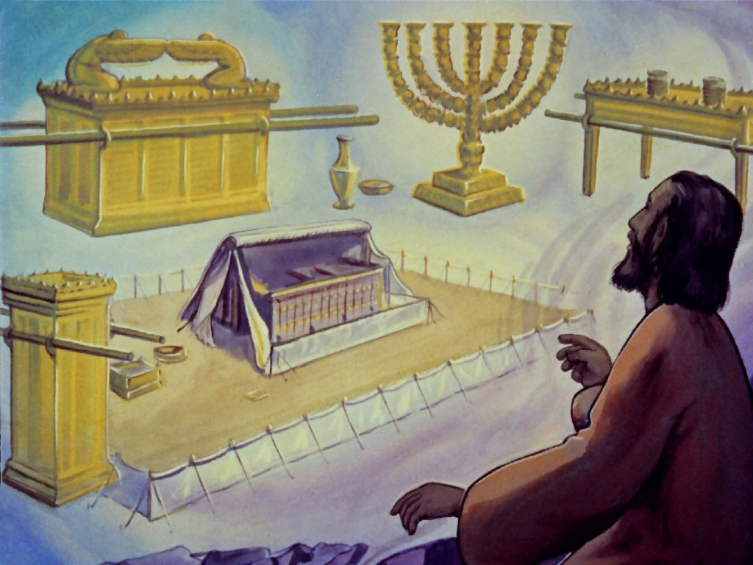
And the altar of burnt oﬀering with all his furniture, and the laver and his foot,

Slide 17
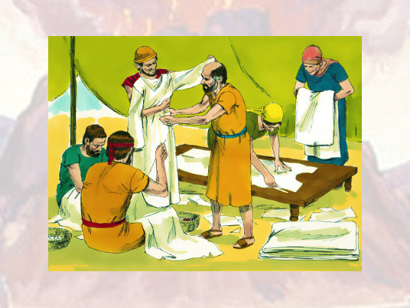
And the cloths of service, and the holy garments for Aaron the priest,

Slide 18
and the garments of his sons, to minister in the priests oﬃce,

Slide 19
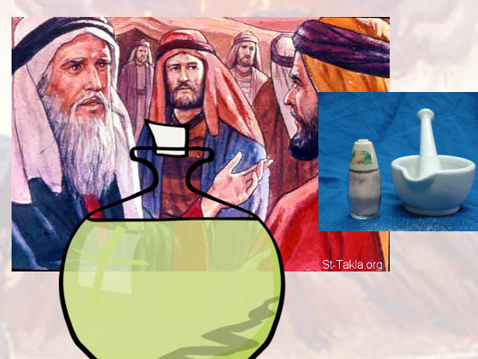
And the anointing oil, and sweet incense for the holy place:

Slide 20
according to all that I have commanded thee shall they do.

Slide 21
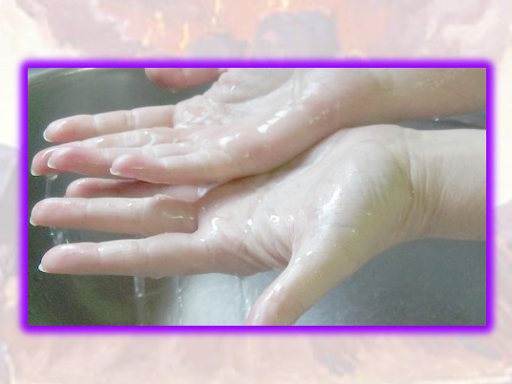
And the LORD spake unto Moses, saying,

Slide 22
speak thou also unto the children of Israel, saying, Verily my sabbaths ye shall keep:

Slide 23
for it is a sign between me and you throughout your generations;

Slide 24
that ye may know that I am the LORD that doth sanctify you.

Slide 25
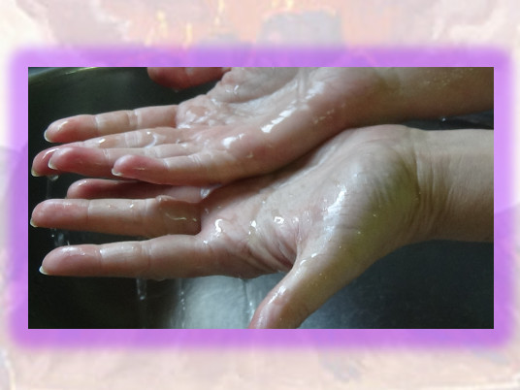
Ye shall keep the sabbath therefore; for it is holy unto you:

Slide 26
every one that deﬁleth it shall surely be put to death:

Slide 27
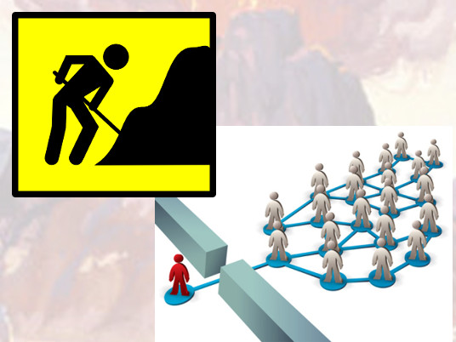
for whosoever doeth any work therein, that soul shall be cut oﬀ from among his people.

Slide 28
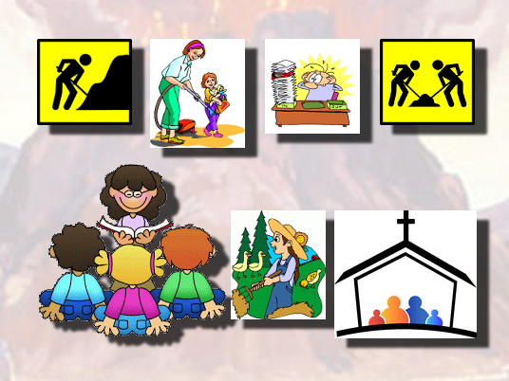
Six days may work be done; but in the seventh is the sabbath of rest, holy to the LORD:

Slide 29
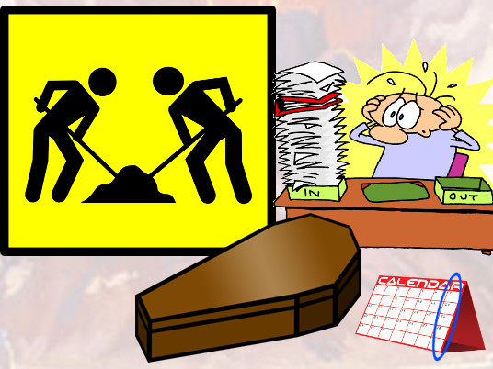
whosoever doeth any work in the sabbath day, he shall surely be put to death

Slide 30
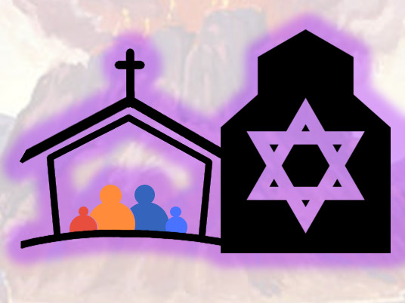
Wherefore the children of Israel shall keep the sabbath,

Slide 31
to observe the sabbath throughout their generations, for a perpetual covenant

Slide 32
Responsive Reading:
Exodus 31:17 – 31:18
Notes:
<number>
<number>
<number>

Slide 33
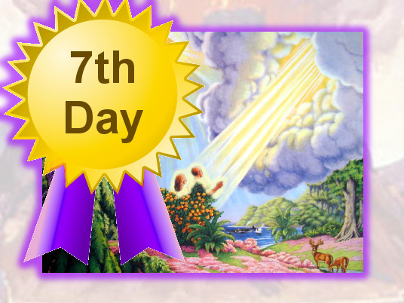
It is a sign between me and the children of Israel for ever:

Slide 34
for in six days the LORD made heaven and earth,

Slide 35
and on the seventh day he rested, and was refreshed.

Slide 36
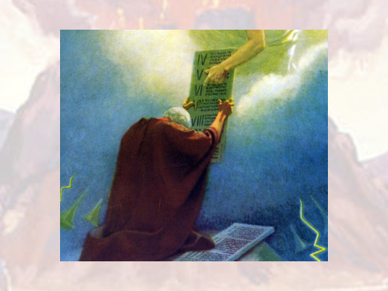
And he gave unto Moses, when he had made an end of communing with him upon mount Sinai,

Slide 37
two tables of testimony, tables of stone, written with the ﬁnger of God.

