Slide 1
Responsive Reading:
Exodus 33:1 – 33:3
Notes:
<number>
<number>
<number>

Slide 2
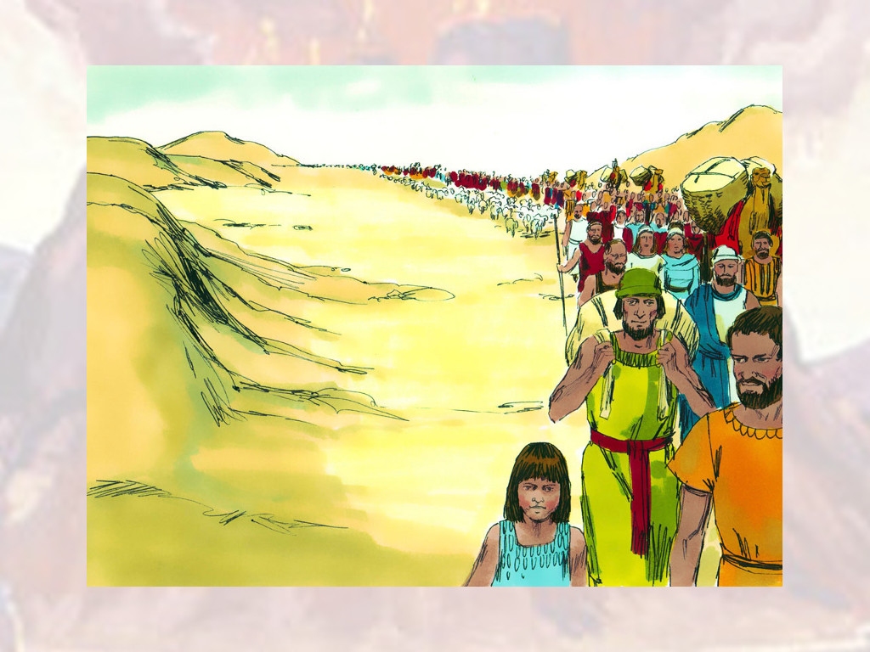
And the LORD said unto Moses, Depart, and go up hence,

Slide 3
thou and the people which thou hast brought up out of the land of Egypt,

Slide 4
unto the land which I sware unto Abraham, to Isaac, and to Jacob, saying, Unto thy seed will I give it:

Slide 5
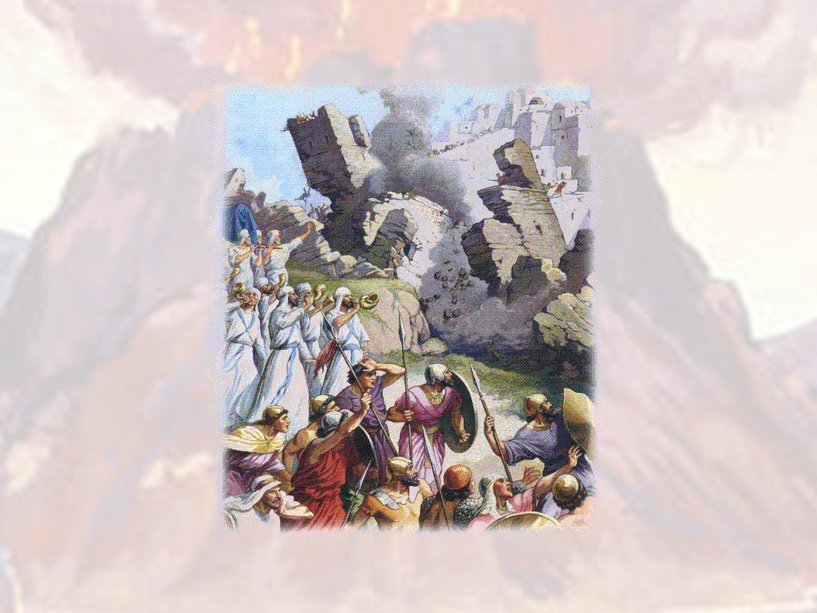
And I will send an angel before thee; and I will drive out the Canaanite, the Amorite,

Slide 6
and the Hittite, and the Perizzite, the Hivite, and the Jebusite:

Slide 7
Unto a land ﬂowing with milk and honey: for I will not go up in the midst of thee;

Slide 8
for thou art a stiﬀnecked people: lest I consume thee in the way.

Slide 9
Responsive Reading:
Exodus 33:4 – 33:11
Notes:
<number>
<number>
<number>

Slide 10
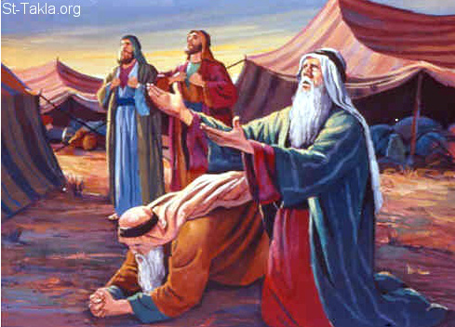
And when the people heard these evil tidings, they mourned:

Slide 11
and no man did put on him his ornaments.

Slide 12
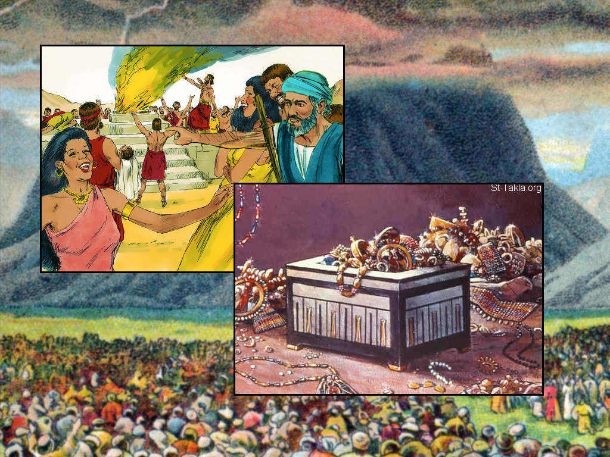
For the LORD had said unto Moses, Say unto the children of Israel,

Slide 13
Ye are a stiﬀnecked people: I will come up into the midst of thee in a moment,

Slide 14
and consume thee: therefore now put oﬀ thy ornaments from thee,

Slide 15
that I may know what to do unto thee.

Slide 16
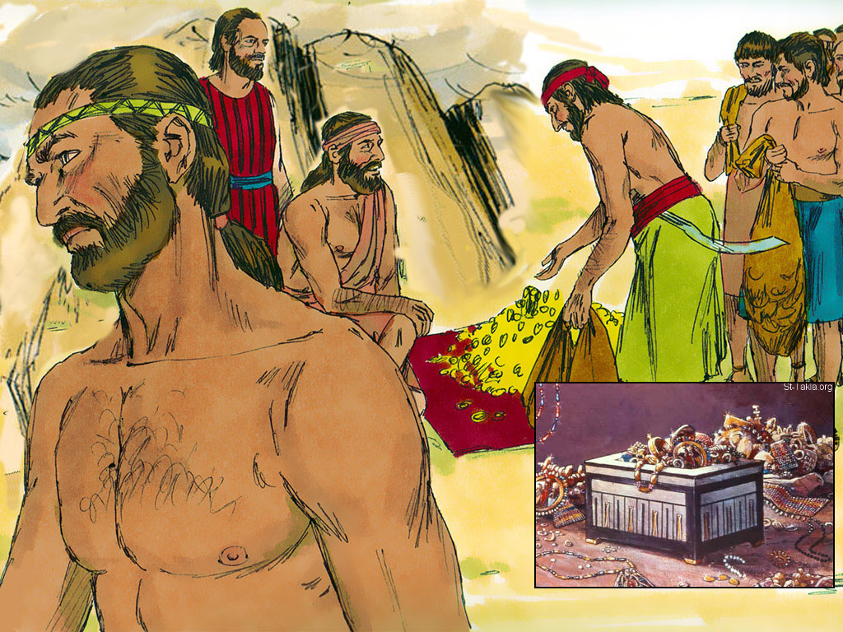
And the children of Israel stripped themselves of their ornaments

Slide 17
by the mount Horeb.

Slide 18
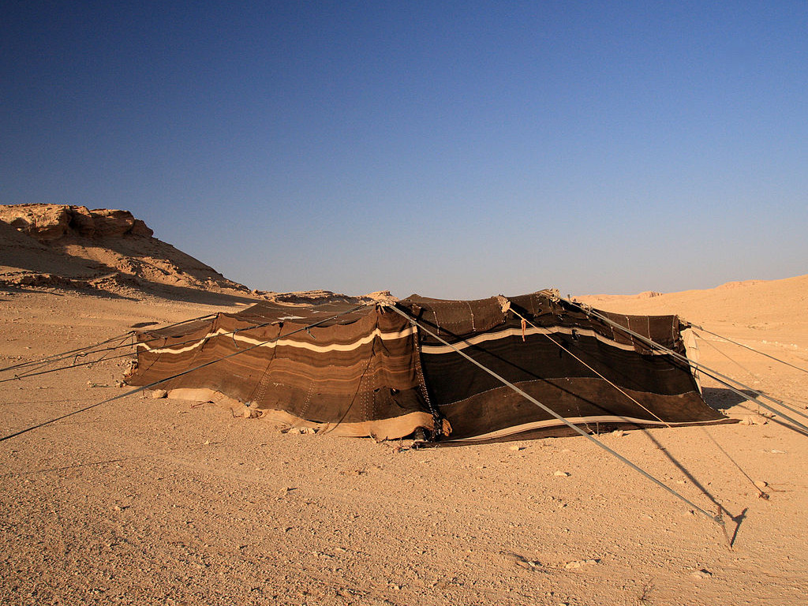
And Moses took the tabernacle, and pitched it without the camp, afar oﬀ from the camp,

Slide 19
and called it the Tabernacle of the congregation. And it came to pass,

Slide 20
that every one which sought the LORD went out unto the tabernacle of the congregation,

Slide 21
which was without the camp.

Slide 22
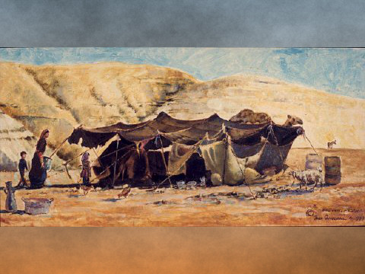
And it came to pass, when Moses went out unto the tabernacle,

Slide 23
that all the people rose up, and stood every man at his tent door,

Slide 24
and looked after Moses, until he was gone into the tabernacle.

Slide 25
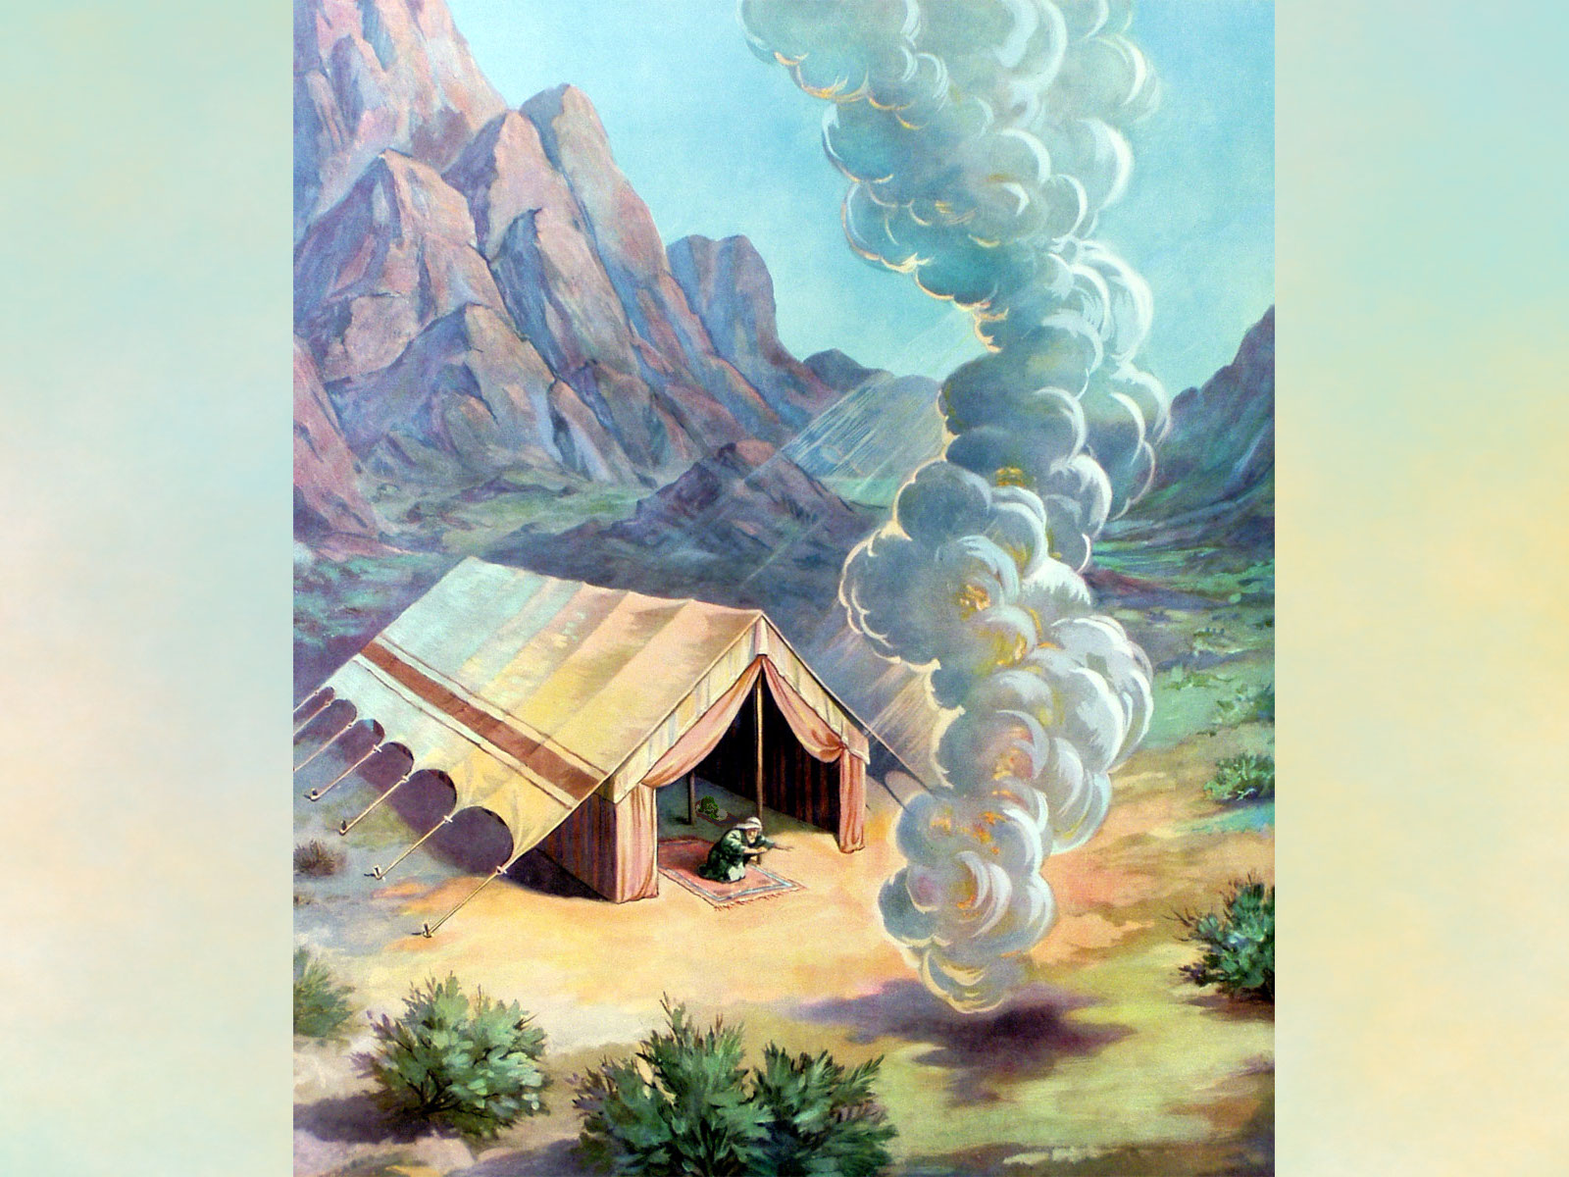
And it came to pass, as Moses entered into the tabernacle, the cloudy pillar descended,

Slide 26
and stood at the door of the tabernacle, and the LORD talked with Moses.

Slide 27
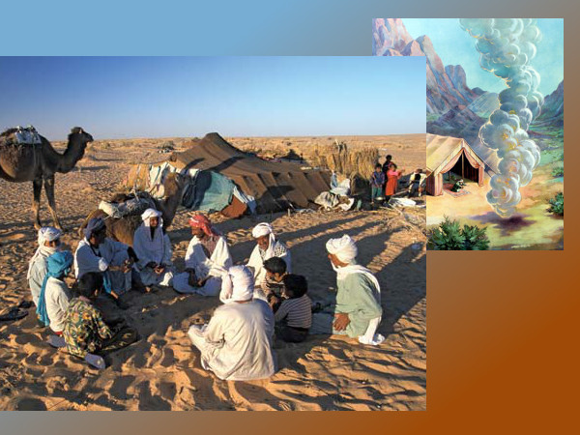
And all the people saw the cloudy pillar stand at the tabernacle door:

Slide 28
and all the people rose up and worshipped, every man in his tent door.

Slide 29
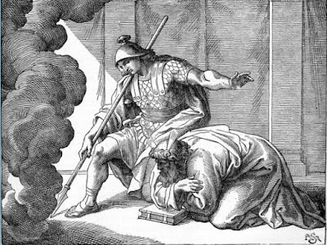
And the LORD spake unto Moses face to face, as a man speaketh unto his friend.

Slide 30
And he turned again into the camp:

Slide 31
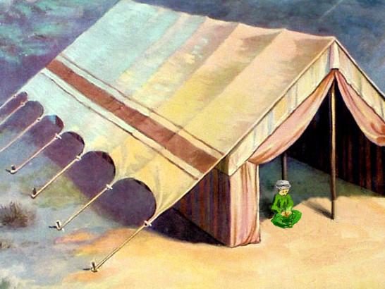
but his servant Joshua, the son of Nun, a young man, departed not out of the tabernacle

Slide 32
Responsive Reading:
Exodus 33:12 – 33:19
Notes:
<number>
<number>
<number>

Slide 33
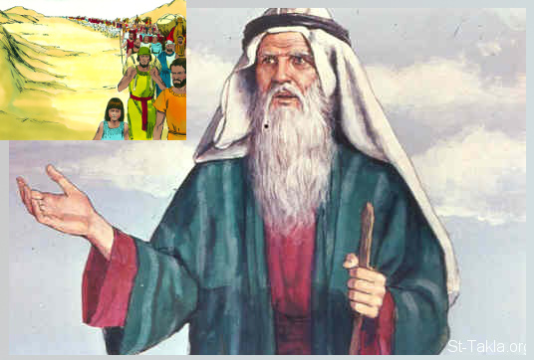
And Moses said unto the LORD, See, thou sayest unto me, Bring up this people:

Slide 34
and thou hast not let me know whom thou wilt send with me. Yet thou hast said,

Slide 35
I know thee by name, and thou hast also found grace in my sight

Slide 36
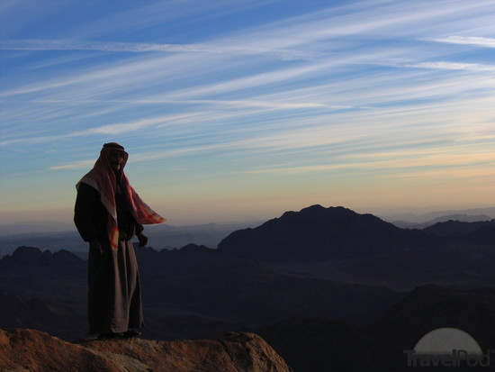
Now therefore, I pray thee, if I have found grace in thy sight, shew me now thy way,

Slide 37
that I may know thee, that I may ﬁnd grace in thy sight:

Slide 38
and consider that this nation is thy people

Slide 39
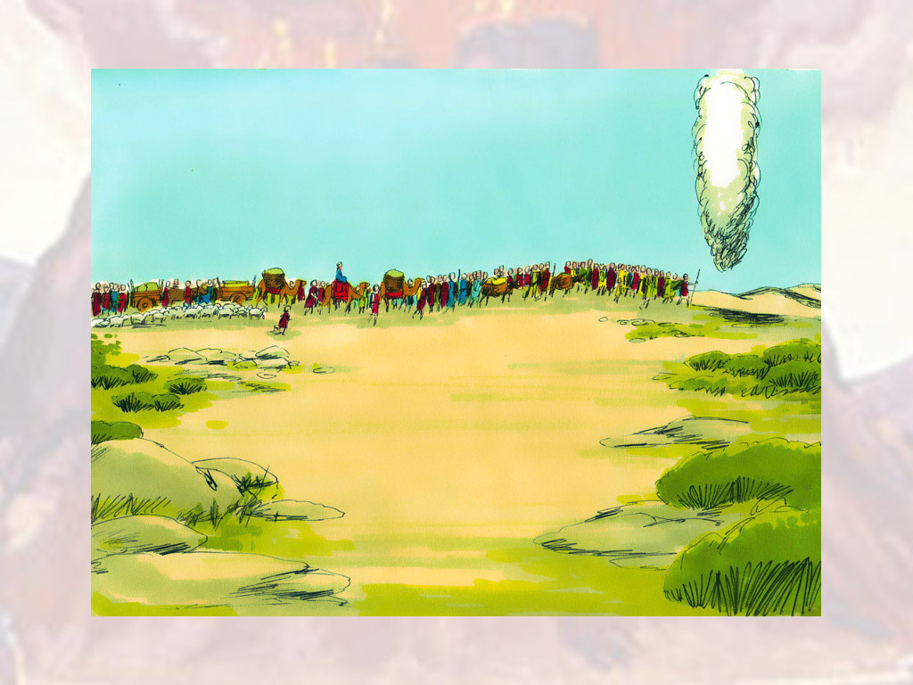
And he said, My presence shall go with thee, and I will give thee rest.

Slide 40
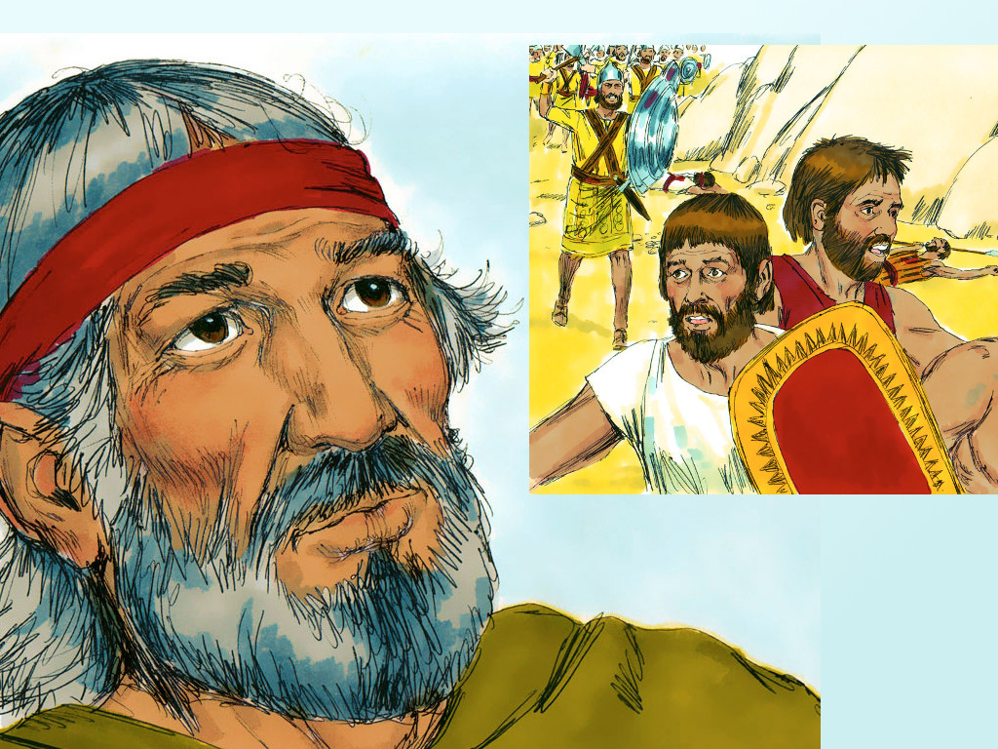
And he said unto him, If thy presence go not with me, carry us not up hence.

Slide 41
For wherein shall it be known here that I and thy people have found grace in thy sight?

Slide 42
is it not in that thou goest with us? so shall we be separated,

Slide 43
I and thy people, from all the people that are upon the face of the earth

Slide 44
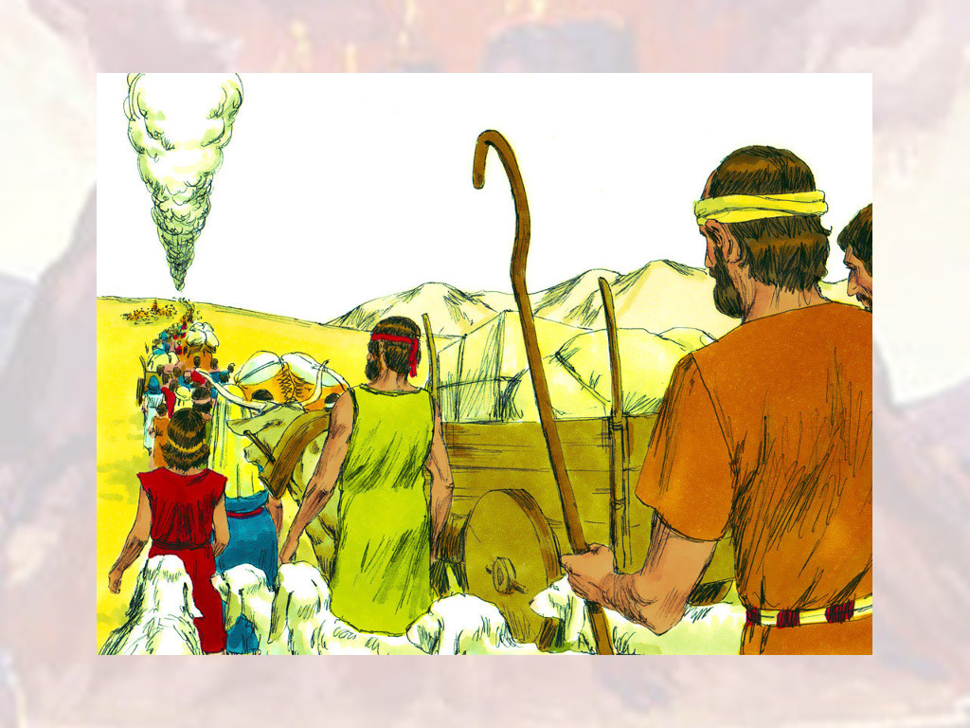
And the LORD said unto Moses, I will do this thing also that thou hast spoken:

Slide 45
for thou hast found grace in my sight, and I know thee by name.

Slide 46
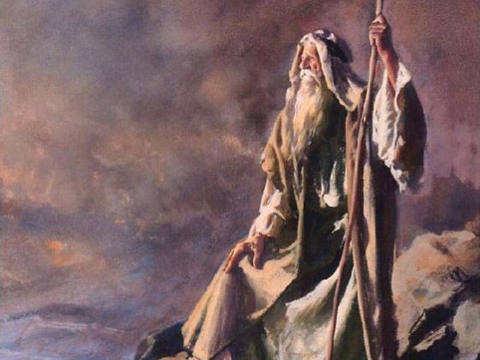
And he said, I beseech thee, shew me thy glory.

Slide 47
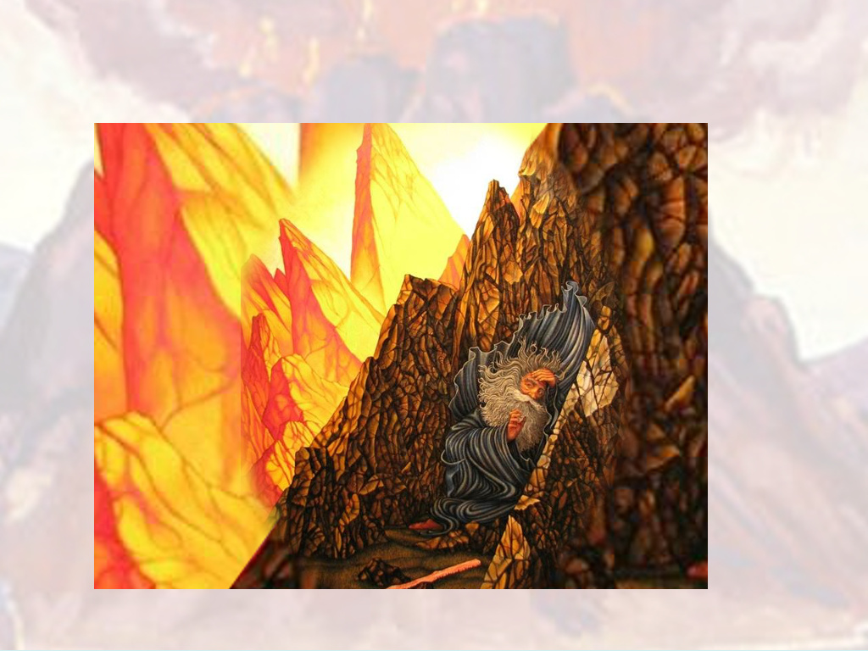
And he said, I will make all my goodness pass before thee,

Slide 48
and I will proclaim the name of the LORD before thee;

Slide 49
and will be gracious to whom I will be gracious,

Slide 50
and will shew mercy on whom I will shew mercy.

Slide 51
Responsive Reading:
Exodus 33:20 – 34:4
Notes:
<number>
<number>
<number>

Slide 52
And he said, Thou canst not see my face: for there shall no man see me, and live

Slide 53
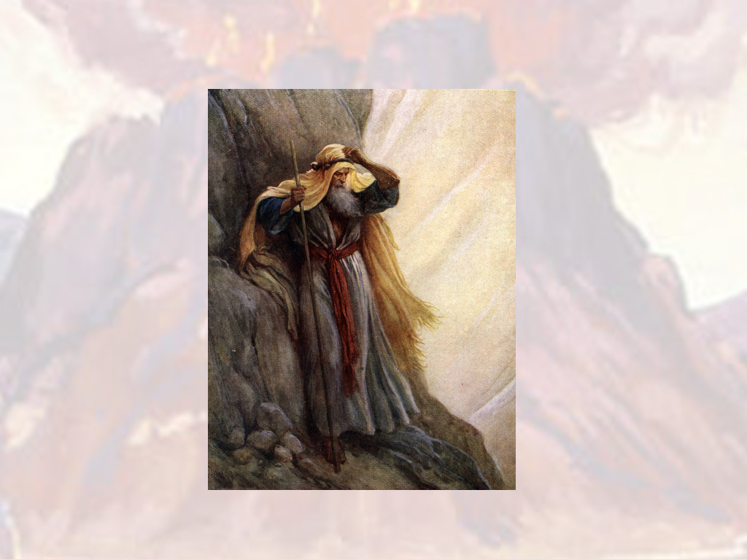
And the LORD said, Behold, there is a place by me, and thou shalt stand upon a rock:

Slide 54
And it shall come to pass, while my glory passeth by, that I will put thee in a clift of the rock,

Slide 55
and will cover thee with my hand while I pass by:

Slide 56
And I will take away mine hand, and thou shalt see my back parts: but my face shall not be seen

