Slide 2
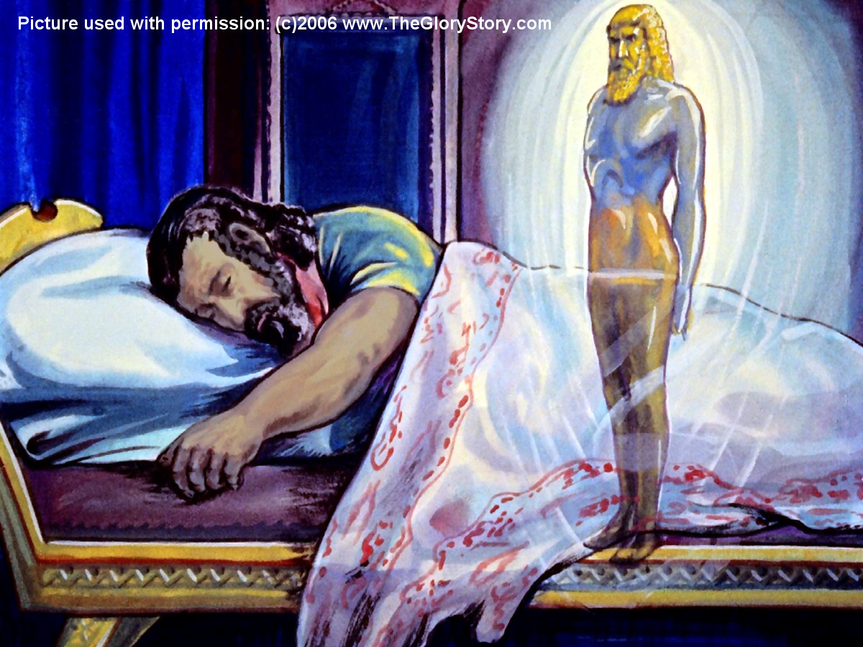

Slide 3
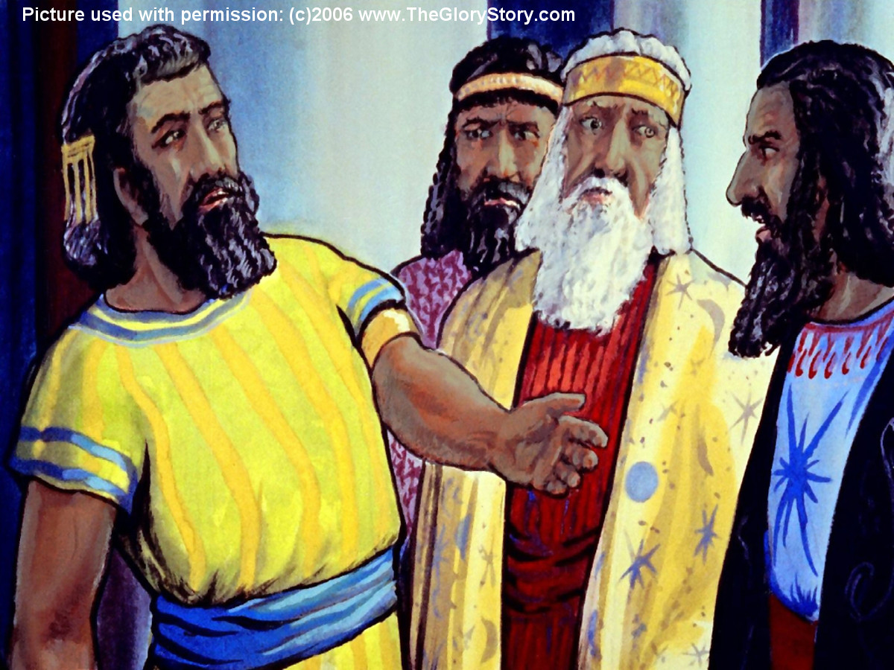

Slide 4
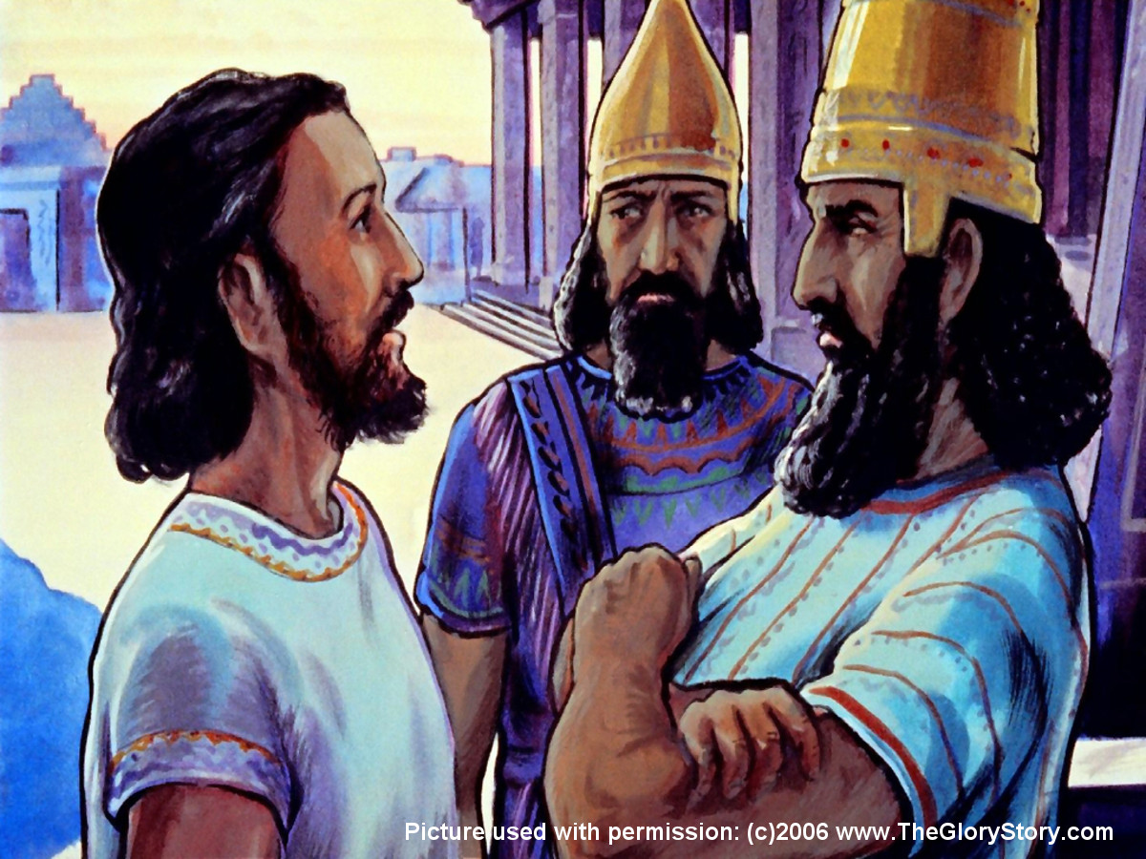

Slide 5
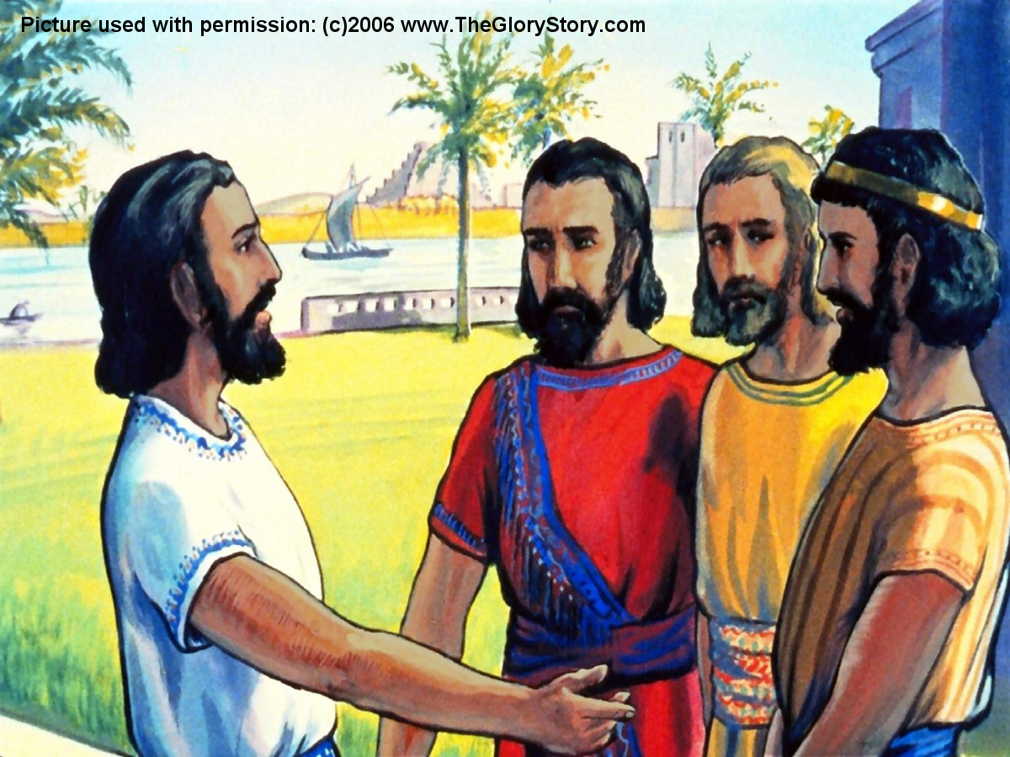

Slide 6
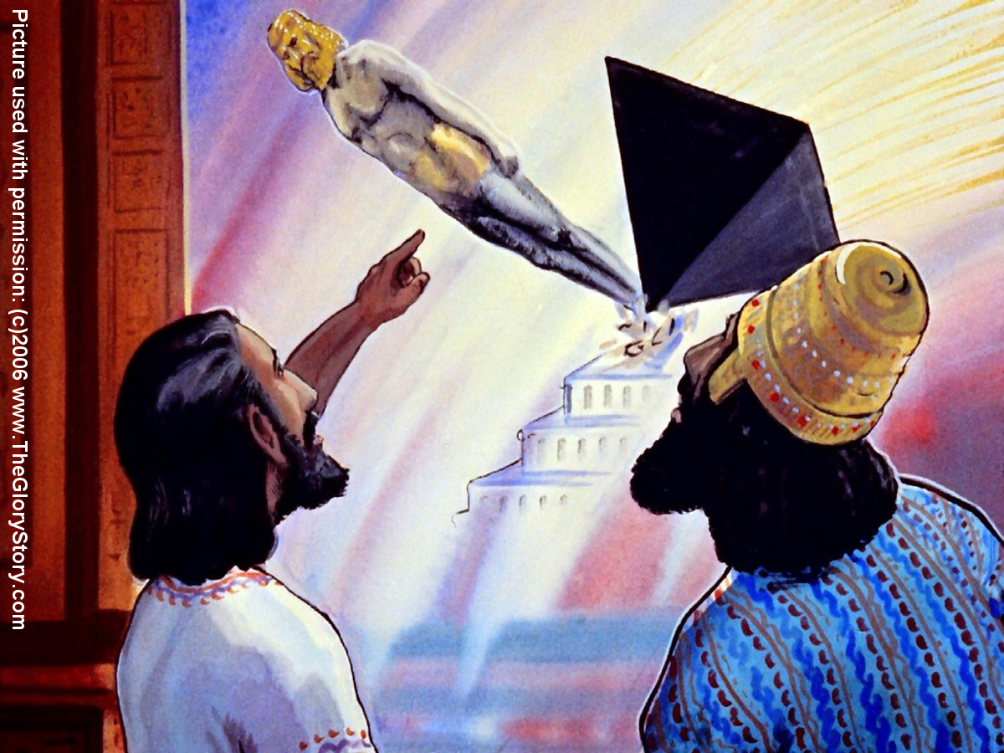

Slide 7
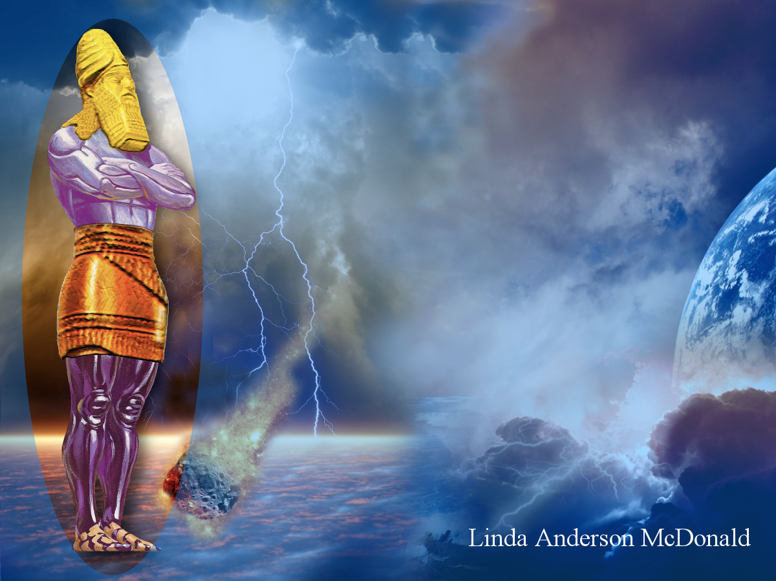

Slide 8
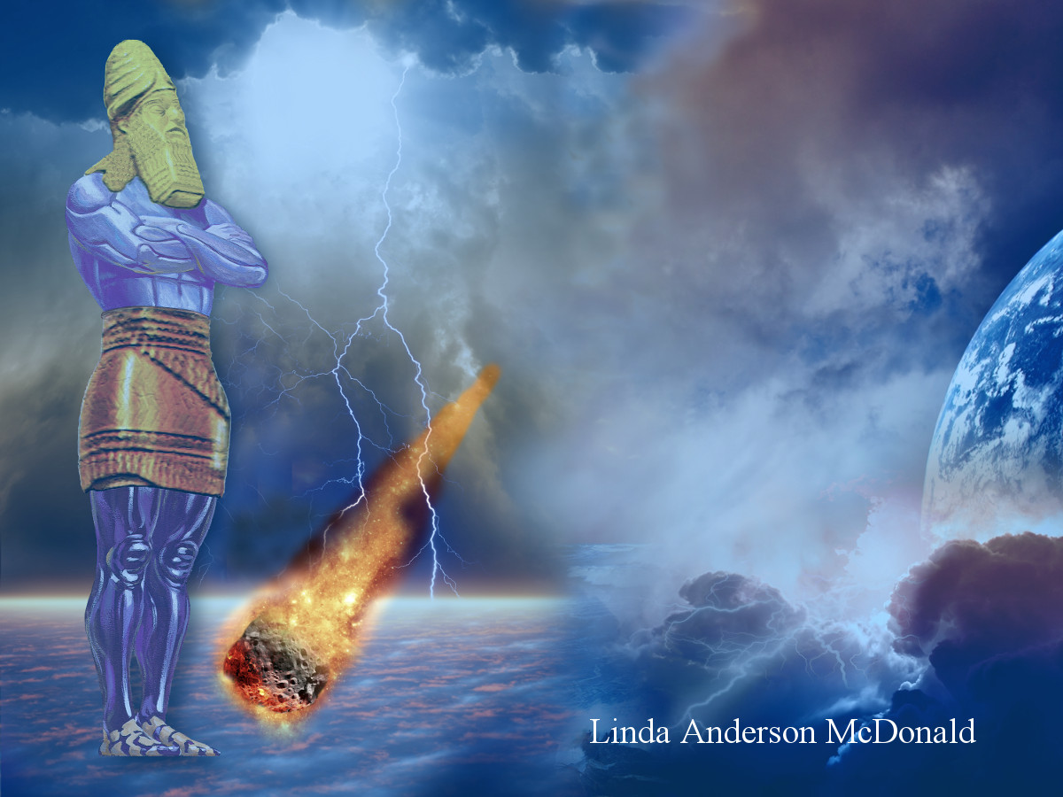

Slide 9
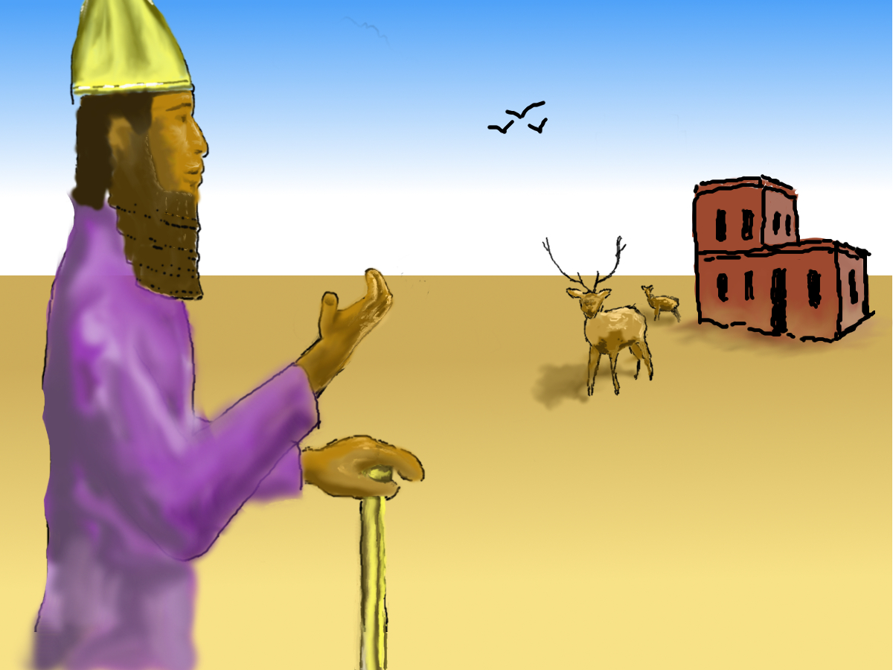

Slide 10
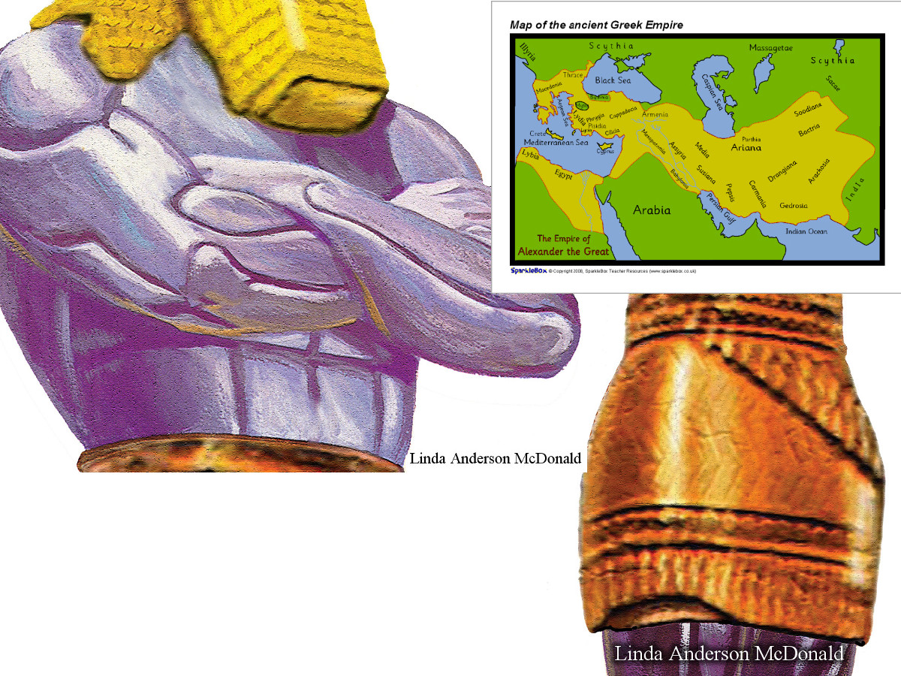

Slide 14
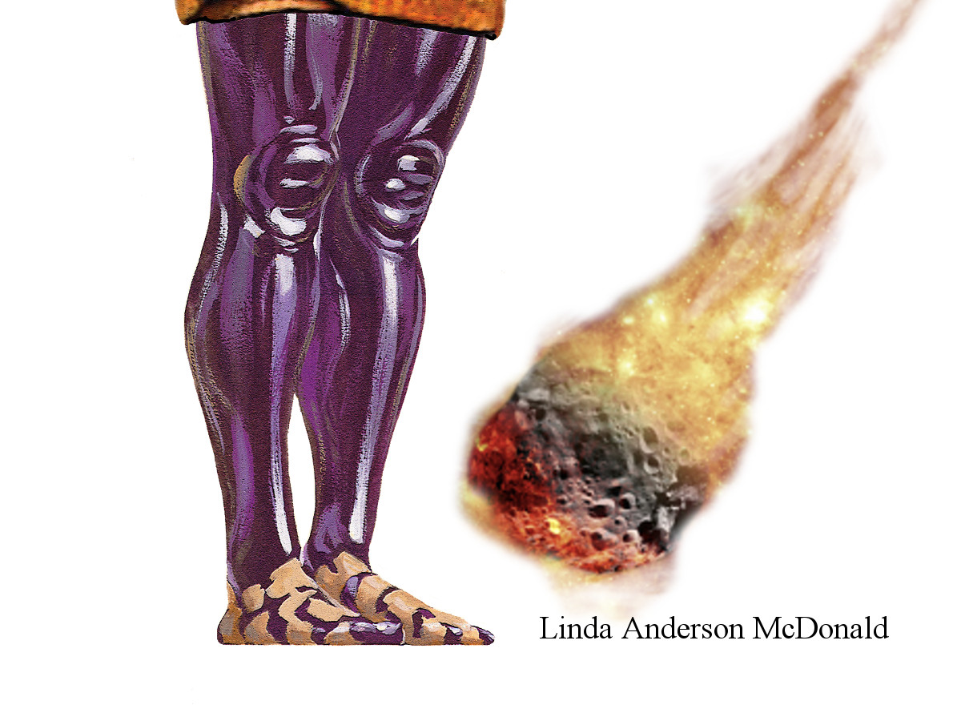

Slide 16
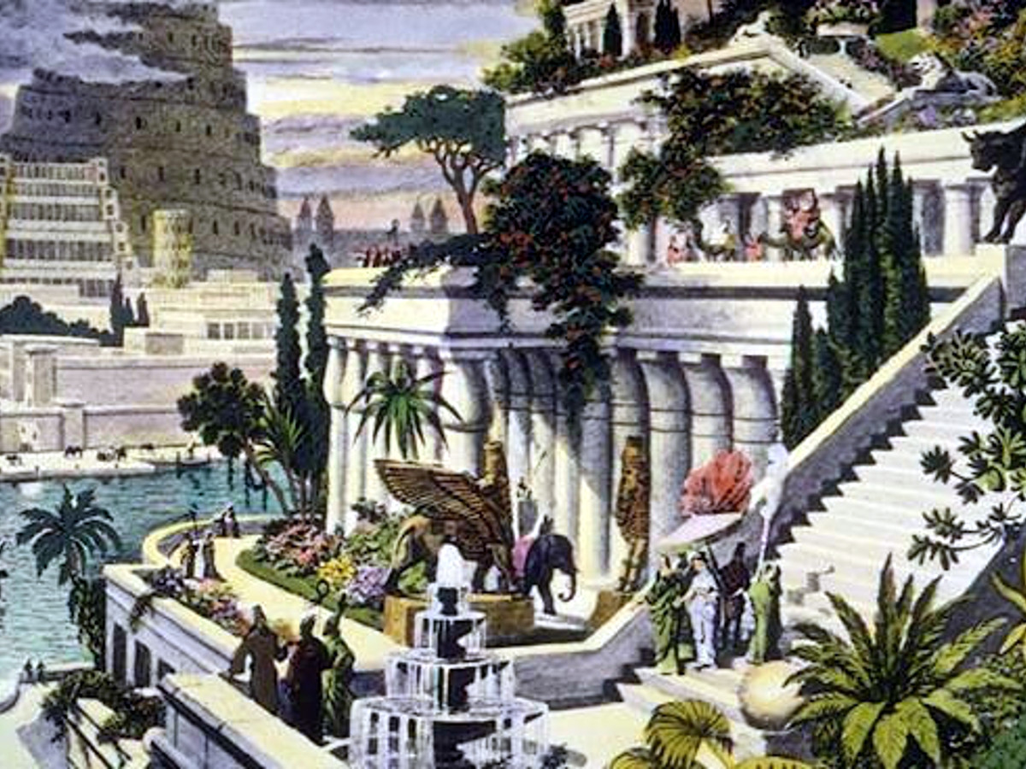

Slide 17
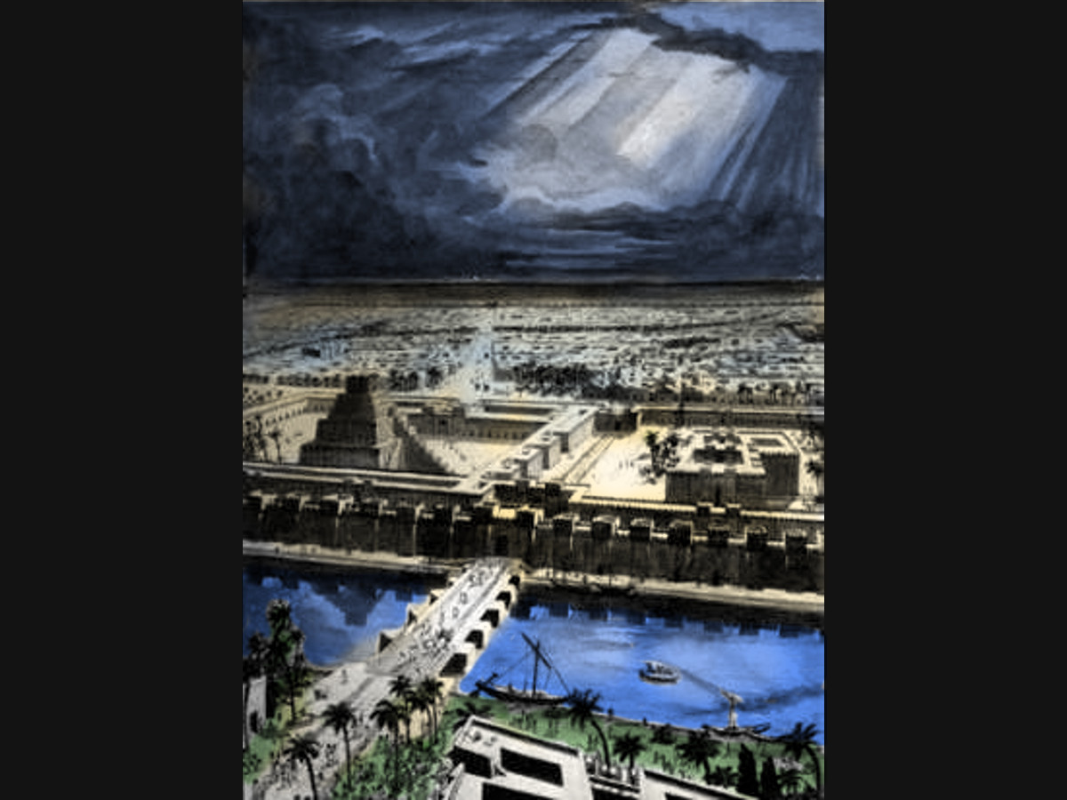

Slide 21
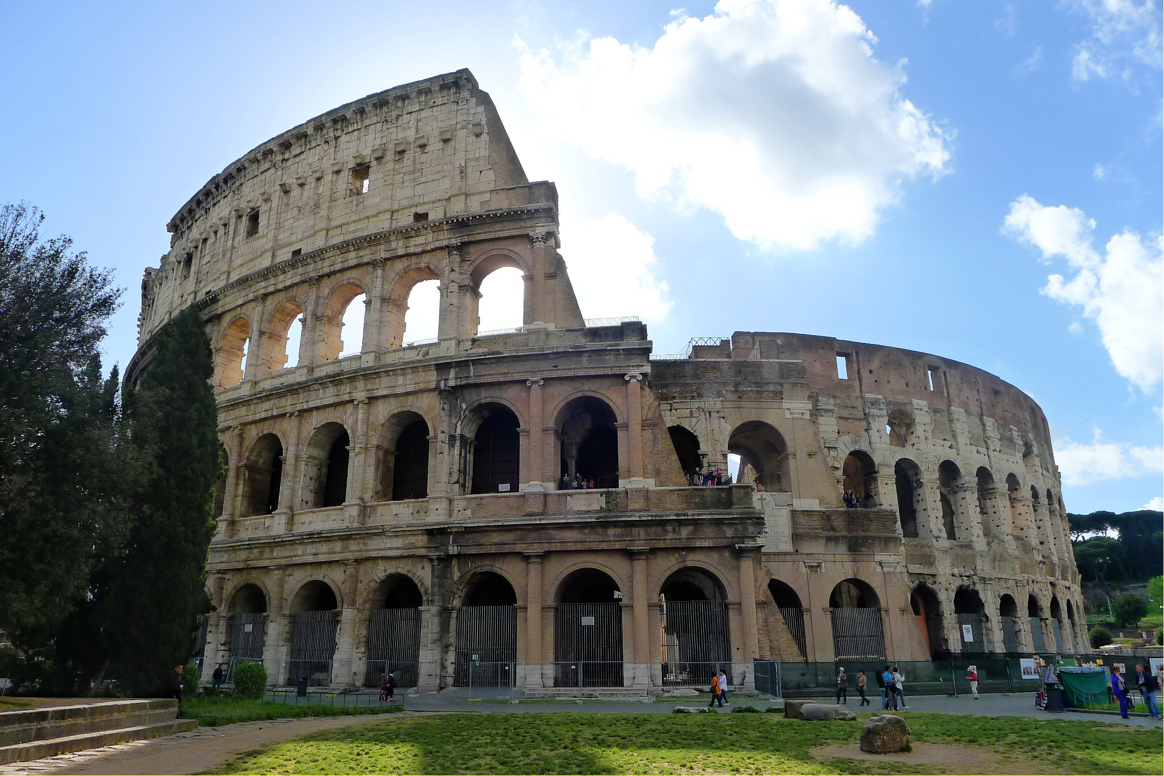

Slide 24
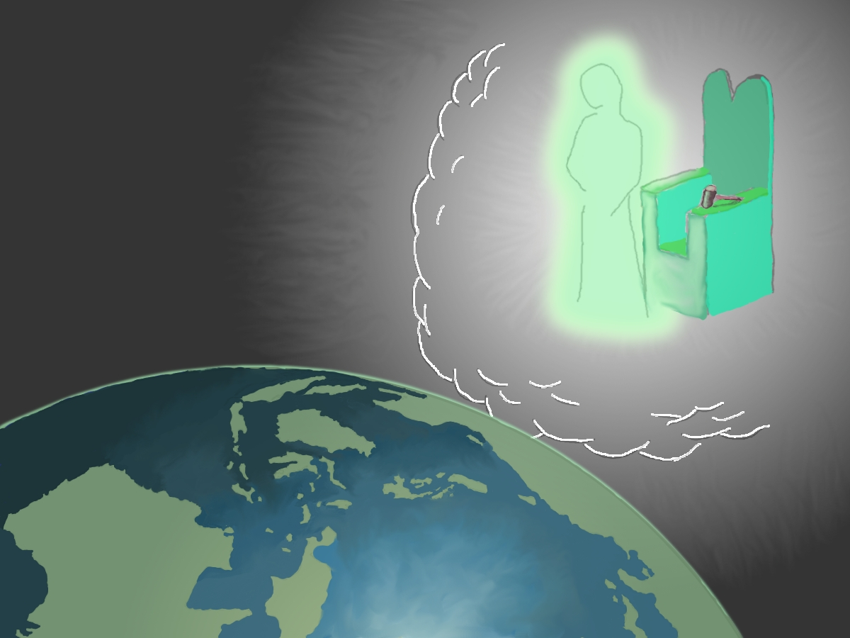

Slide 26
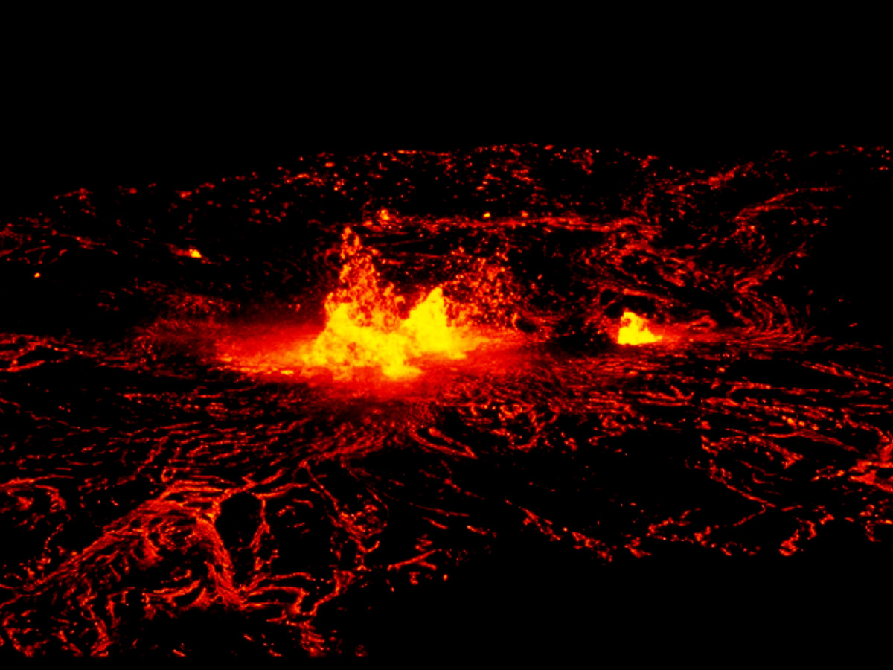

Slide 27
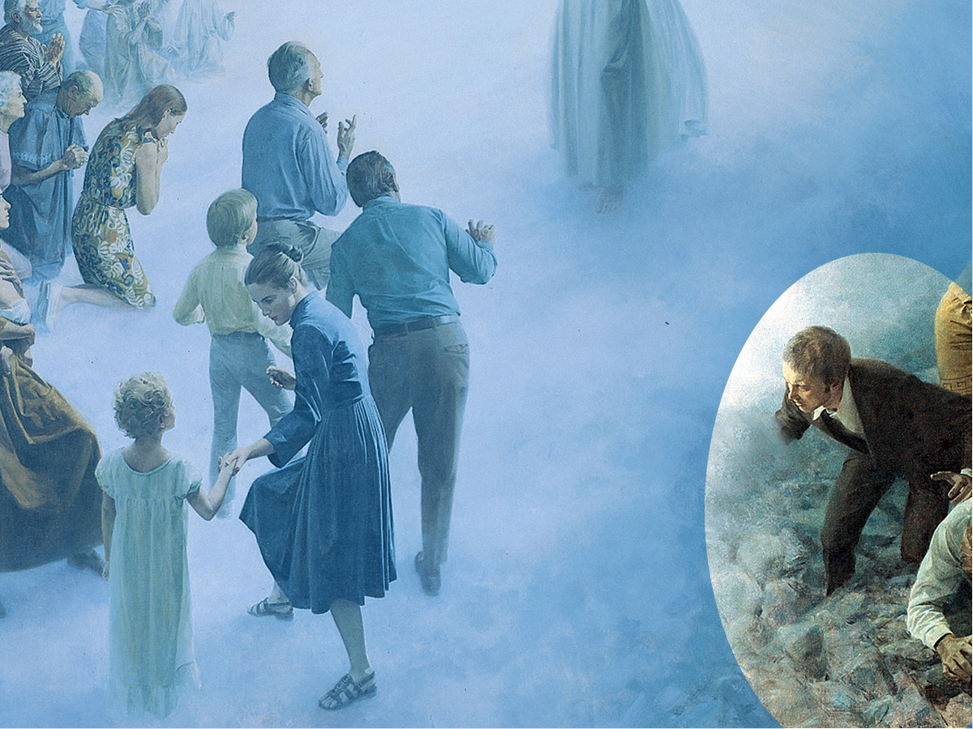

Slide 28
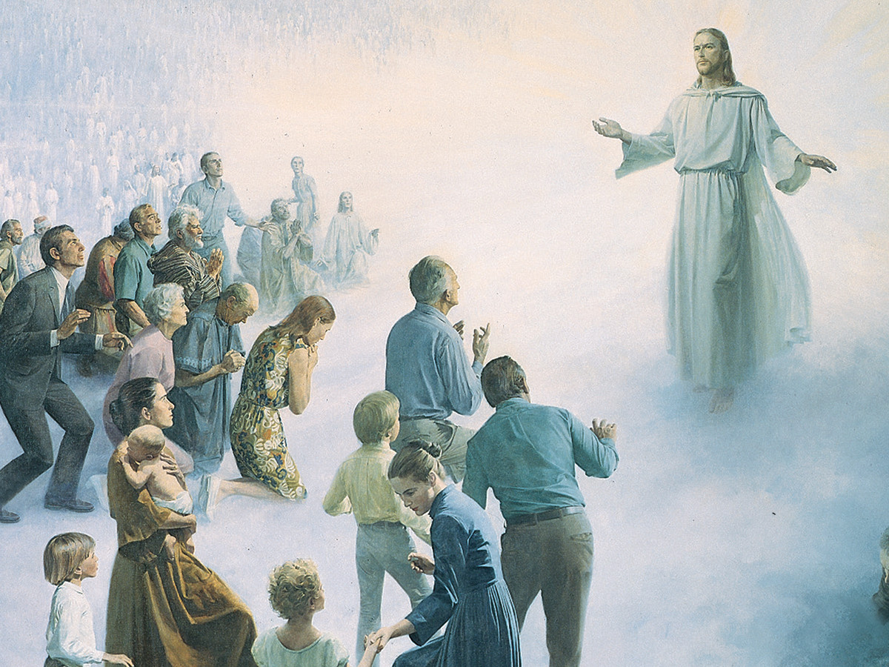

Slide 29
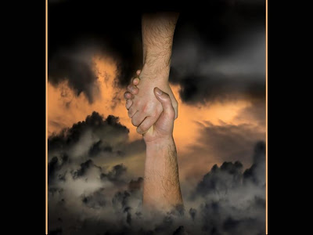

Slide 30
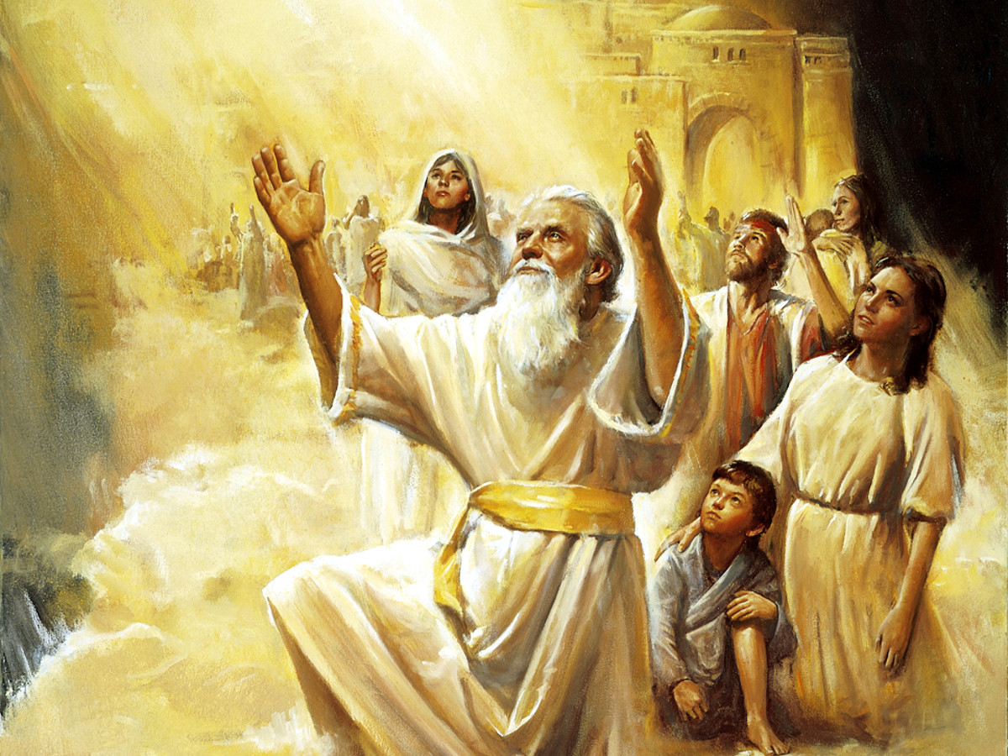

Slide 31
Picture Sources
p.1 JesusImageStoneHorz.jpg by Linda Anderson McDonald
p.3 Nebuchadnezzar’s Dream: http://www .TheGloryStory.com Daniel 1 13 Picture used with permission: (c)2006 www.TheGloryStory.com
p.4 Nebuchadnezzar asking wise men: http://www .TheGloryStory.com Daniel 1 14 Picture used with permission: (c)2006 www.TheGloryStory.com
p.5 Daniel asks for more time. http://www .TheGloryStory.com Daniel 1 15 Picture used with permission: (c)2006 www.TheGloryStory.com
p.6 Daniel ask his friends to pray. http://www .TheGloryStory.com Daniel 1 20 Picture used with permission: (c)2006 www.TheGloryStory.com
p.7 Daniel Explains Dream: http://www .TheGloryStory.com Daniel 1 17 Picture used with permission: (c)2006 www.TheGloryStory.com
p.8 golden image Dan 2 HD from Linda Anderson McDonald Focus on image.
p.9 golden image Dan 2 HD from Linda Anderson McDonald Focus on stone.
p.10 Original work by William Houser.
p.11 Original work by William Houser.
p.12 Metal man from Linda Anderson McDonald focus on arms and brass. Map of the Grecian kingdom: http://www.sparklebox.co.uk/61216130/sb6124.html#.WR9PJ8a1vIV
p.13 Metal man from Linda Anderson McDonald focus on iron. Mohr’s hardness scale for metals: http://www.solarroadways.com/Speciﬁcs/Glass http://www.jewelrynotes.com/the-mohs-scale-ofhardness-for-metals-why-it-is-important/ Roman Soldier with ”Divide and Conquer” :https://itit.facebook.com/catenaumanaparlamento/ photos/divide-et-impera-ovvero-la-strategiausata-dal-potere-per-controllarci-meglio-di/ 1233347483438253/
p.14 Metal man from Linda Anderson McDonald focus on iron. Map of England: http://googlemapseurope.blogspot.com/2011/ 05/cities-map-of-england-pics.html Map of Libya: http://www.psywarrior.com/LibyaMap05.gif
p.15 Map of Europe around 500 AD: http://www .euratlas.net/history/europe/500/index.html. Copyright 2010 Christos Nussli, www euratlas.net
p.16 Metal man and rock from Linda Anderson McDonald combined by William Houser. New Jerusalem coming down: http://westloopchurch.blogspot.com/2011/01/god-will-create-newheavens-and-new.html
p.17 Xuan Che , ﬂikr 86747233-04e9a49fc7-b https://www.ﬂickr.com/photos/rosemania/ 86747223/in/photolist-8EAVM-mA2r3-aWgHqgRecwG-3ftCoJ-dfVxkx-g9vXgR-eejQYj-oSkTRW3UDxn4-q7tNEN-qcQ1vR-9dQhTQ-qJViz4dov5M3-6Ytr7y-sAcAba-fQY5vj-iyXwM-oFUbmYamcwSw-bGKjg4-qkBvsx-8mQu49-6S51Sq-6rNhrxeijkqh-b6ZPJ2-mhXKSN-qabzs-7Ak2Qm-3ftyLydAX81i-6BGsbV-ecn199-54L7ny-edChYB-dE2hRnehuq88-7DTywf-2yk2qX-ez4p3G-6Nz4aQ-5iYiLgdiPSyZ-mdX2VW-euv9PQ-euvS7f-q3b3H9oEQDWn Metropolitan Museum of Art, NYC. Gate relief of Babylon, built during the reign of Nebuchadnezzar II. Two Panels with striding lions, Neo-Babylonian, Nebuchadnezzar II; 604-562 B.C.
p.18 Hanging Gardens of Babylon: Posted by Carla216 on ﬂikr. Number 232968544-c172f3d83e-o.
p.19 Babylon4 fromhttp://www.truthnet.org/Daniel/Chapter5/ we added colorizations
p.20 Metal man from Linda Anderson McDonald combined by William Houser with his own photograph of Cyrus’ Cylinder
p.21 Stone image of Greek armor: http://www.geocities.com/TimesSquare/Chaos/ 4103/armor.html, in November, 2002 Bronze images of Greek armor: http://uts.cc.utexas.edu/ sparta/topics/panoply.htm, in November, 2002
p.22 Metal man from Linda Anderson McDonald http://commons.wikimedia.org/wiki/File:Italy12.68449E-42.33265N.jpg
p.23 Roman Colosseum: 9631655723-bc9b6d57cd-o on ﬂikr by Cagsawa.
p.24 Leaders Trying to Unite Old Roman Empire: Charlemagne (742-814 AD), Durer-EmperorCharlemagne-and-Emperor-Sigismund-2 from http://www.wikigallery.org/wiki/painting221441/Albrecht-Durer/page-1 ; Charles V (15001558), http://www.wikigallery.org/wiki/painting367610/Louis XIV (1638-1715), Rigaud-LouisXIV-1638-1715-in-Royal-CostumeNapoleon (17691821), from http://www.worldstandards.eu ; Kaiser Wilhelm II (1859-1941), StrassbergerPortrait-of-Kaiser-Wilhelm-II-1859-1941 from http://www.wikigallery.org/wiki/painting234837/Bruno-Heinrich-Strassberger/page1 ; Adolf Hitler (1889-1945), BundesarchivBild-183-S33882,-Adolf-Hitler-retouched from http://en.wikipedia.org/wiki/Adolf-Hitler
p.25 golden image Dan 2 HD from Linda Anderson McDonald Focus on stone.
p.26 Original work by William Houser.
p.27 A ﬁre goeth before Him: 5671687542-5242d8628co from ﬂikr Waiting for the Word https://www .ﬂickr.com/photos/waitingfortheword/5671687542/ in/photolist-curmno-7DUHca-7EjtF-8LaeeSsPHwpS-oyJ1qN-9vonNr-8DwTee-b5e4Rr-owri8y9xhtD2-9DbT7f-9DbSRs-9x3Gek-nmCtLL-f1fh1ycVeCkb-aZk6YD-rcd28x-4PKrJK-61HM17oLdTdw-5Z8Hsd-bT4JUa-9K9v3g-oQP85F7fq4Tq-eyC68p-6E9UA4-fQxdBB-5LREDUbWJaag-fu2Wz-bzNjcM-bMLSTa-61znh2-aep1XCaeoTsd-9D8YGV-4s8Sd3-aeoSmL-aem6px-buaeBo7QAanD-aem4hx-5MnBYt-aeoV6b-UsoEC8V225y-9DbT7N
p.28 The Hills Melted like Wax: by Image Editor on Flikr. 2044855541-043e5777e2-o https://www .ﬂickr.com/photos/11304375@N07/2044855541/ in/photolist-47Gqj2-9iayfV-7TKQvm-7WJ4wKeq5qCT-82Ba37-qKFjcs-4wSX1d-g81BS-iVoYjSjJiKDh-Mugbp-9Tuwgu-7NMXZA-7votah83b3rP-eq5qHk-98BAnP-7THLSk-wXNAg9TrFfx-6JPDL9-99N1pk-aD3Fd-7TMfhj-99R9QEipPbtS-6bHbPq-fZpxBo-er1EDL-er1EHJ-eq5qxB8gQU1J-6aKoXx-7V6h1y-8P8KVW-8P5DFt7iEykj-6X9hZy-JoFW-6hz6AP-a2H49A-7ZNMSm7TKDET-eRq2dG-bWXkjG-99Ra4S-99N15c7JB9Mc-2qxqzv
p.29 Judgement: http://media.ldscdn.org/images/ media-library/gospel-art/new-testament/the-lastjudgement-john-scott-355306-print.jpg, focus on bad guys in lower right corner.
p.30 Judgement: http://media.ldscdn.org/images/ media-library/gospel-art/new-testament/the-lastjudgement-john-scott-355306-print.jpg, focus on good people in middle of picture.
p.31 He delivereth the souls of his saints: Salvation2 from http://sonofjoseph.blogspot.com/2010-08-01archive.html?view=classic
p.32 Light is Sown for the Righteous: cityof-zion-taken-up-82612-print from http://media.ldscdn.org/images/medialibrary/gospel-art/old-testament

