Slide 1
Responsive Reading:
Exodus 34:1 – 34:4
Notes:
<number>
<number>
<number>

Slide 2
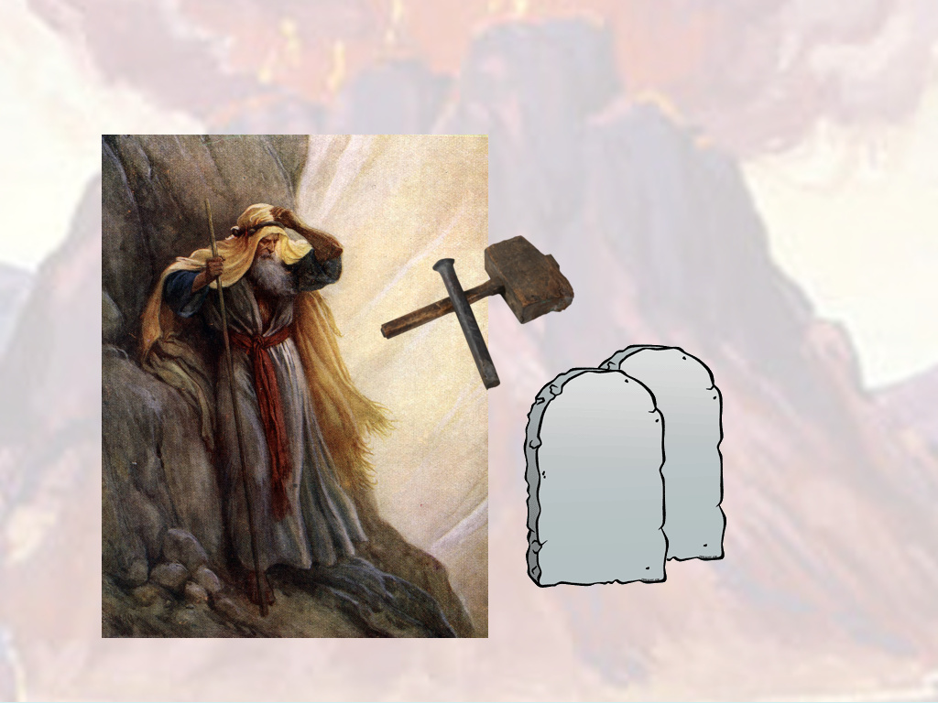
And the LORD said unto Moses, Hew thee two tables of stone like unto the ﬁrst:

Slide 3
and I will write upon these tables the words that were in the ﬁrst tables,

Slide 4
which thou brakest.

Slide 5
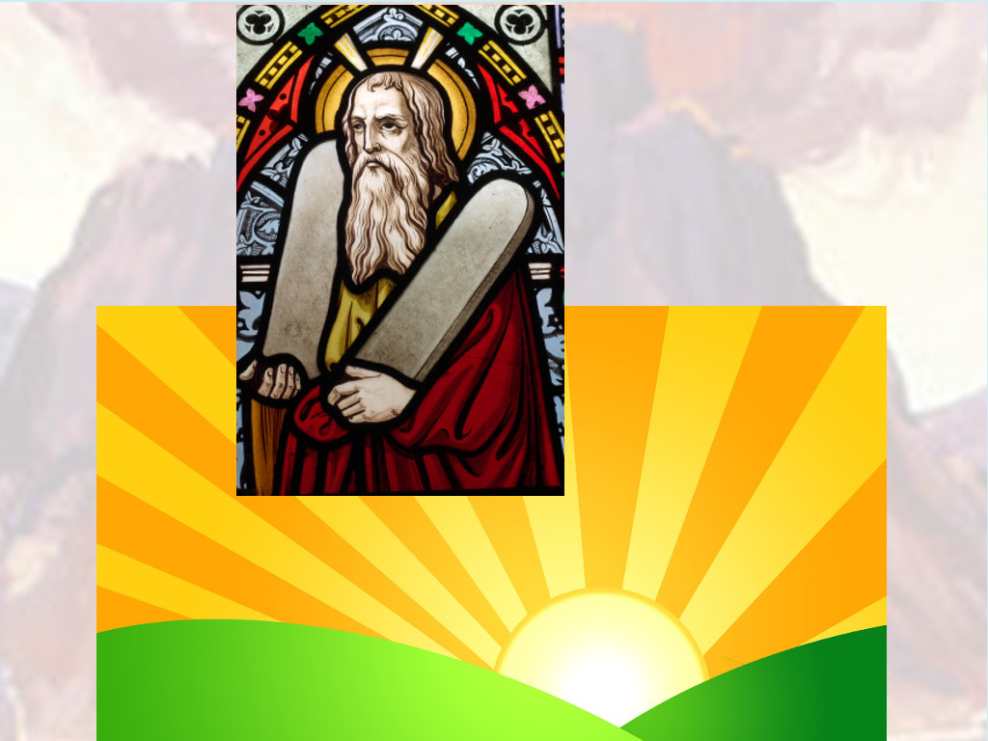
And be ready in the morning, and come up in the morning unto mount Sinai,

Slide 6
and present thyself there to me in the top of the mount.

Slide 7
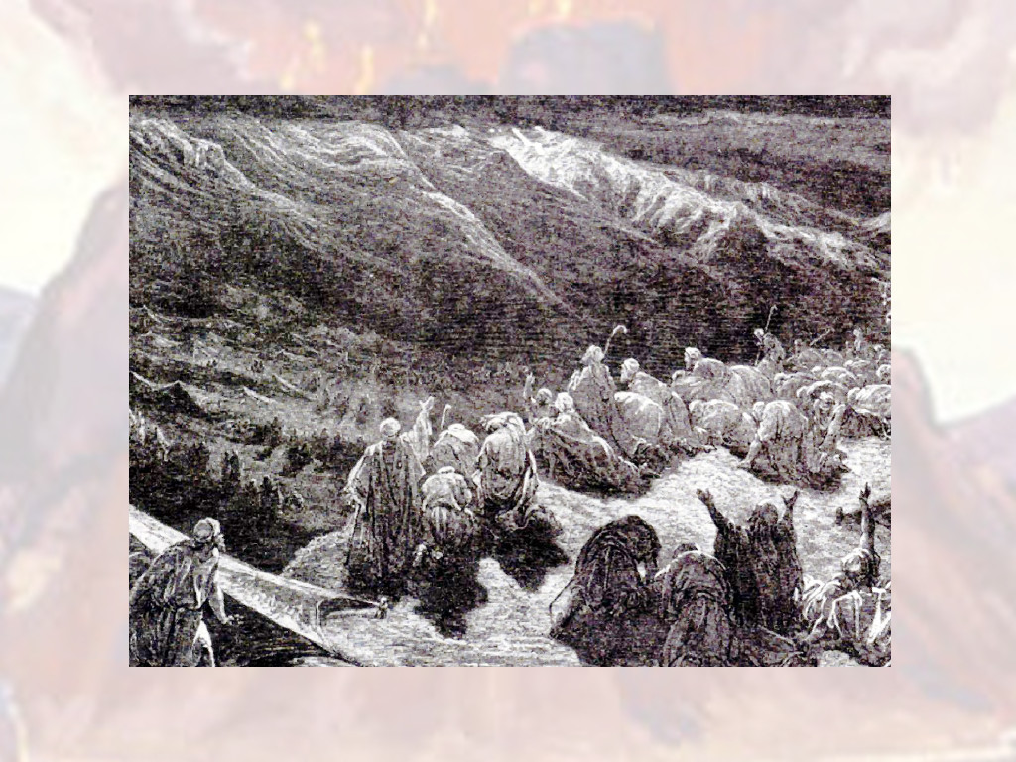
And no man shall come up with thee, neither let any man be seen throughout all the mount;

Slide 8
neither let the ﬂocks nor herds feed before that mount

Slide 9
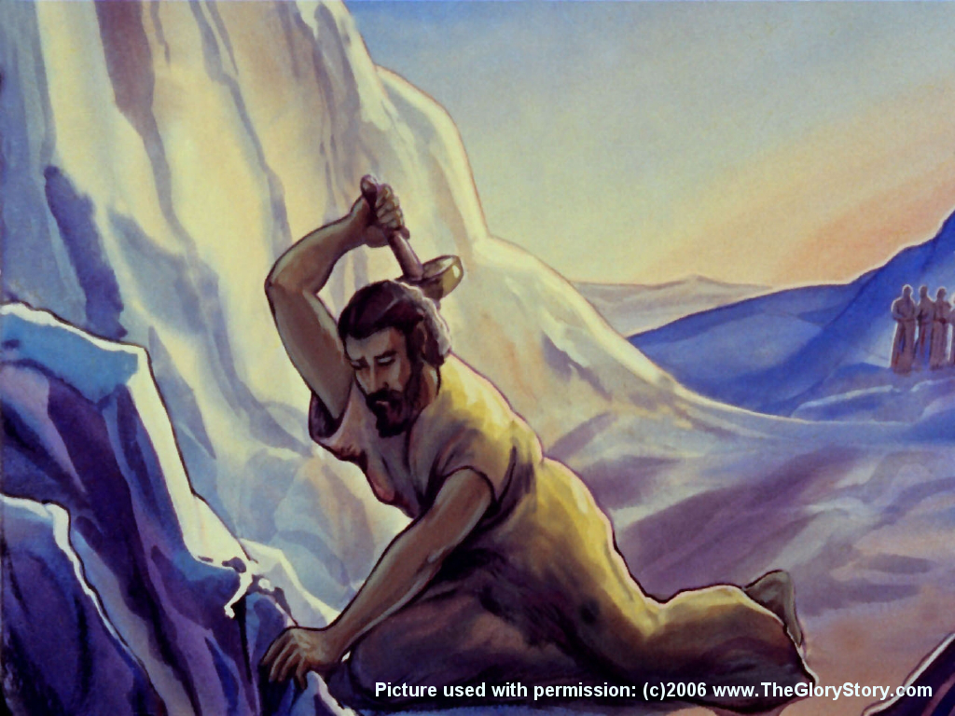
And he hewed two tables of stone like unto the ﬁrst; and Moses rose up early in the morning,

Slide 10
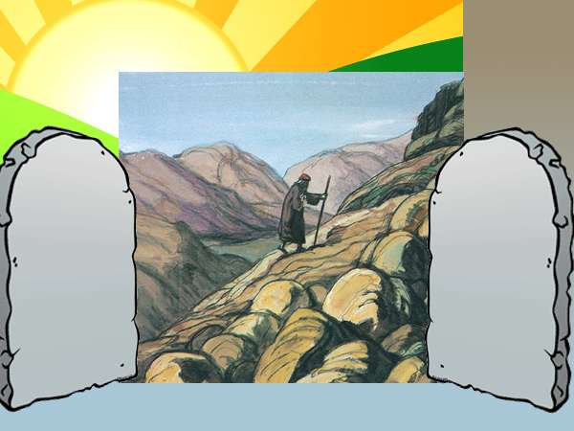
and went up unto mount Sinai, as the LORD had commanded him,

Slide 11
and took in his hand the two tables of stone.

Slide 12
Responsive Reading:
Exodus 34:5 – 34:12
Notes:
<number>
<number>
<number>

Slide 13
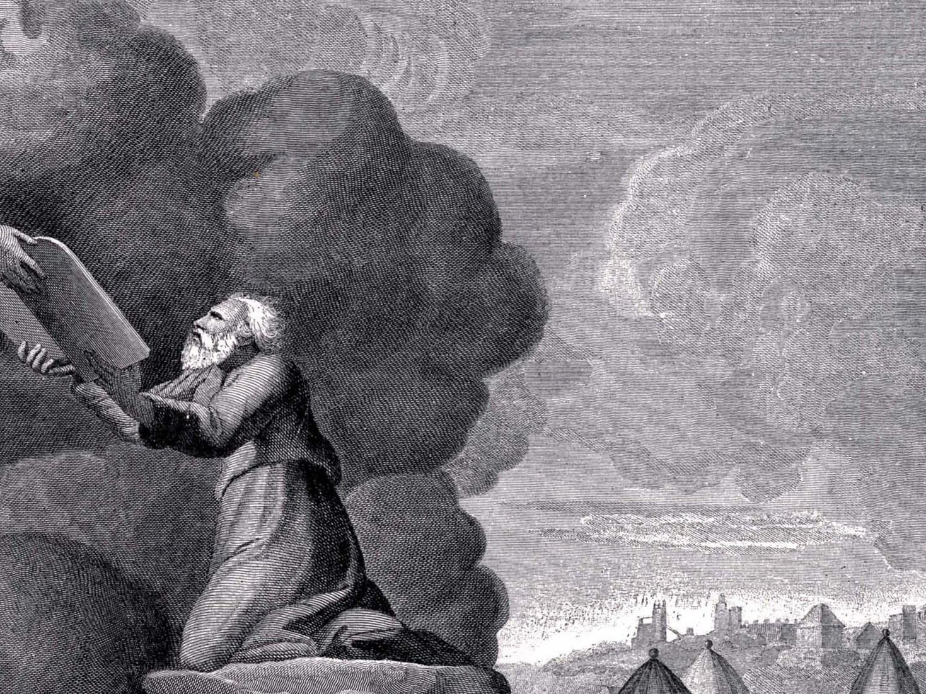
And the LORD descended in the cloud, and stood with him there,

Slide 14
and proclaimed the name of the LORD.

Slide 15
And the LORD passed by before him, and proclaimed, The LORD, The LORD God,

Slide 16
merciful and gracious, longsuﬀering, and abundant in goodness and truth,

Slide 17
Keeping mercy for thousands, forgiving iniquity and transgression and sin,

Slide 18
and that will by no means clear the guilty;

Slide 19
visiting the iniquity of the fathers upon the children, and upon the childrens children,

Slide 20
unto the third and to the fourth generation.

Slide 21
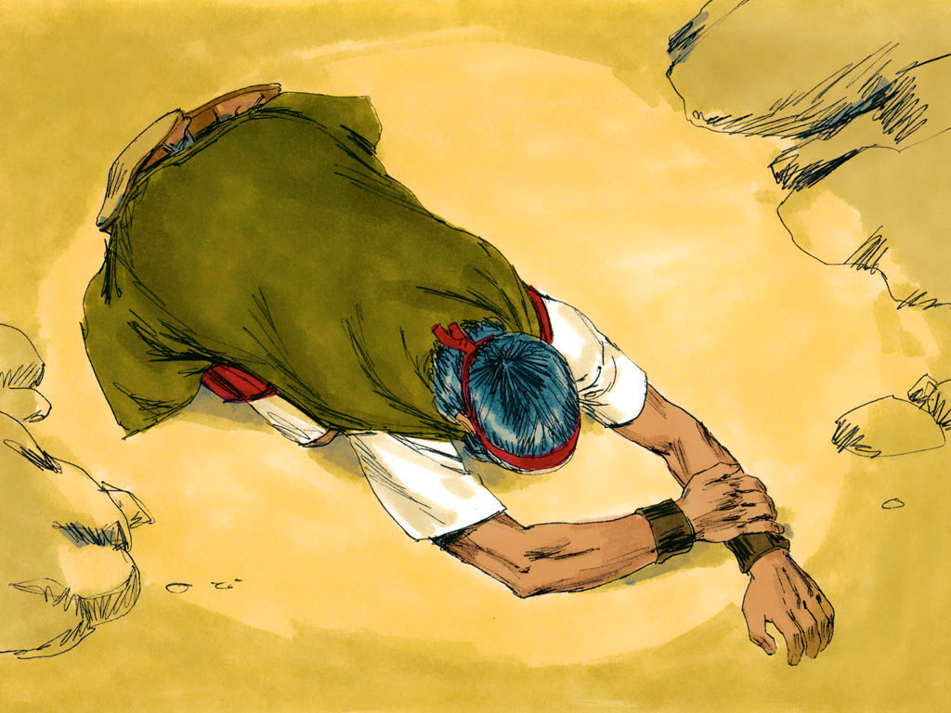
And Moses made haste, and bowed his head toward the earth, and worshipped.

Slide 22
And he said, If now I have found grace in thy sight, O Lord, let my Lord, I pray thee,

Slide 23
go among us; for it is a stiﬀnecked people; and pardon our iniquity and our sin,

Slide 24
and take us for thine inheritance.

Slide 25
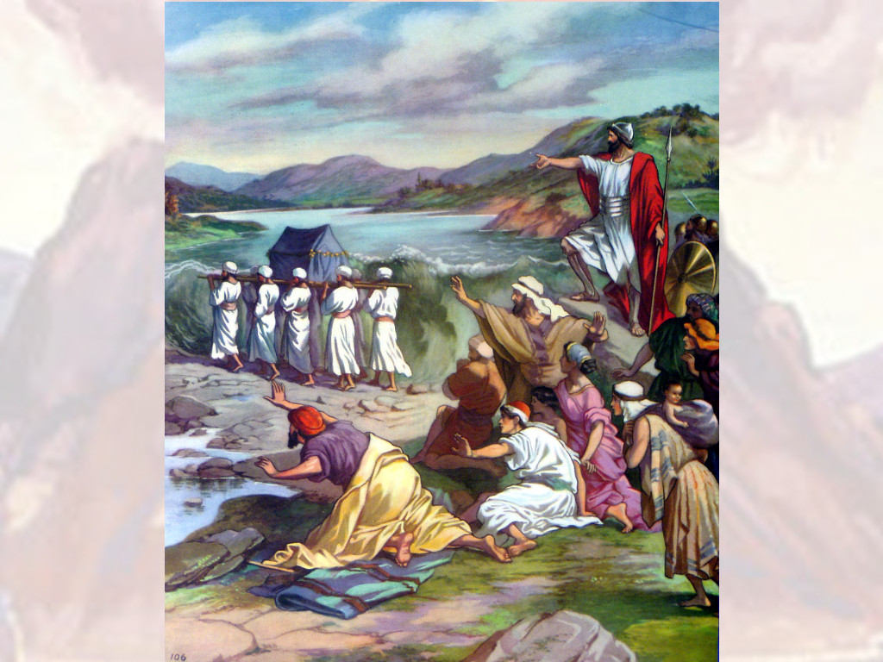
And he said, Behold, I make a covenant: before all thy people I will do marvels,

Slide 26
such as have not been done in all the earth, nor in any nation:

Slide 27
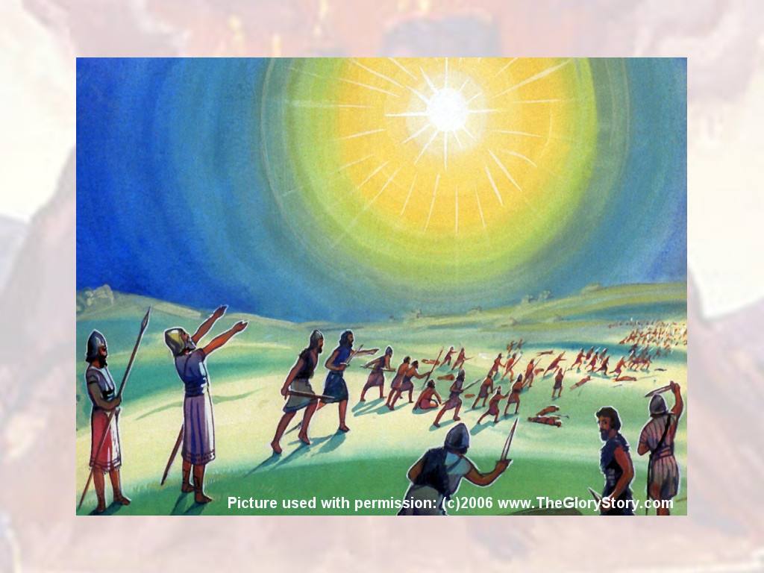
and all the people among which thou art shall see the work of the LORD:

Slide 28
for it is a terrible thing that I will do with thee.

Slide 29
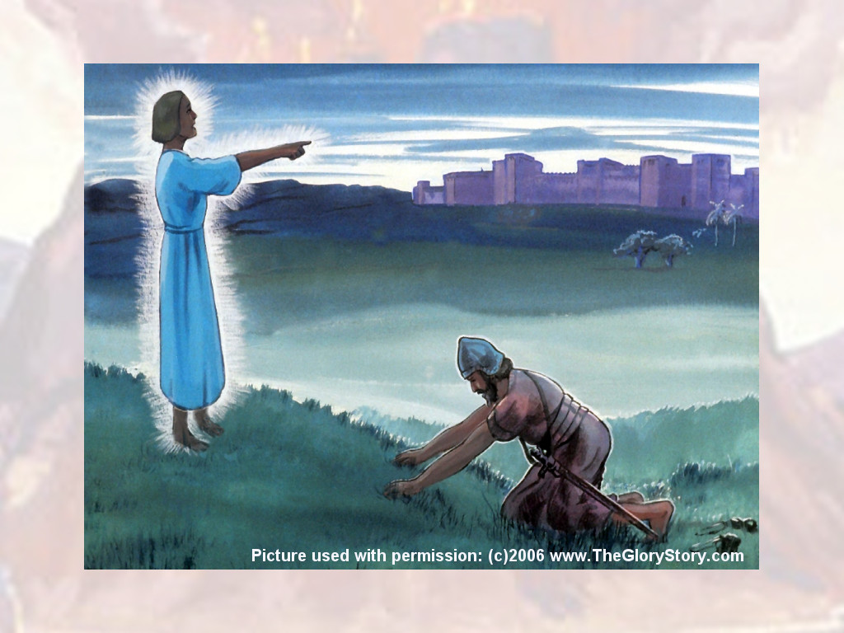
Observe thou that which I command thee this day: behold, I drive out before thee the Amorite,

Slide 30
and the Canaanite, and the Hittite, and the Perizzite, and the Hivite, and the Jebusite.

Slide 31
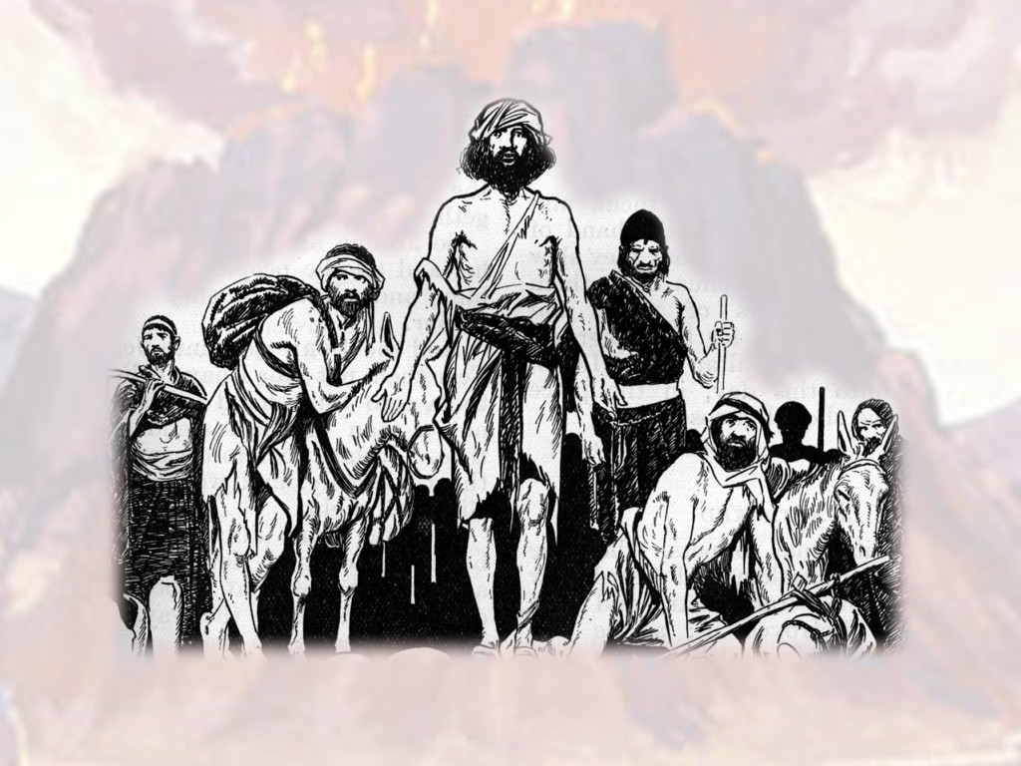
Take heed to thyself,

Slide 32
lest thou make a covenant with the inhabitants of the land whither thou goest,

Slide 33
lest it be for a snare in the midst of thee:

Slide 34
Responsive Reading:
Exodus 34:13 – 34:20
Notes:
<number>
<number>
<number>

Slide 35
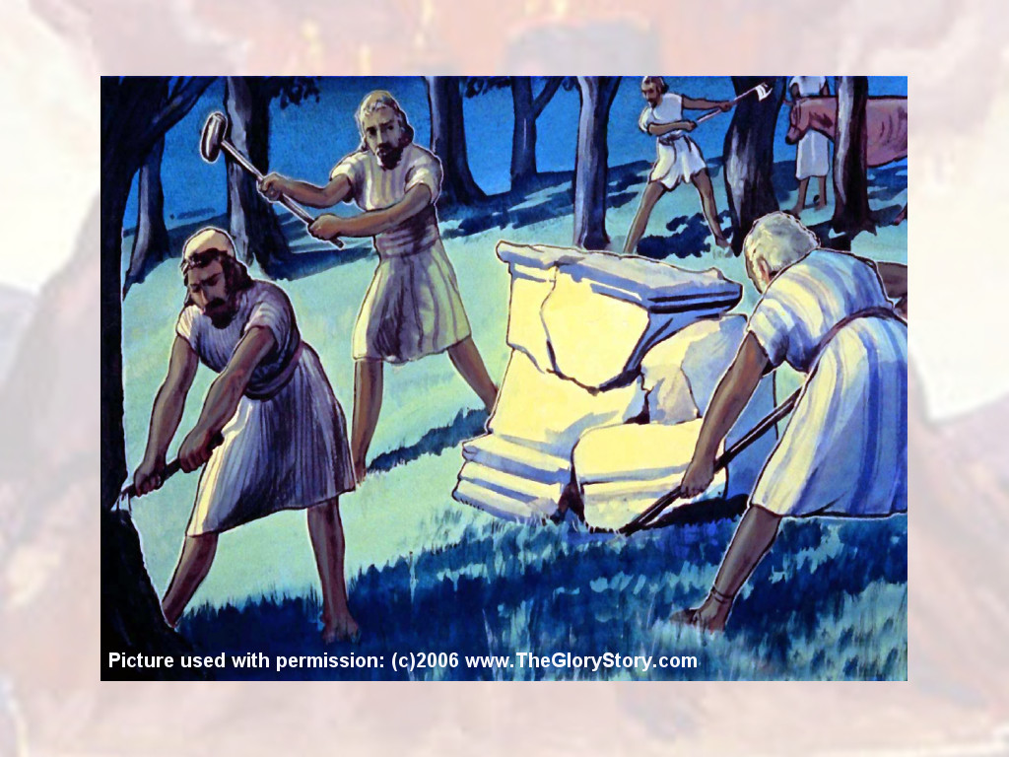
But ye shall destroy their altars, break their images, and cut down their groves:

Slide 36
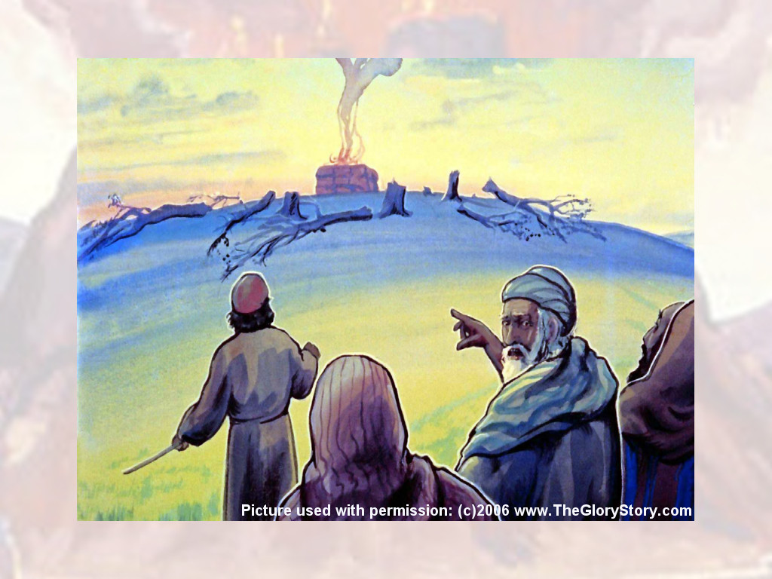
For thou shalt worship no other god: for the LORD, whose name is Jealous, is a jealous God:

Slide 37
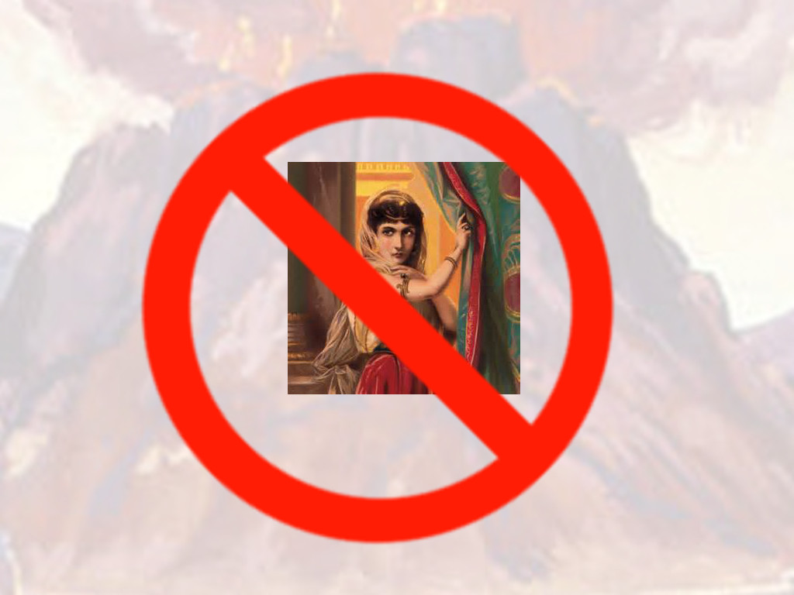
Lest thou make a covenant with the inhabitants of the land,

Slide 38
and they go a whoring after their gods, and do sacriﬁce unto their gods,

Slide 39
and one call thee, and thou eat of his sacriﬁce;

Slide 40
And thou take of their daughters unto thy sons,

Slide 41
and their daughters go a whoring after their gods, and make thy sons go a whoring after their gods

Slide 42
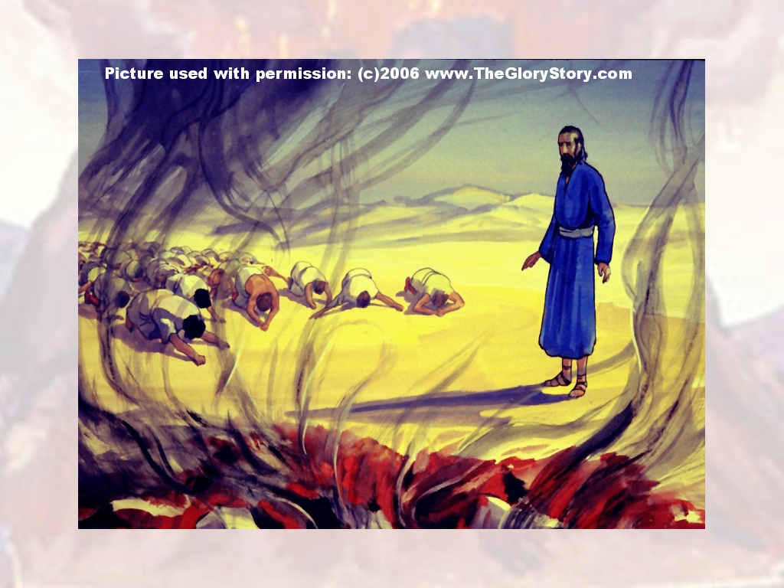
Thou shalt make thee no molten gods.

Slide 43
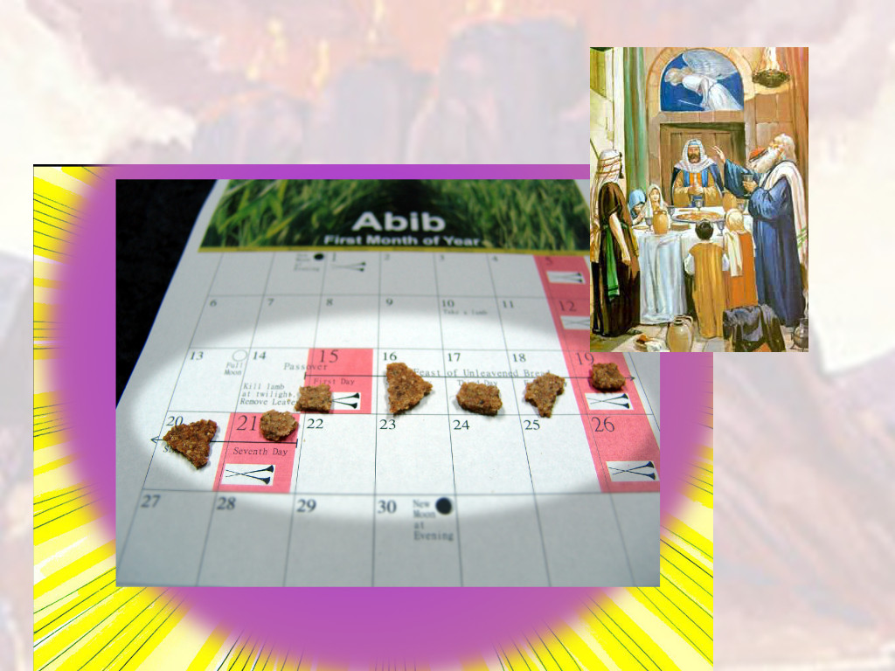
The feast of unleavened bread shalt thou keep.

Slide 44
Seven days thou shalt eat unleavened bread, as I commanded thee,

Slide 45
in the time of the month Abib: for in the month Abib thou camest out from Egypt.

Slide 46
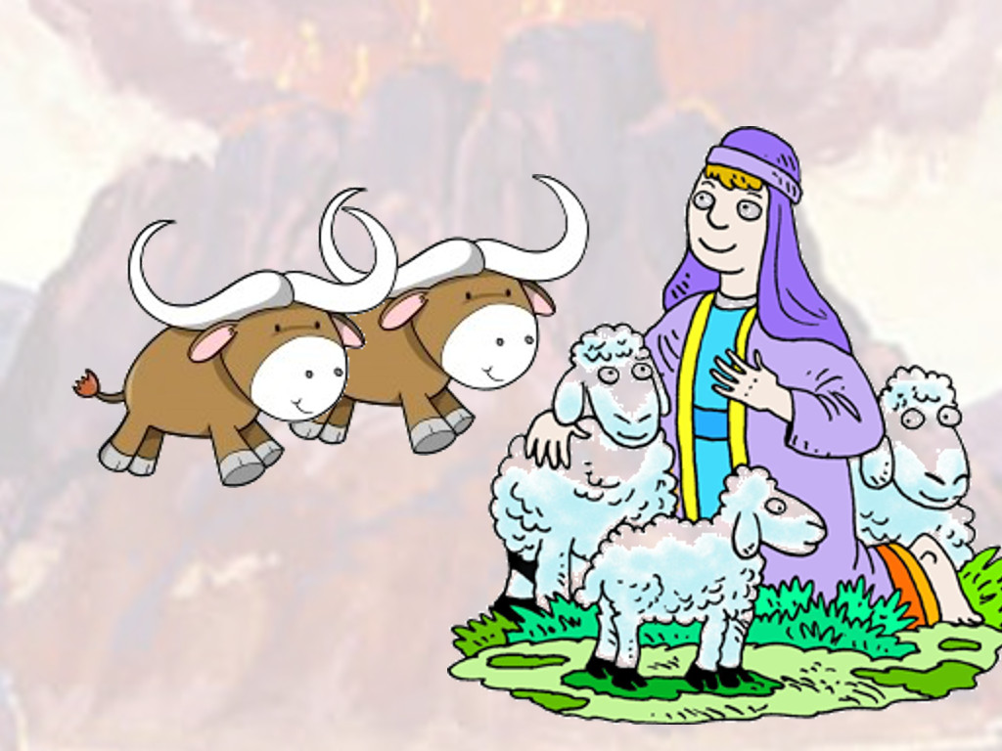
All that openeth the matrix is mine; and every ﬁrstling among thy cattle,

Slide 47
whether ox or sheep, that is male.

Slide 48
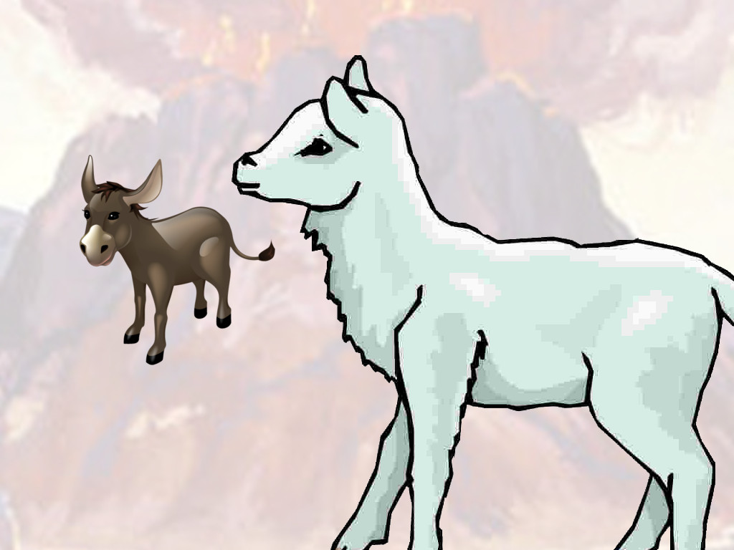
But the ﬁrstling of an ass thou shalt redeem with a lamb:

Slide 49
and if thou redeem him not, then shalt thou break his neck.

Slide 50
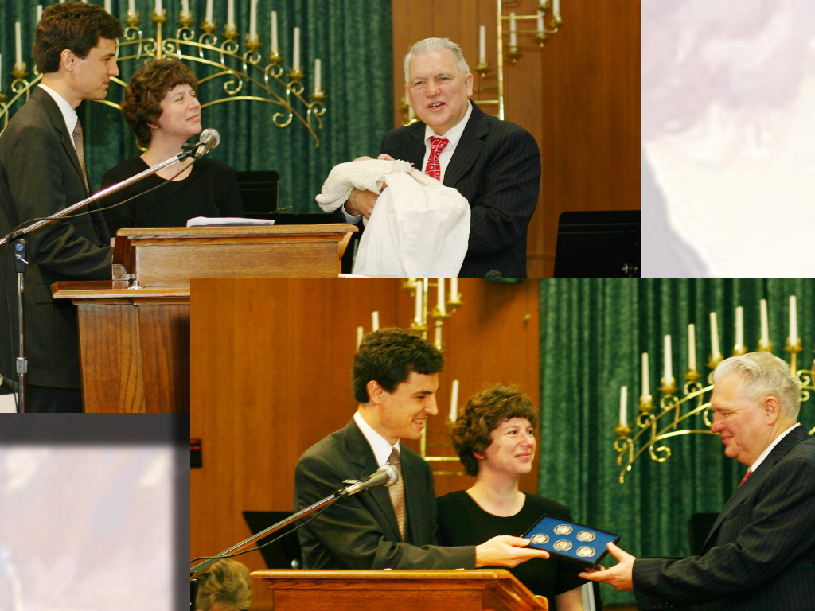
All the ﬁrstborn of thy sons thou shalt redeem. And none shall appear before me empty.

Slide 51
Responsive Reading:
Exodus 34:21 – 34:28
Notes:
<number>
<number>
<number>

Slide 52
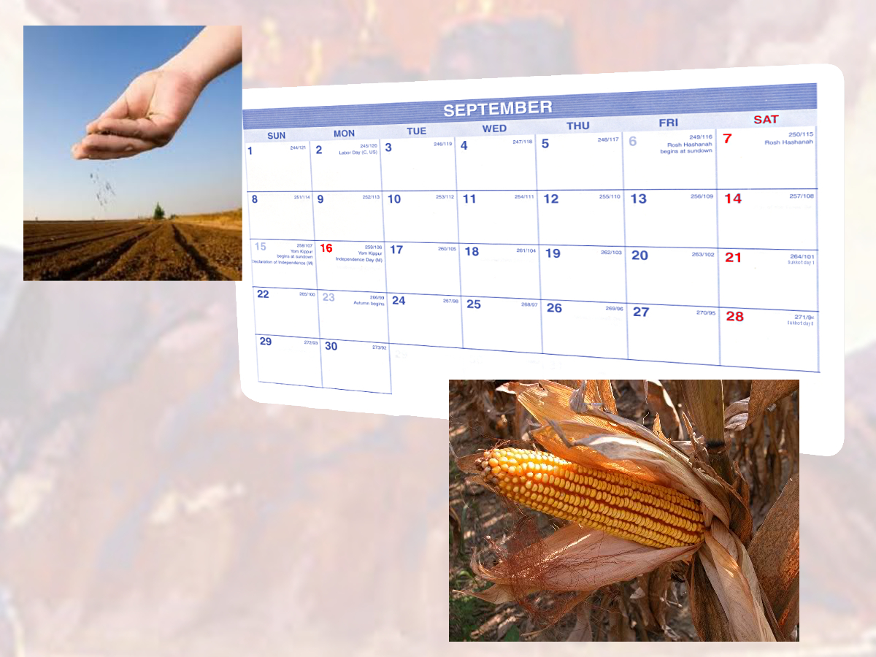
Six days thou shalt work, but on the seventh day thou shalt rest:

Slide 53
in earing time and in harvest thou shalt rest.

Slide 54
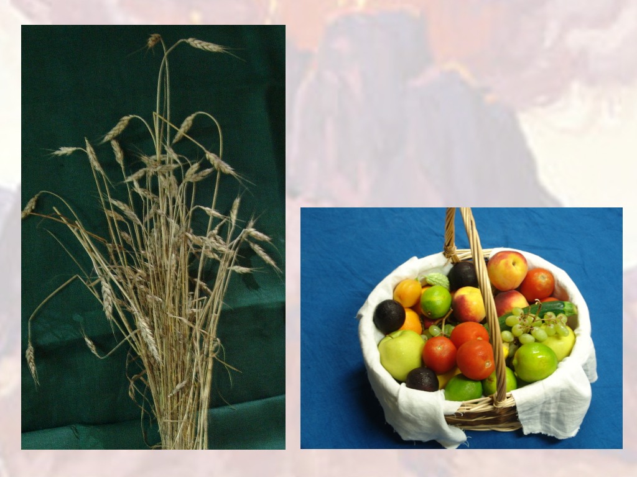
And thou shalt observe the feast of weeks, of the ﬁrstfruits of wheat harvest,

Slide 55
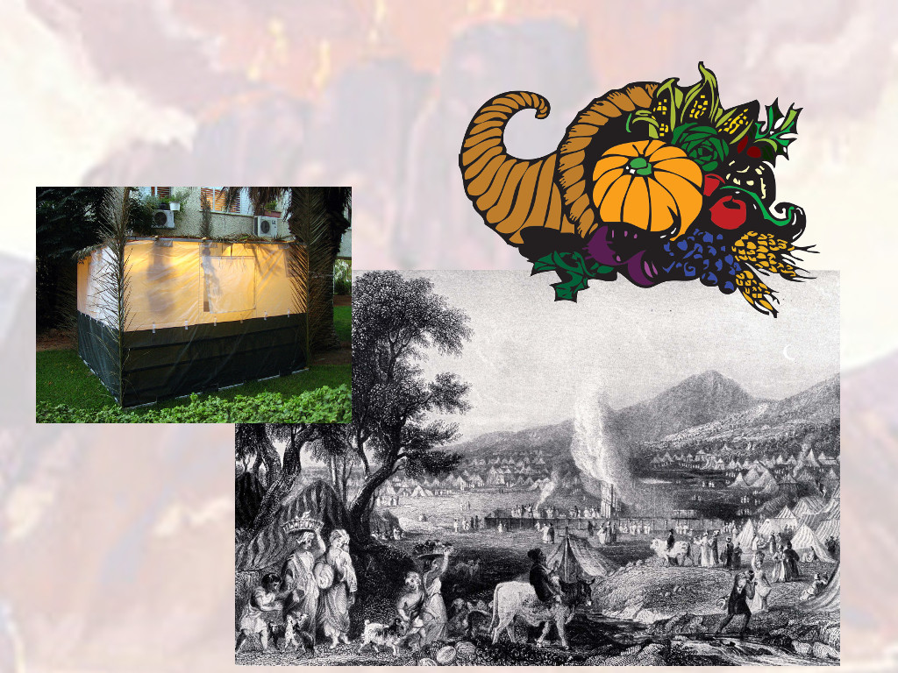
and the feast of ingathering at the years end.

Slide 56

Thrice in the year shall all your men children appear before the Lord GOD,

Slide 57
the God of Israel.

Slide 58
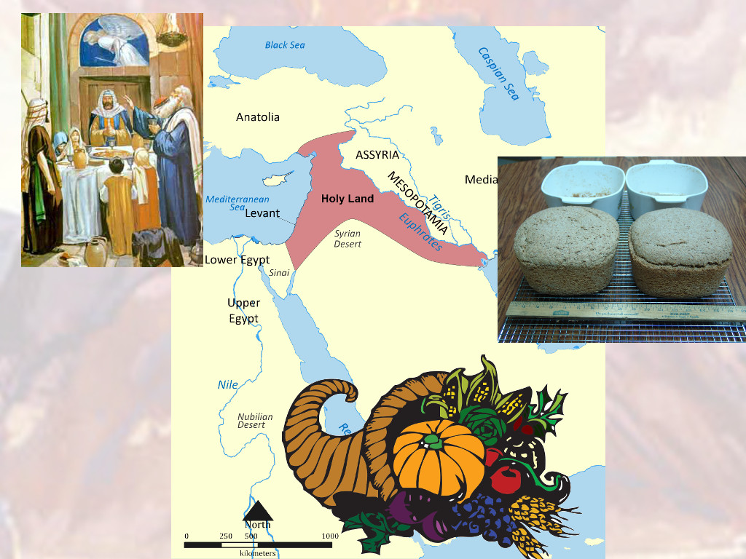
For I will cast out the nations before thee, and enlarge thy borders:

Slide 59
neither shall any man desire thy land,

Slide 60
when thou shalt go up to appear before the LORD thy God thrice in the year.

Slide 61
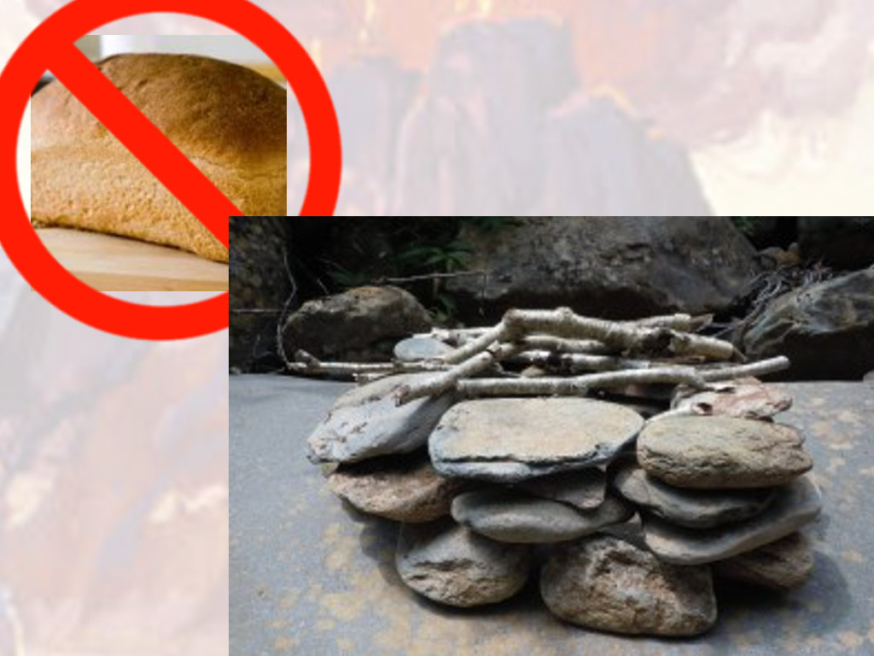
Thou shalt not oﬀer the blood of my sacriﬁce with leaven;

Slide 62
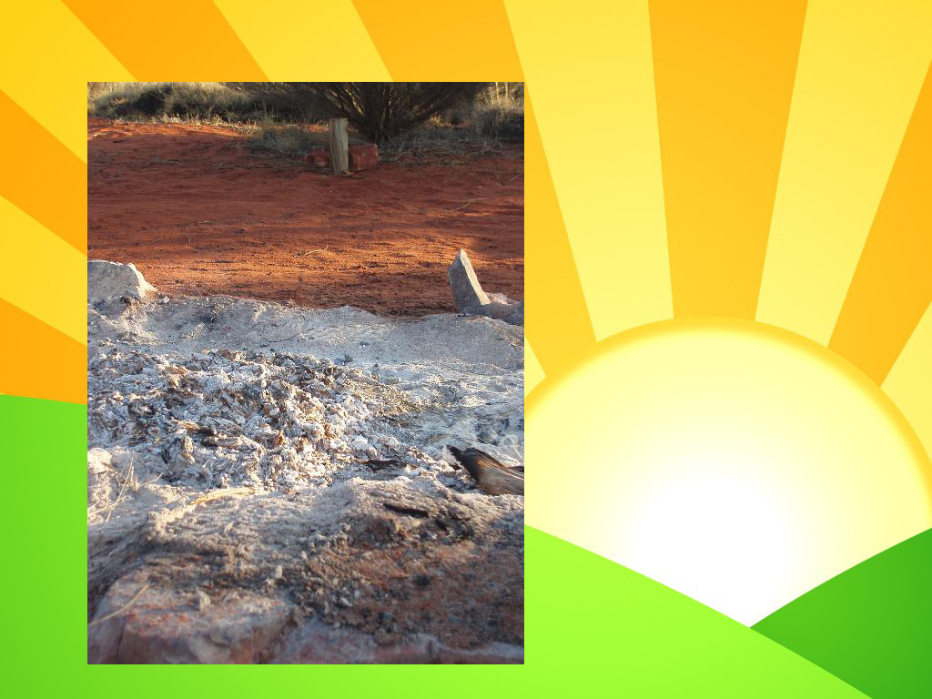
neither shall the sacriﬁce of the feast of the passover be left unto the morning.

Slide 63
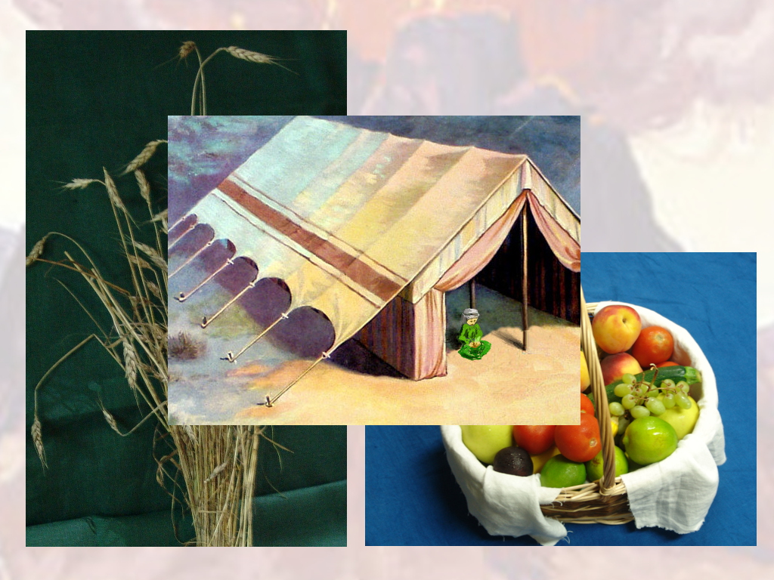
The ﬁrst of the ﬁrstfruits of thy land thou shalt bring unto the house of the LORD thy God.

Slide 64
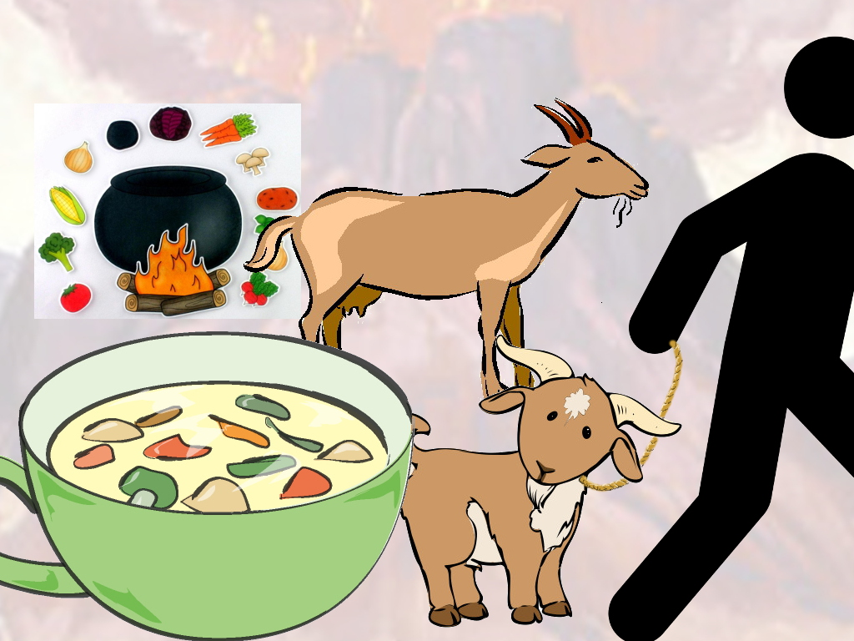
Thou shalt not seethe a kid in his mothers milk.

Slide 65

And the LORD said unto Moses, Write thou these words:

Slide 66
for after the tenor of these words I have made a covenant with thee and with Israel.

Slide 67
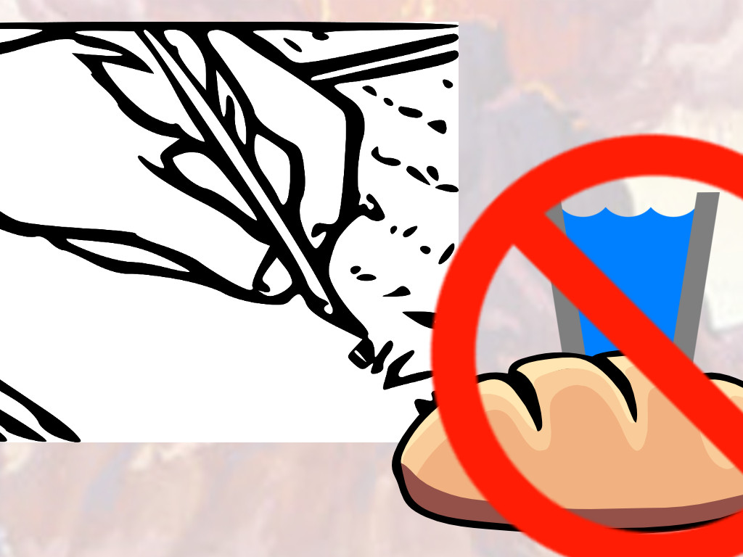
And he was there with the LORD forty days and forty nights;

Slide 68
he did neither eat bread, nor drink water.

Slide 69
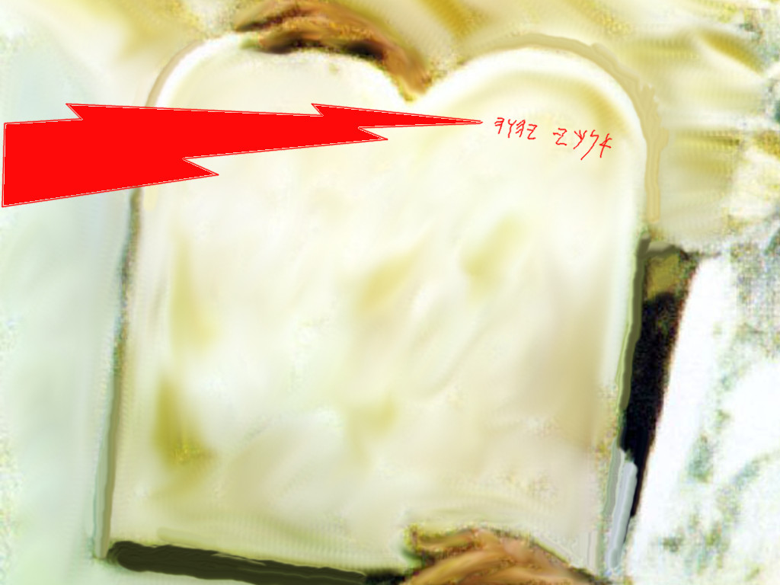
And he wrote upon the tables the words of the covenant, the ten commandments.

Slide 70
Responsive Reading:
Exodus 34:29 – 34:35
Notes:
<number>
<number>
<number>

Slide 71
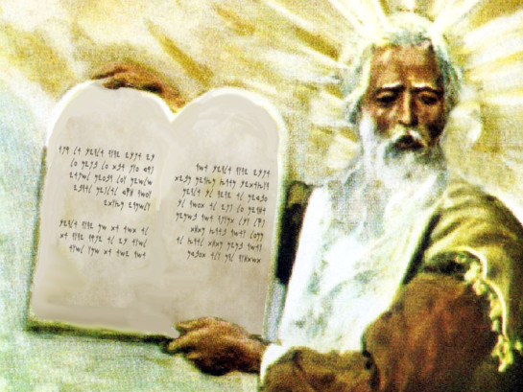
And it came to pass, when Moses came down from mount Sinai

Slide 72
with the two tables of testimony in Moses hand, when he came down from the mount,

Slide 73
that Moses wist not that the skin of his face shone while he talked with him.

Slide 74
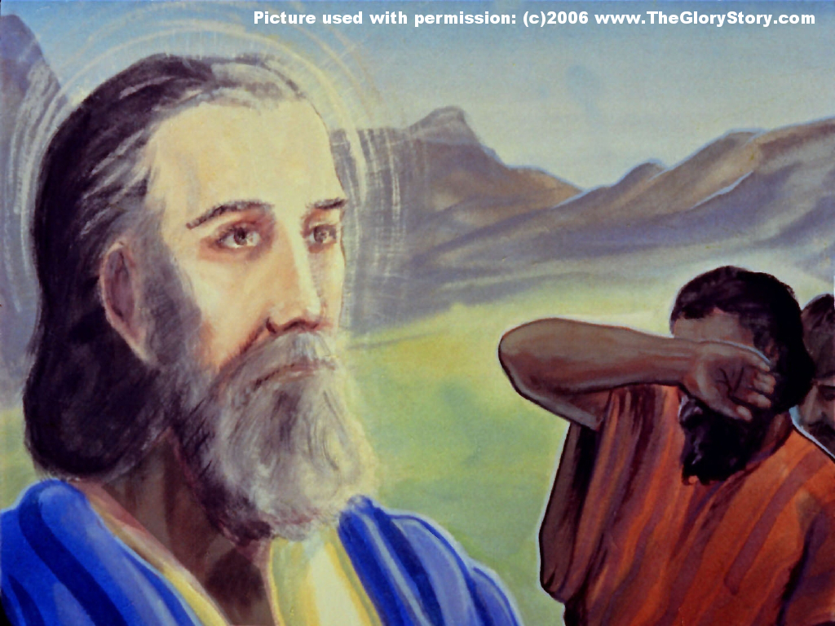
And when Aaron and all the children of Israel saw Moses, behold, the skin of his face shone;

Slide 75
and they were afraid to come nigh him.

Slide 76
And Moses called unto them;

Slide 77
and Aaron and all the rulers of the congregation returned unto him:

Slide 78
and Moses talked with them.

Slide 79
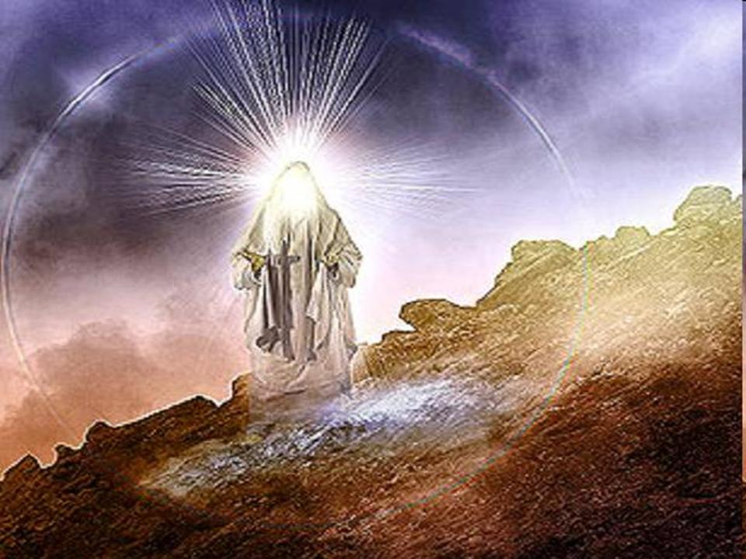
And afterward all the children of Israel came nigh:

Slide 80
and he gave them in commandment all that the LORD had spoken

Slide 81
with him in mount Sinai.

Slide 82
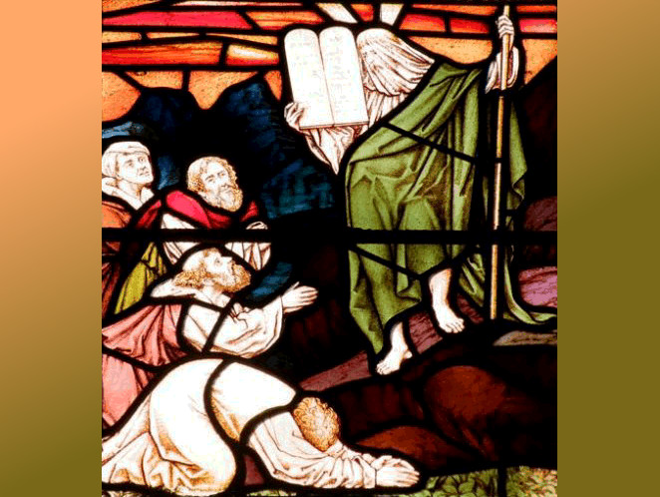
And till Moses had done speaking with them, he put a vail on his face.

Slide 83
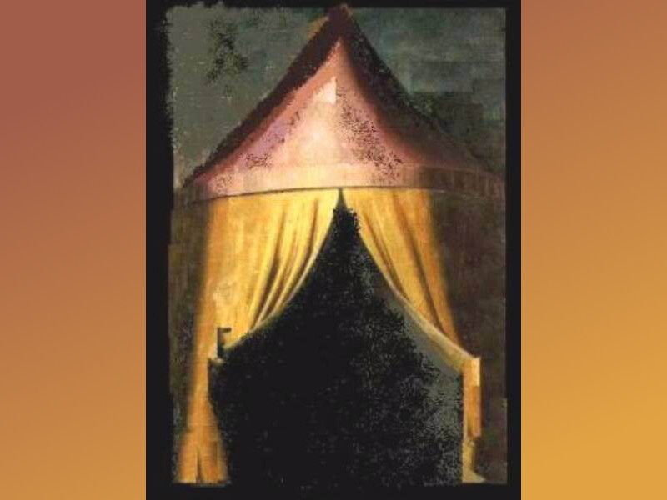
But when Moses went in before the LORD to speak with him, he took the vail oﬀ,

Slide 84
until he came out.

Slide 85
And he came out, and spake unto the children of Israel that which he was commanded.

Slide 86
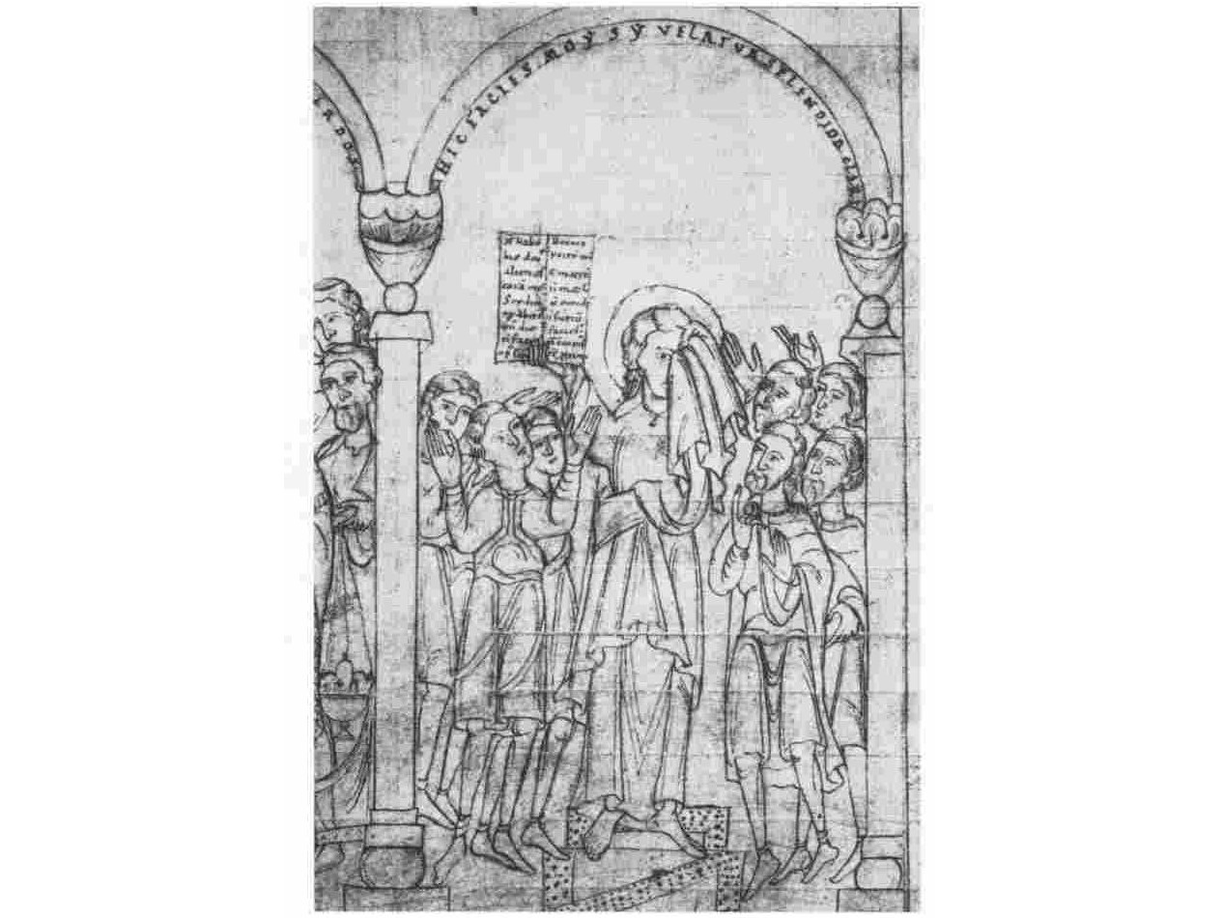
And the children of Israel saw the face of Moses, that the skin of Moses face shone:

Slide 87
and Moses put the vail upon his face again, until he went in to speak with him.

